Slide 1

Faith-Based Weight Loss Program
Leonna S. Ameduite
Doctoral Candidate
Liberty University

Slide 2
Agenda
Sign in
Registration and Consent Form completion
Blood Pressure
Weigh-in
Pre-survey
Prayer
Overview of Program
Definition of Health
Obesity
High Blood Pressure
Calories

Slide 3
Faith-Based Weight Loss Program Weekly Agenda
Week 1 | Registration and Consent forms Weigh in and blood pressure Pre-Survey What it means to be overweight/obese? What is hypertension? Calorie counting and how to do it CHALLENGE: Calorie count for one week utilizing one of the calorie counting tools | Week 5 | Weigh in Group Discussion: Sodium Changing the way we eat Meal Planning Making time to change Healthy recipes CHALLENGE: Cont. calorie counting. Attempt at least one new healthy recipe and consume 2-3 servings of fruits and vegetables a day
Week 2 | Weigh in Group Discussion: Calorie counting Portion control Healthy calories vs empty calories The role of physical activity CHALLENGE: Cont. calorie counting. Monitor portion control and quality of calories | Week 6 | Weight in Group Discussion: Healthy recipe Foods that improve blood pressure (Potassium) Omega threes CHALLENGE: Cont. to calorie count. Consume at least one serving foods high in potassium once a day
Week 3 | Weigh in and blood pressure Group Discussion: Emotional Eating Sodium and Sugar DASH Diet CHALLENGE: Cont. to calorie count. Monitor amount of sodium | Week 7 | Weigh in Group Discussion of current difficulties The Holy Spirit CHALLENGE: Cont. to calorie count and reflect on scriptures.
Week 4 | Weigh in Group Discussion: Portion control Emotional Eating The role of physical activity continued CHALLENGE: Cont. calorie counting. Track emotions prior to eating | Week 8 | Group Discussion: God as our source Physical Activity Final weigh in and blood pressure Post survey

Slide 4
WEEK ONE
Understanding Obesity, Obesity Related Illnesses, and calorie counting basics

Slide 5
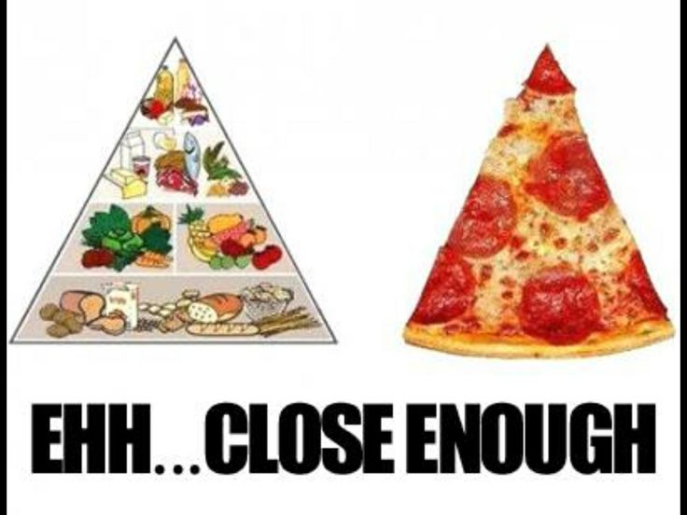
Thoughts about Health and Nutrition
Most Americans believe that health, nutrition, and exercise is important.
43% of Americans believe that they already eating well
Information OVERLOAD!!!!!!
  Television
  Magazines
  Internet
  (Anding, 2009)
Notes:
Since 1970s Americans have increased their calorie intake by 523 calories per day.
Calories from added sugar and fat
Fast food
Increased Portion sizes

Slide 6
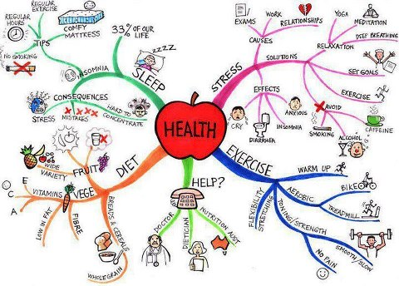
Definition of Health
World Health Organization (WHO) defines health as “a state of physical, mental, and social well-being and not merely the absence of disease or infirmity” (1948).
Notes:
https://yourhealthblog.net/short-description-about-health-definition/

Slide 7
Obesity
A combination of what we eat and the decreased physical activity

Slide 8

Our Lifestyle Choices
Why we eat what we eat….
  Taste
  Convenience
  Emotions
  Religion/Culture
  Health Beliefs
  Socioeconomics/Finances
1 Corinthians 10:24
  (Anding, 2009)
Notes:
What we eat
How much physical activity we do

Slide 9
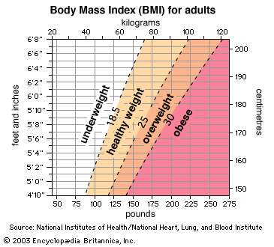
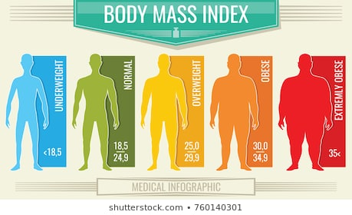
Body Mass Index (BMI)

Slide 10
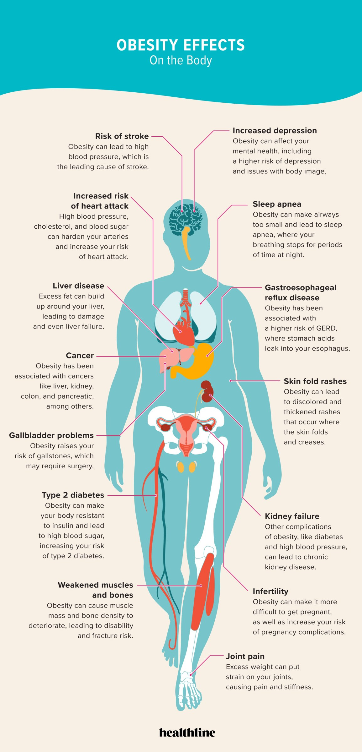

Slide 11
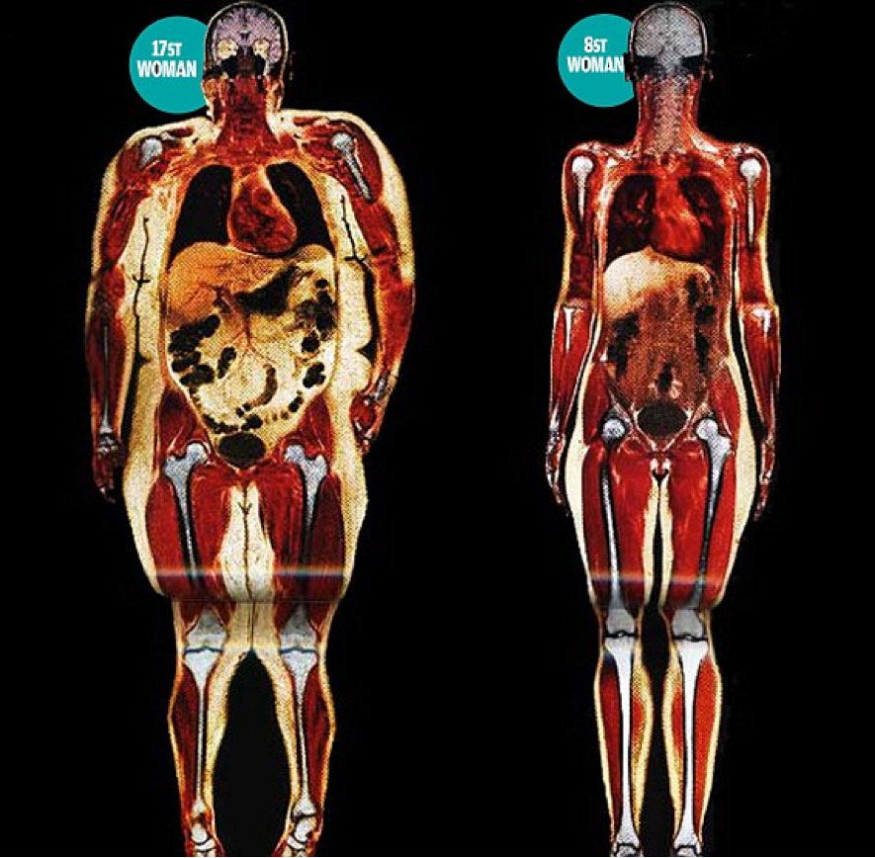
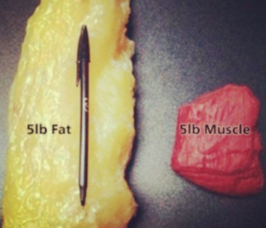
224.2 lbs
118 lbs
Lambert, 2014
Notes:
MRI scan of two women.
Around the neck fat can compress the nerves and contribute to headaches and neck pain. Fat deposits around the neck can cause snoring and sleep apnea.
Enlarged heart
Lungs: The fat around the visceral organs compresses the lungs making it difficult to breath which leads to decreased oxygen circulating in the body → lack of energy, impaired immune system and even high blood pressure.
Muscleskeletal: excess weight on hips, knees, back, and ankles.
Increased risk of varicose veins
Visceral fat: very dangerous… but can leak chemicals and is linked to heart disease, diabetes and some forms cancer. Can produce cytokines which causes an internal inflammatory response within the body.
Arteries: fat clogs the arteries
Sore feet: plantar fascia
Knees: increased weight wears out the built-in absorbency of the knee (look at the space between the knees)

Slide 12
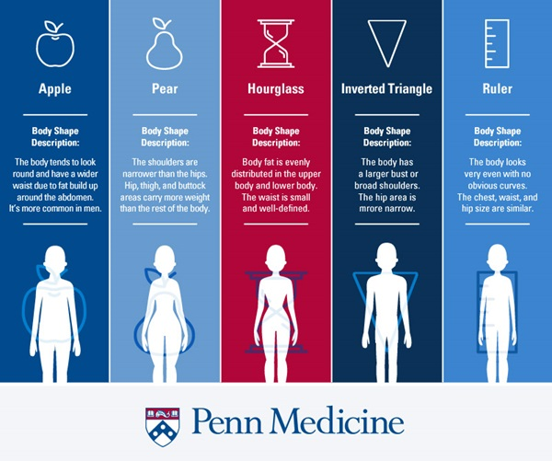

Slide 13
Hypertension
(High Blood Pressure)

Slide 14
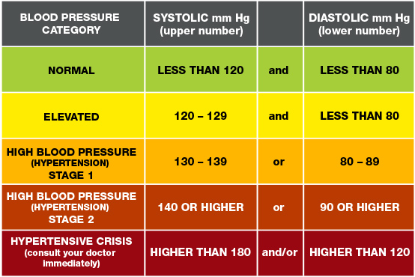
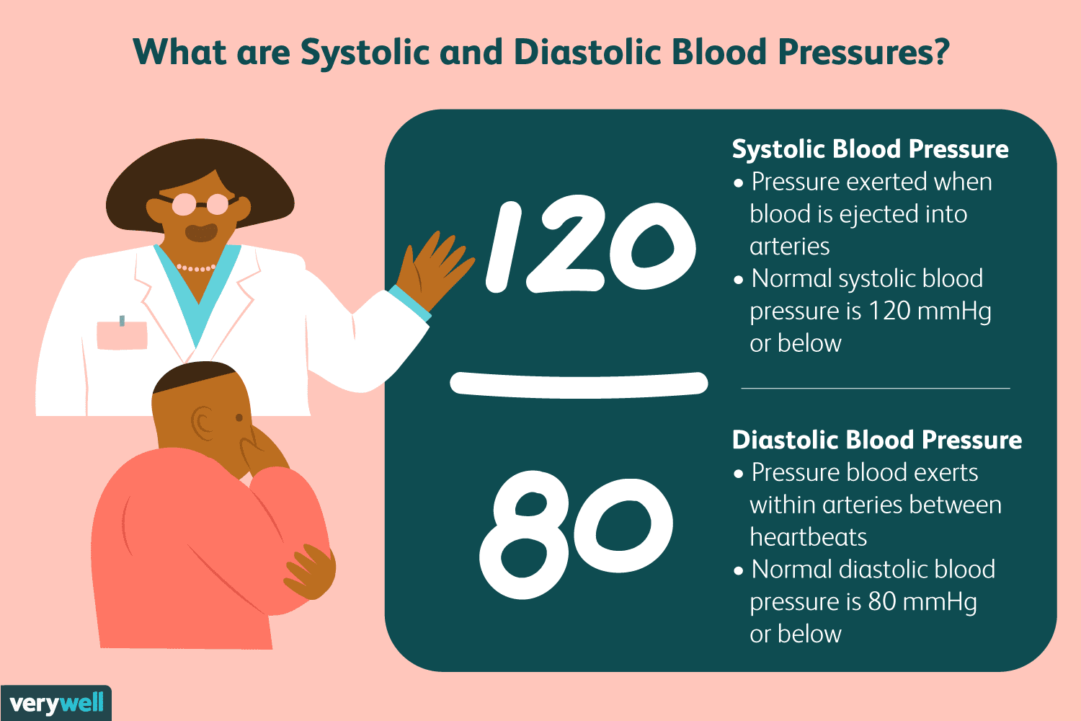
High Blood Pressure (Hypertension)
Notes:
140/90 regardless of medical guideline used, age, or medical condition is the standard.
NEED SQUEEZE TOY!!!!

Slide 15
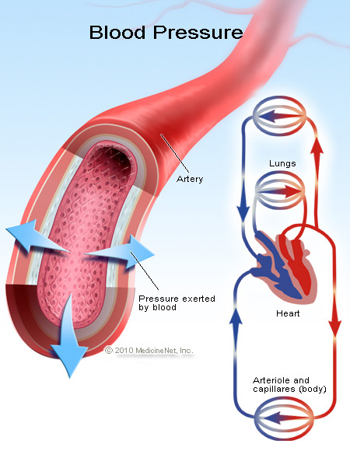
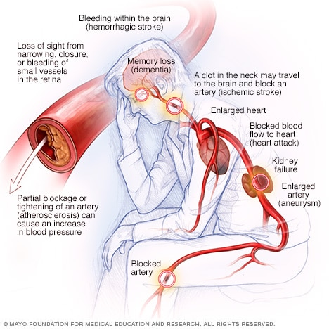
Effects of High Blood Pressure
Notes:
High blood pressure is an adaptation of our health habits.

Slide 16
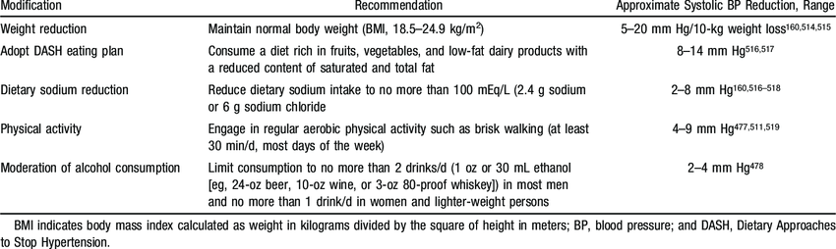
Controlling High Blood Pressure

Slide 17
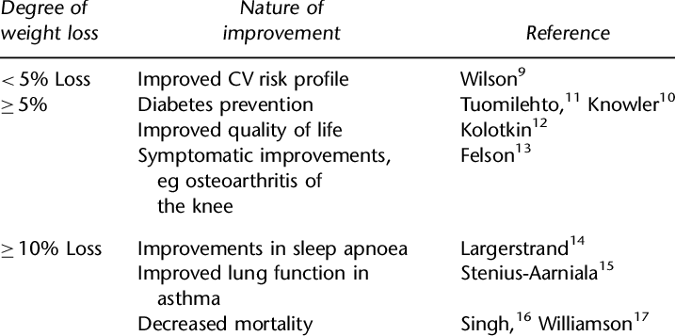
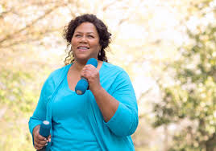
Benefits of Weight Loss

Slide 18
Calorie Counting
The Basics

Slide 19
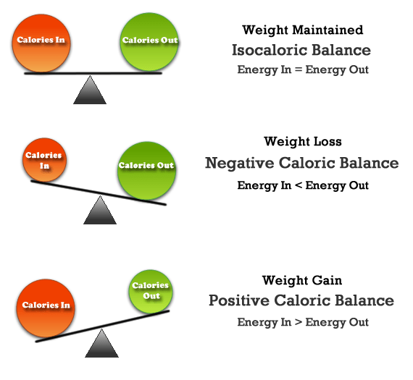
Calories
Calories = a unit of energy
Our bodies are machines and require energy to function (sleep, move, breath, heart function, etc.)
Notes:
Basal Metabolic Rate (BMR) is the amount energy your body uses for basic functions (digestive system, heart rate, breathing, etc).

Slide 20
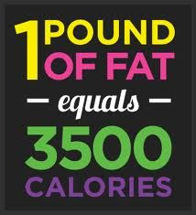
How do we gain weight?
If we eat just 100 calories over our daily caloric need, we will gain over 1 pound per year.
  100 calories x 365 days = 3650 calories
If we eat 500 calories over our daily need, we will gain 1 pound in a week
  500 x 7 days = 3500 calories
Notes:
If we eat 1000 calories over our daily need we will gain 1 pound in 3-4 days
1000 calories x 4 days = 4000 calories

Slide 21
Male 200lbs = 2000 calories a day
2 eggs scrambled = 202
4 slices of bacon = 316
2 turkey sausage = 152
Grits = 140
Orange Juice = 113
TOTAL = 923
1 bar= 100
TOTAL = 100
1 Big Mac= 540
1 Large Fry= 470
1 Large Coke = 320
TOTAL = 1,330
2 Steak = 395
Mashed potatoes and Gravy = 133
Green beans = 40
Sweet Tea = 100
TOTAL = 668
1 Yogurt = 100
TOTAL = 100
Total = 3,121 → OVER BY 1,121
Notes:
If I continue to eat like this I will gain 1 pound of weight in about 3-4 days.

Slide 22
Male 200lbs = 2000 calories a day
2 servings = 200
2 cups of milk 2% = 240
Orange Juice = 113
TOTAL = 553
1 bar= 100
TOTAL = 100
1 McChicken = 410
1 Med Fry= 360
1 Med Coke = 220
TOTAL = 900
Grilled Chicken = 291
Romaine Lettuce = 20
Corn = 72
Tomatoes = 27
Avocados = 80
Ranch Dressing (4 Tbs) = 280
Sweet Tea = 100
TOTAL = 870
1 Orange = 68
TOTAL = 68
Total = 2,581 → OVER BY 581
Notes:
If I eat like this everyday, I will gain around 1 pound a week.

Slide 23
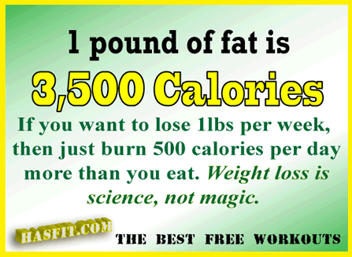
How do we loose weight?

Slide 24
How do we loose weight?
1 pound of body weight = 3500 calories of stored energy
To lose 1 pound a week we would need to decrease our daily intake by 500 calories.
500 calories x 7 days = 3500 calories
TRUE WEIGHT LOSS IS NOT A FAST PROCESS!!!!!!!
Notes:
When loosing weight it is important that we do not go under our BMR or our body will think it is starving and it will be impossible to continue to loose weight.

Slide 25
1 lbs per week
Male 200lbs = 1500-1600 calories a day
2 eggs scrambled = 202
4 slices of bacon = 316
2 turkey sausage = 152
Grits = 140
Orange Juice = 113
Water = 0
TOTAL = 494
1 bar= 100
TOTAL = 100
1 Big Mac= 540
1 Large Fry= 470
1 Large Coke = 320
Med. Half and Half Sweet Tea = 50
TOTAL =640
2 Steaks = 395
1 Steak = 198
Mashed potatoes and Gravy = 133
Green beans = 40
Sweet Tea = 100
Water = 0
TOTAL = 371
1 Yogurt = 100
TOTAL = 0
Total = 1,555

Slide 26
1 lbs per week
Male 200lbs = 1500-1600 calories a day
2 servings = 200
1 serving = 100
2 cups of milk 2% = 240
1 serving = 120
Orange Juice = 113
TOTAL = 333
1 bar= 100
TOTAL = 100
1 McChicken= 410
1 Large Fry= 360
1 Large Coke = 220
Water = 0
TOTAL = 410
1 Grilled Chicken = 291
½ Grilled Chicken = 146
Romaine Lettuce = 20
Corn = 72
Tomatoes = 27
Avocados = 80
Ranch Dressing (4 Tbsp) = 280
Ranch Dressing (3 Tbsp) = 210
Sweet Tea = 100
Med Half and Half Sweet Tea = 50
TOTAL = 535
1 Orange = 68
TOTAL = 68
Total = 1,516

Slide 27
Consistency is KEY!!!!!!!!!!!
Day | Calories | Deficit/Surplus
1 | 1700 | +100
2 | 2200 | +600
3 | 1605 | +5
4 | 1555 | -50
5 | 1575 | -175
6 | 1600 | 0
7 | 2575 | +975
8 | 3100 | +1500
9 | 2725 | +1,125
10 | 1800 | +200
11 | 2200 | +600
12 | 1300 | -600
13 | 1400 | -200
14 | 2200 | +600
15 | 2100 | +500
Day | Calories | Deficit/Surplus
16 | 1500 | -100
17 | 1600 | 0
18 | 1750 | +150
19 | 1825 | +225
20 | 3100 | +1500
21 | 2100 | +500
22 | 1555 | -45
23 | 1600 | 0
24 | 2100 | +500
25 | 2300 | +700
26 | 1700 | +100
27 | 1600 | 0
28 | 1550 | -50
29 | 2100 | +500
30 | 2500 | +900
+10,060
+~3lbs over 30 days

Slide 28
Consistency is KEY!!!!!!!!!!!
Day | Calories | Deficit/Surplus
1 | 1600 | 0
2 | 1700 | +100
3 | 1605 | +5
4 | 1555 | -50
5 | 1575 | -175
6 | 1600 | 0
7 | 2000 | +400
8 | 2000 | +400
9 | 1600 | 0
10 | 1600 | 0
11 | 2200 | +600
12 | 1300 | -600
13 | 1400 | -200
14 | 1500 | -100
15 | 1600 | 0
Day | Calories | Deficit/Surplus
16 | 1500 | -100
17 | 1600 | 0
18 | 1550 | -50
19 | 1825 | +225
20 | 2000 | +400
21 | 1800 | +200
22 | 1555 | -45
23 | 1600 | 0
24 | 1600 | 0
25 | 1600 | 0
26 | 1700 | +100
27 | 1600 | 0
28 | 1550 | -50
29 | 1550 | -50
30 | 1500 | -50
+960
-~4lbs over 30 days

Slide 29
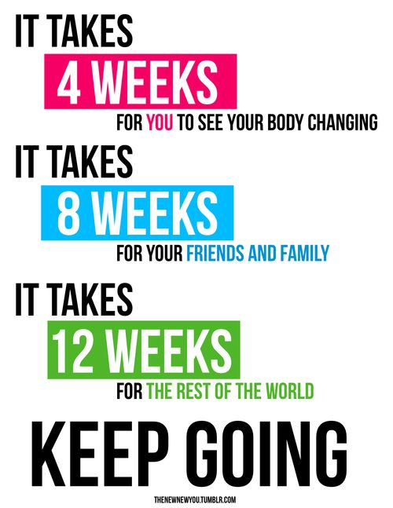

Slide 30
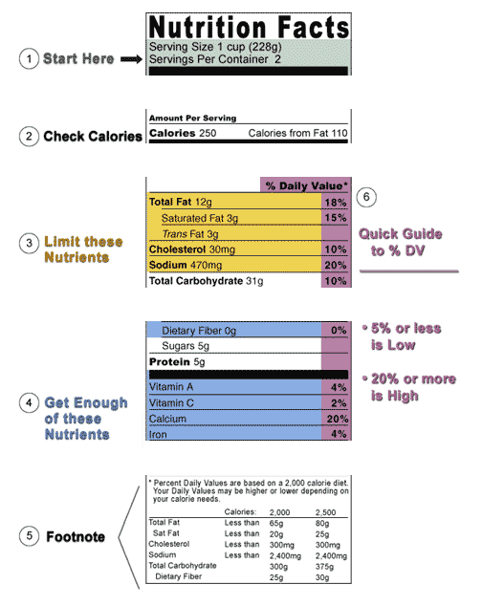
Reading Nutritional Labels Overview

Slide 31
Reading Nutrition Labels for Calories and Portion Size

Slide 32
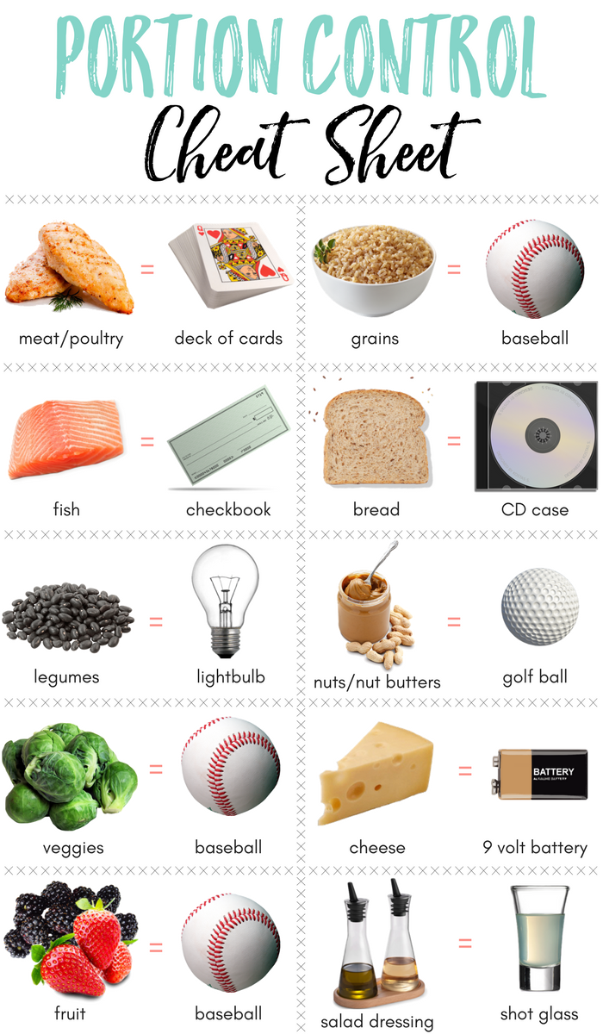
Portion Control: Overeating

Slide 33
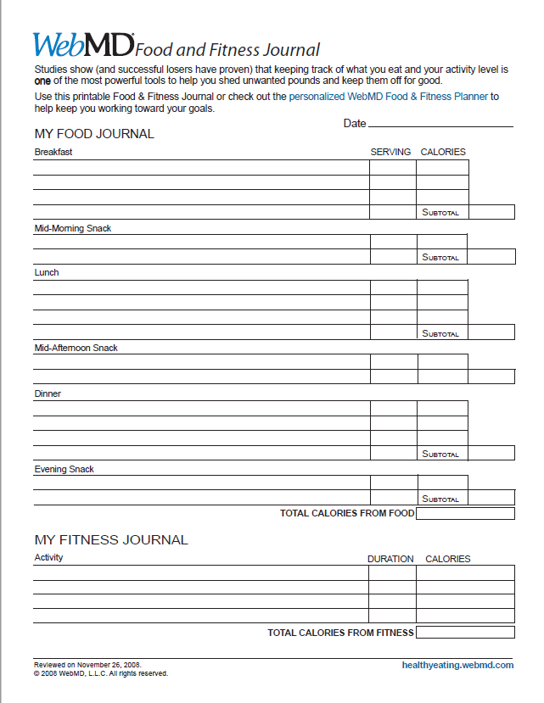
Calorie Counters

Slide 34
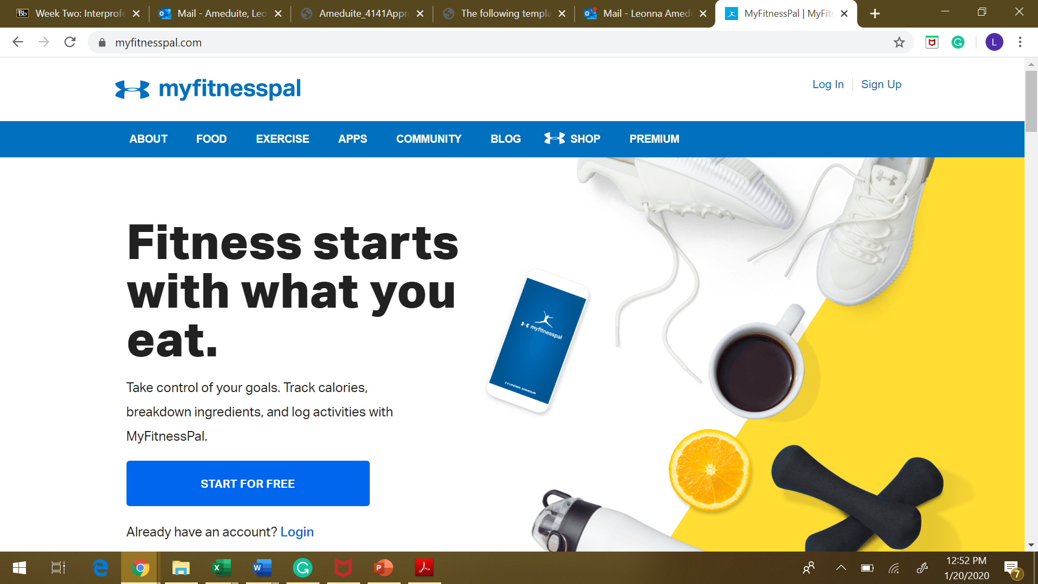
My Fitness Pal www.myfitnesspal.com

Slide 35
CHALLENGE!!!!!
Calorie count for one week utilizing one of the calorie counting tools
Objective
  Track calorie intake
  Learn our current eating habits
  Identify areas of improvement that fit your current lifestyle
  The information that we collect this week will be the basis of our program

