Slide 1



Listings Suite
Listing Builder, Listing Distribution, Listing Sync Pro
Notes:
Ensuring your clients are found and accurate across the web is extremely important in today’s day, as most consumers are going to search engines for their information. Whether they are trying to discover a new business by searching “pizza places near me” or searching for a specific business, your clients information needs to be present so their business can be found online. Our suite of Listings products allows businesses in all types of verticals be found online through the power of listings.

Slide 2



We believe businesses have the right to...
Listings Suite
Businesses should have the ability to...
Be found and accurate
Online, offline, and on mobile devices
Make listing updates in real time
See proof-of- performance
from one location.
Notes:
Businesses should be found and accurate, whether it be online, offline, on mobile sources, voice search, or GPS sources. When a customer is searching for a need they want met, they go to a search engine. If your client is not visible online, or is only visible on a few listing sites, the chances of that customer finding your business are slim.
There are hundreds of listings sites, and managing them all is a difficult task. Your client needs one place where they can easily create, manage, and update their listings, saving them hundreds of hours over the course of a year.
Proof-of-performance is essential when making your clients happy, so they have the ability to see where there business is being shown and accurate.
Your clients should be able to manage all of this from one location. The solution? Our Listings Suite of products.

Slide 3

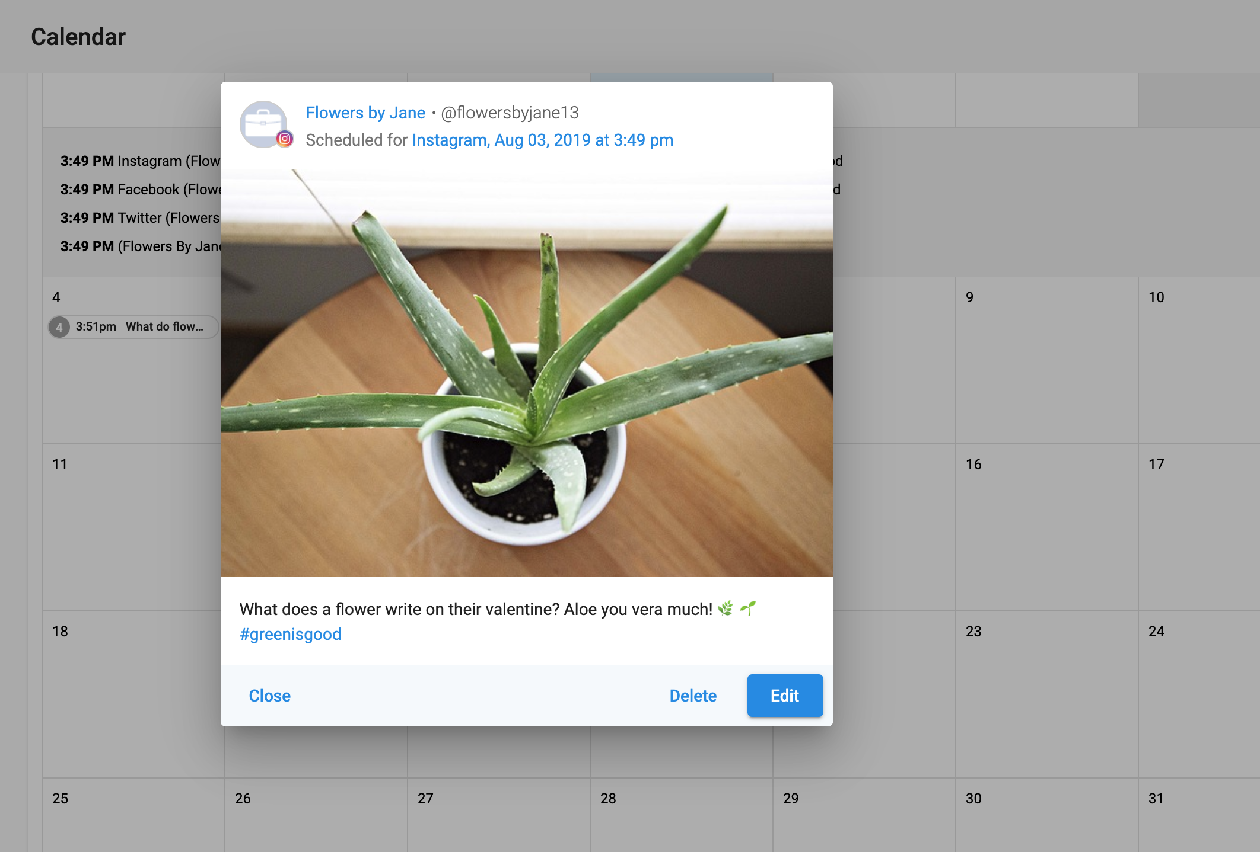
Two ways to request feedback
Listings Suite
What is the Listings Suite?
A listings management tool that allows you to:
Push listing data to aggregators and straight to directories
Ensure your clients are accurate and found across the web, mobile devices, and voice search
Make updates in real-time
View Google insights
Show proof-of-performance
Notes:
Our listings suite is a listings management tool that allows you to
Push listing data to aggregators and straight to directories. We have a few different products within the Listings suite that address these needs. We’ll talk more about these products later.
Ensure your clients are accurate and found across the web, mobile devices, and voice search. It’s extremely important for your clients to be found on anywhere that a customer may be looking for information. This can include anything from a Google web search, booking a trip to a restaurant on Uber, or asking your Alexa what time a clinic is open until.
Make updates in real-time - business information changes. Whether it’s new business hours or holiday hours, a new phone number, or a new location, a business should have an easy way to update all of their information across multiple listings. Using our products, your clients will save a ton of time being able to update information from one place and having it be distributed across their listings.
View Google Insights - we know that Google My Business is extremely important to have fully optimized in order to boost SEO and ensure businesses are found. You can easily see GMB insights and how your listing is performing from one place.
Show proof-of-performance - it’s important to make sure you can show your clients how their dollars are paying off. They can see this information right in the platform and through the executive report.

Slide 4
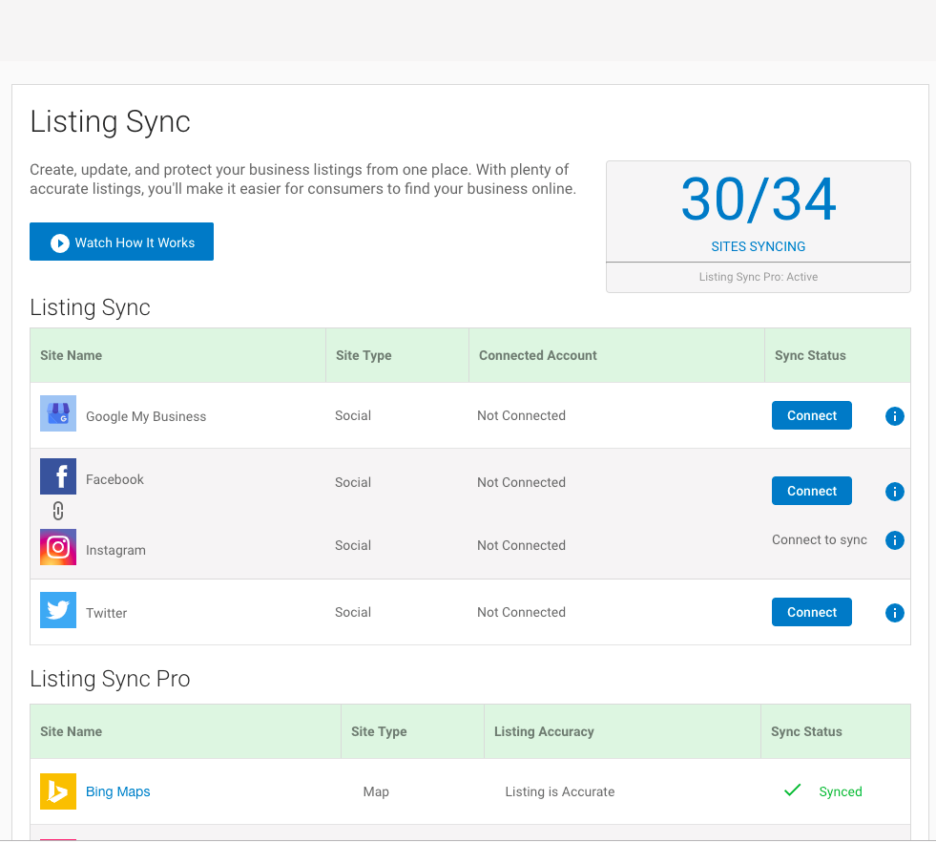
Two ways to request feedback
Listings Suite
Listing Builder
Product Overview
Listing Builder is a freemium product that allows your clients to kick-start their online presence
Listing Sync: Sync to popular listing sources (Google, Facebook, Instagram, Twitter)
My Listing: A business listing that is optimized for local searches
Access to Google Insights
Notes:
Listing Builder empowers you to start the conversation about digital solutions with local businesses. For no additional cost, you can introduce hundreds of business owners to online presence management and your digital marketing platform.
Listing Builder offers 3 important features to start helping your clients be found:
The first is Listing Sync. Your clients have the ability to sync their business information to some of the most highly trafficked listing sources on the web - GMB, Facebook, Instagram, and Twitter.
The second feature is My Listing. This is a free business landing page that a business owner can easily create in Listing Builder. The landing page includes branding, location, business info, and customers can leave feedback that will be delivered straight to the business.
Last but not least, Listing Builder offers GMB Insights, as discussed in the previous slide.
This freemium product delivers a ton of value and shows your client the importance of being present online and is a fantastic segway into an upgrade to a paid version.

Slide 5
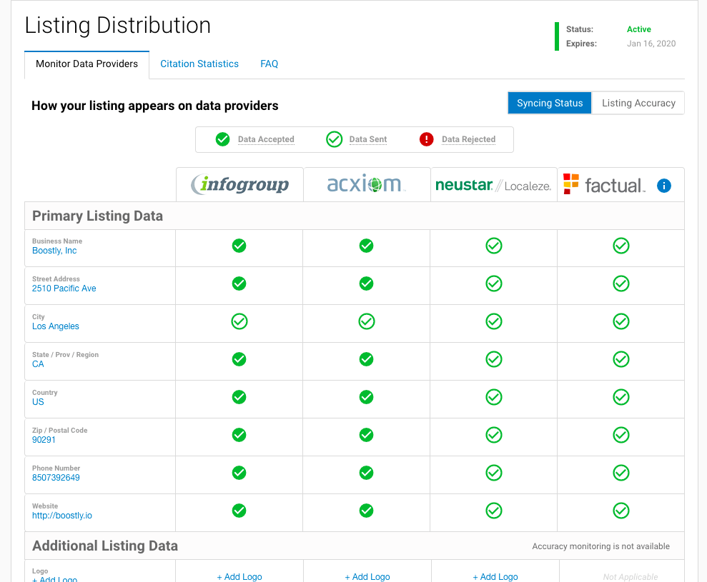
Two ways to request feedback
Listings Suite
Listing Distribution
Product Overview
Listing Distribution sends your clients’ business data to the four main data aggregators: Infogroup/Neustar, Localeze, Factual, and Acxiom.
Data can be accessed by hundreds of listing sites across the web and mobile apps
Build online presence, boost SEO, and increase accurate citations
Update business data from one platform
Notes:
Listing Distribution is the next step in ensuring your clients are found everywhere across the web, mobile apps, and more. Listing Distribution sends your clients’ business data to the four main data aggregators on the market: Infogroup, Localeze/Neustar, Factual, and Acxiom. These aggregators have hundreds of connection points across the web, namely listing sites, GPS systems, and mobile apps. These directory services reference the four trusted data aggregators for business info that is published to their website or app.
Listing Distribution helps build your clients’ online presence and boost SEO. It is extremely important that your clients’ data is pushed out to the web, not only for listing sources, but to make sure that customrtd can find your clients’ business information - especially if the customer is trying to discover a business. Having correct business data out in the ecosystem is crucial to a business being found.
If any business info changes, you or your client can easily make changes within the platform. These changes will then be sent to the four data aggregators.

Slide 6
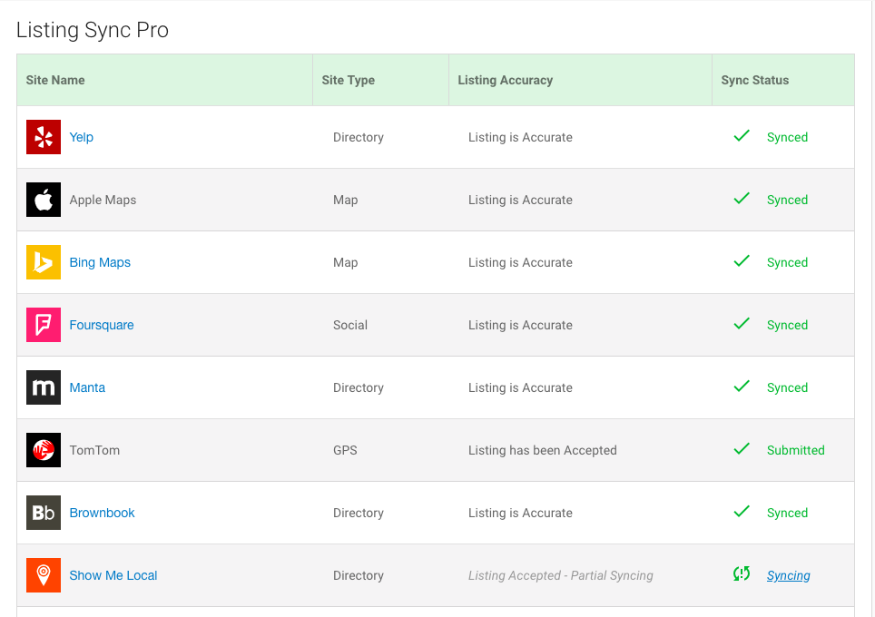
Two ways to request feedback
Listings Suite
Listing Sync Pro
Product Overview
Listing Sync Pro pushes data to the most important listing sources across the web and mobile apps.
Make updates to your listings in real-time
Protect your listings from 3rd party changes
Suppress duplicate listings
Provide proof of performance
Notes:
Listing Sync Pro is the final step in completing your clients’ online presence solution. With Listing Sync Pro, your clients’ business data is published to a list of sources; with a click of a button in the platform, you can create, update, and manage your clients’ listings. Any new sources or changes that are made are updated across listing sites in 15 minutes to an hour (excluding GPS sources, which take a bit longer). Listing Sync Pro gives your clients’ ownership over their online listings and prevents any third party changes, such as a competitor trying to change information, from occurring.
The number of sources Listing Sync Pro syncs to depends on the region; for a full list of sources, visit the product page.

Slide 7
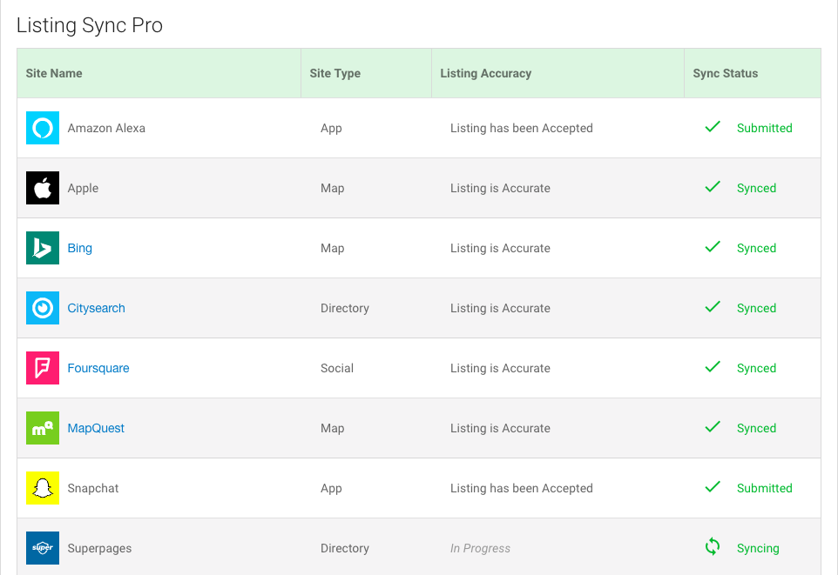
Two ways to request feedback
Listings Suite
Listing Sync Pro powered by Yext
Product Overview
Listing Sync Pro Yext pushes data to the most important listing sources across the web and mobile apps.
Make updates to your listings in real-time
Protect your listings from 3rd party changes
Suppress duplicate listings
Provide proof of performance
Access to the Yext dashboard
Notes:
Listing Sync Pro powered by Yext is very similar to Listing Sync Pro. LSP by Yext support some different sources compared to regular LSP. LSP powered by Yext is currently only available to businesses in the U.S., although more locations will be supported soon. With LSP powered by Yext, you also have access to the Yext dashboard, including Yext insights.

Slide 8
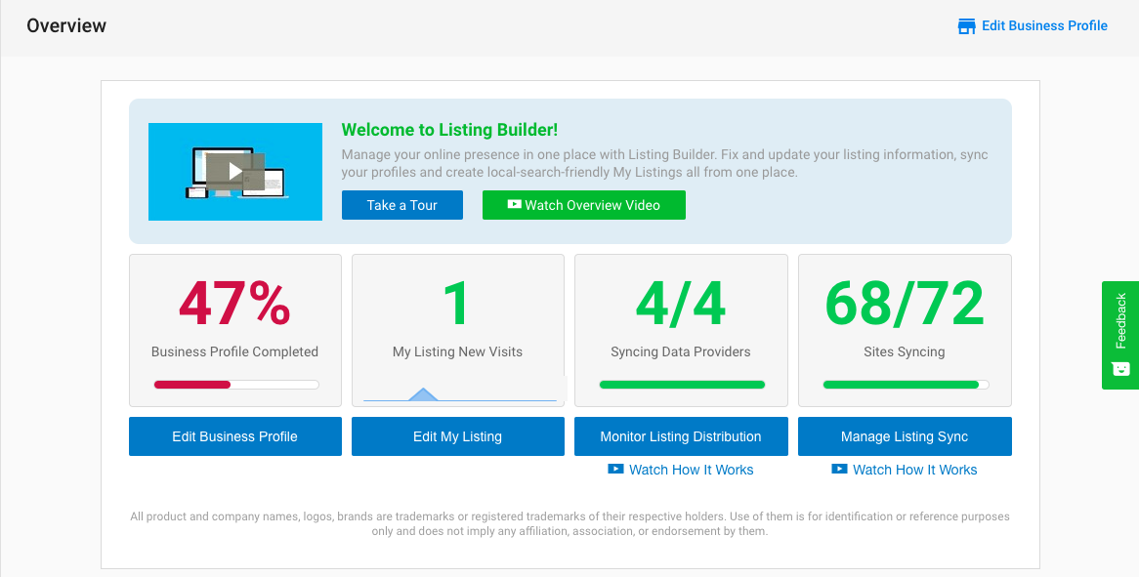
Two ways to request feedback
Listings Suite
Tab: Overview Listing Builder at a glance
Overview
Your Listings management account at a glance:
% of business profile complete
My Listing visits
Sites Syncing
Syncing data providers
Click any of the CTAs to get started in the product!
Notes:
Here is an overview of each tab in the Listings product. The tab in the navigation is the Overview page, which gives you a summary of your clients’ listings management account performance.

Slide 9
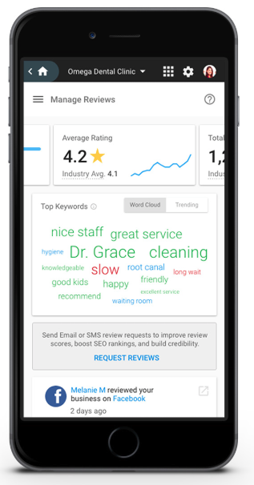
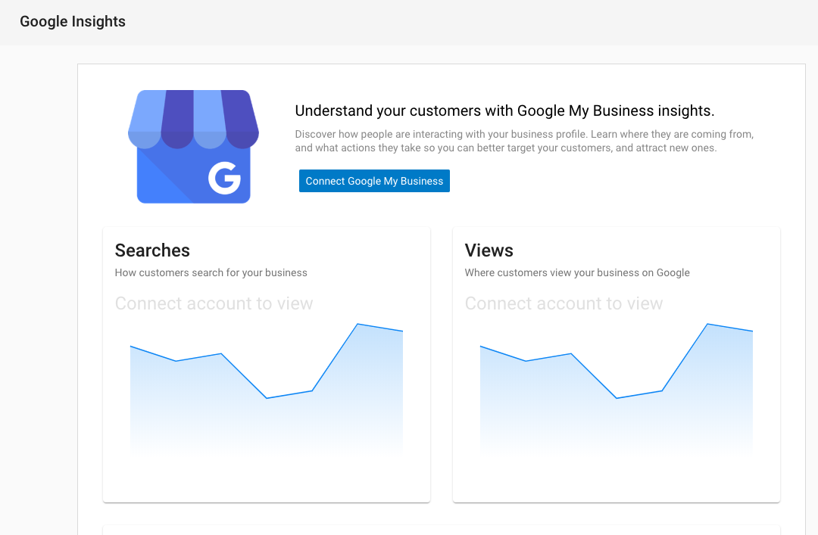
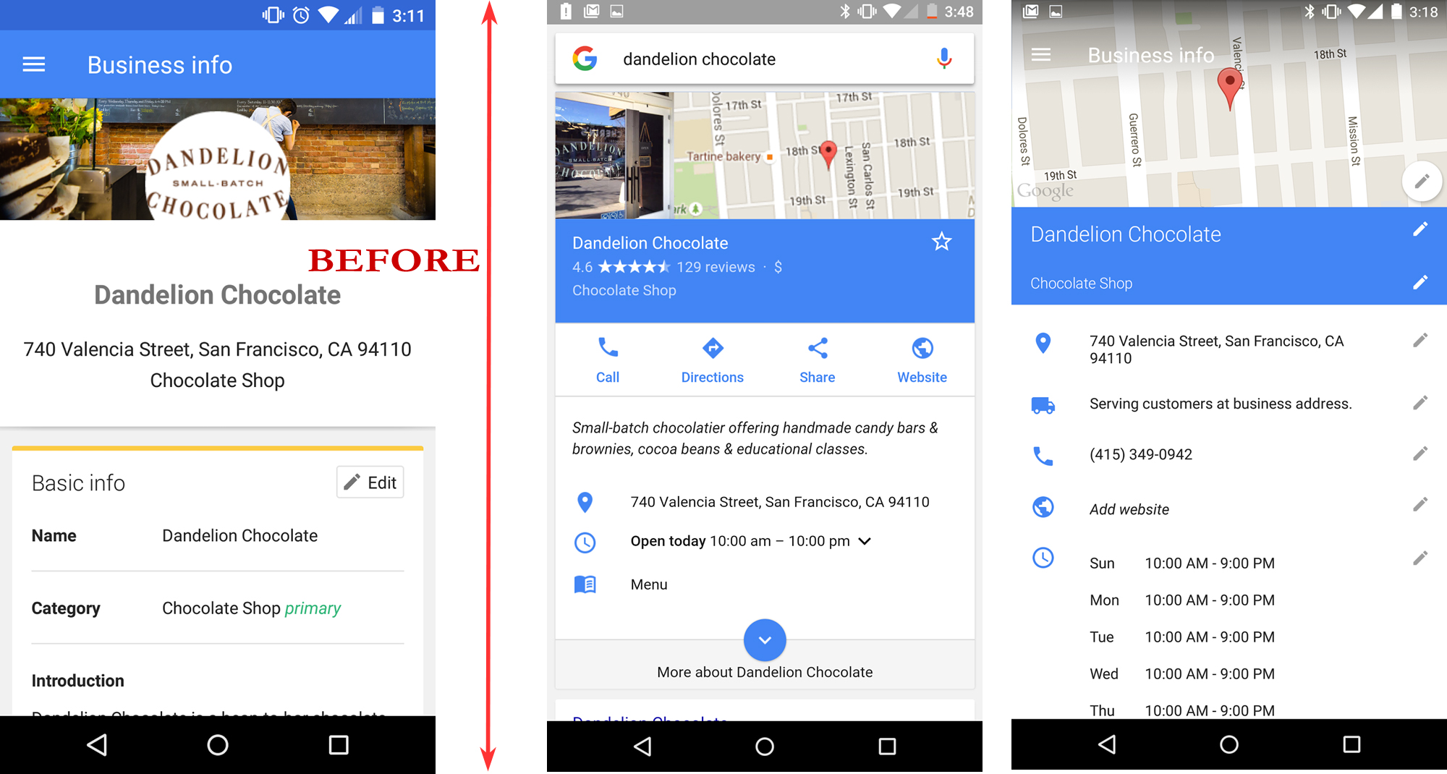
Two ways to request feedback
Listings Suite
Tab: Google Insights See how your GMB Listing is performing
Google My Business Insights
How and where customers search for and view your business
Common actions your customers are taking on your listing
Direction request
Phone calls
Photo insights
Notes:
As mentioned before, it’s extremely important to ensure your clients’ Google My Business profile is fully optimized in order for your client to have a higher chance of being found online above their competitors. This includes basic data such as name, address and phone numbers, but it’s also important to have information such as store hours, holiday hours, reveiws, photos, linked website, and more.
With GMB insights within the Listing Builder product, your clients’ can learn more about their customers.

Slide 10
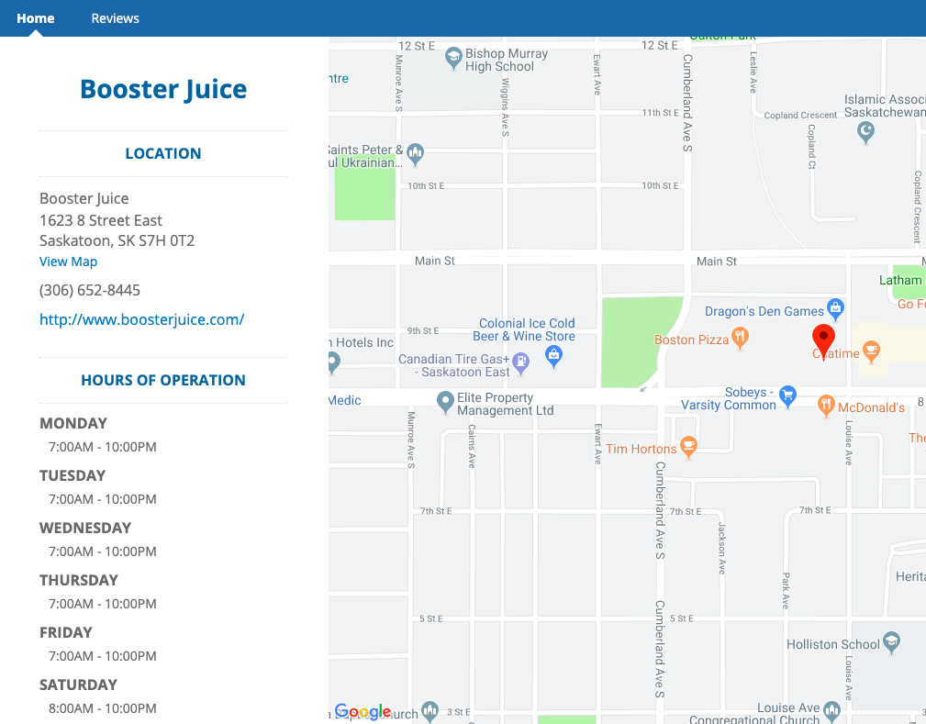
Two ways to request feedback
Listings Suite
Tab: My Listing
My Listing
Create, manage, and update a landing page for your customers to visit
Customers can leave feedback on your business
Track visitors and view analytics
Add themes, branding, domains, and more

Slide 11
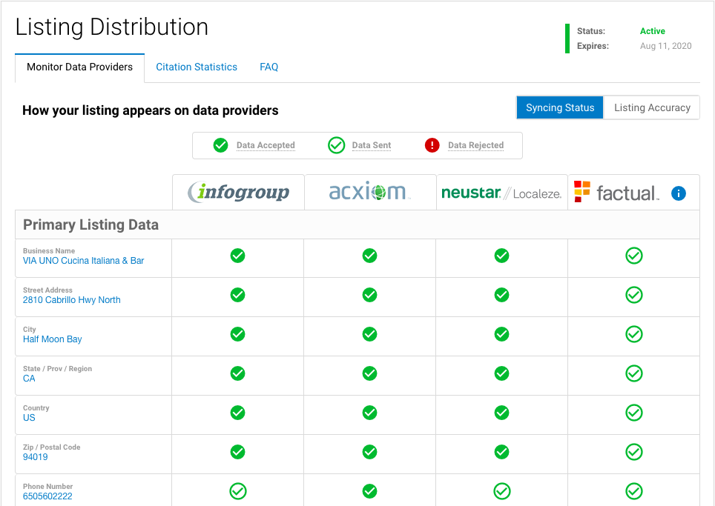
Two ways to request feedback
Listings Suite
Tab: Listing Distribution
Listing Distribution
View proof-of-performance on Listing Syndication
View any potential errors in business info and fix within the platform
Update or add business information
View the Syncing Status and the Listing Accuracy

Slide 12
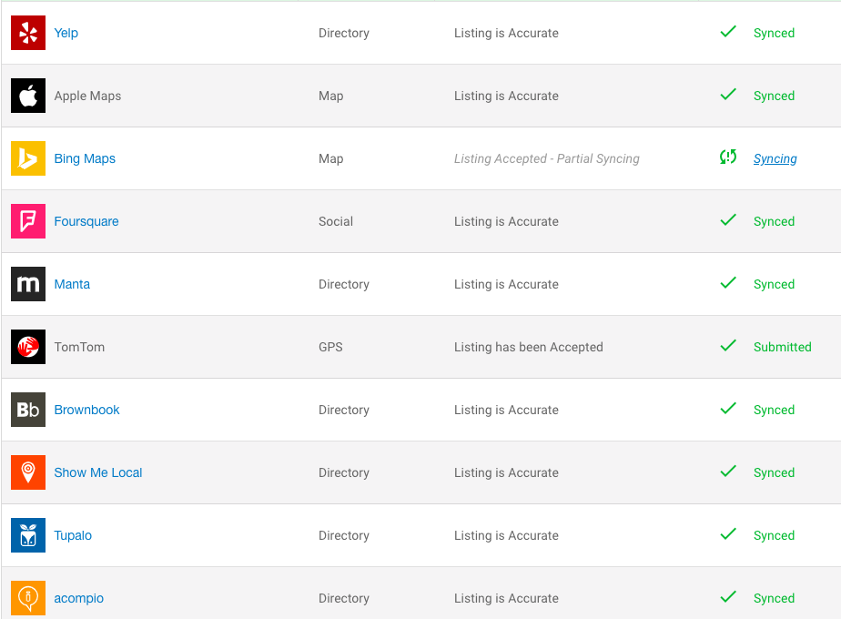

Two ways to request feedback
Listings Suite
Tab: Listing Sync Check up on your listing health
Listing Sync
A place to create, update, and check on business listings and to show proof-of-performance
Create and edit listings, such as adding business hours or photos
Updates will be distributed across synced sources
Check on any submission inconsistencies

Slide 13
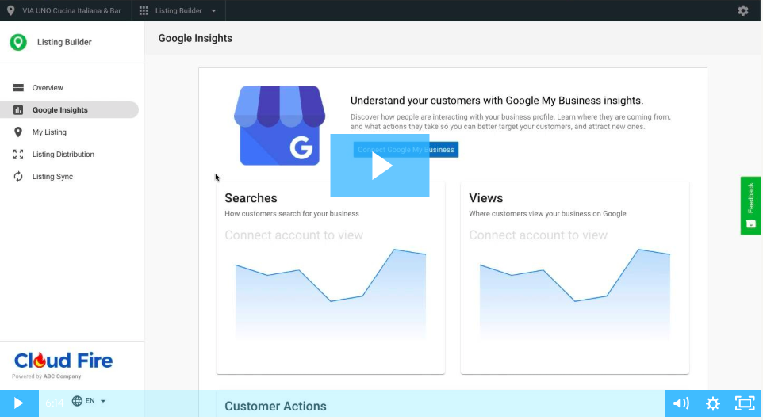
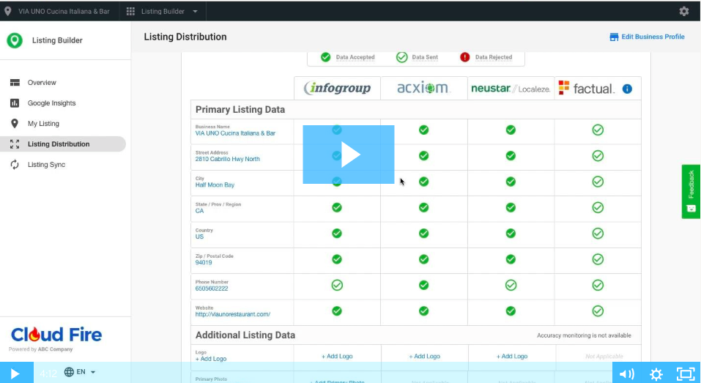
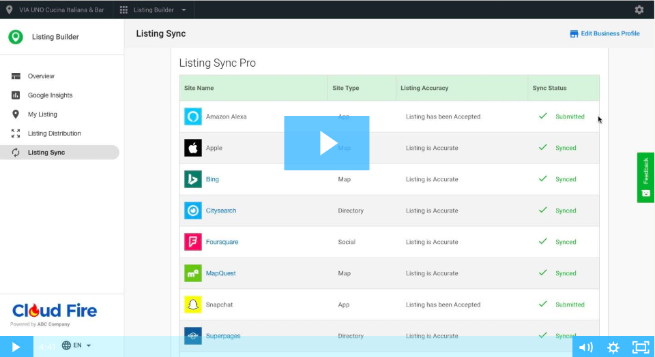
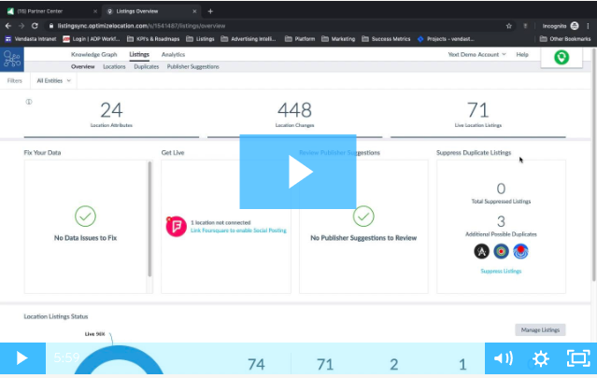
Two ways to request feedback
Listings Suite
Demos
Listing Builder
Listing Distribution
Listing Sync Pro
Listing Sync Pro powered by Yext

