Slide 1
Reputation Management
Notes:
Reputation Management is a industry leading reputation app for local business. This product lays the foundation for your clients to earn 4-5 star ratings in order to establish trust and credibility with their customers!

Slide 2
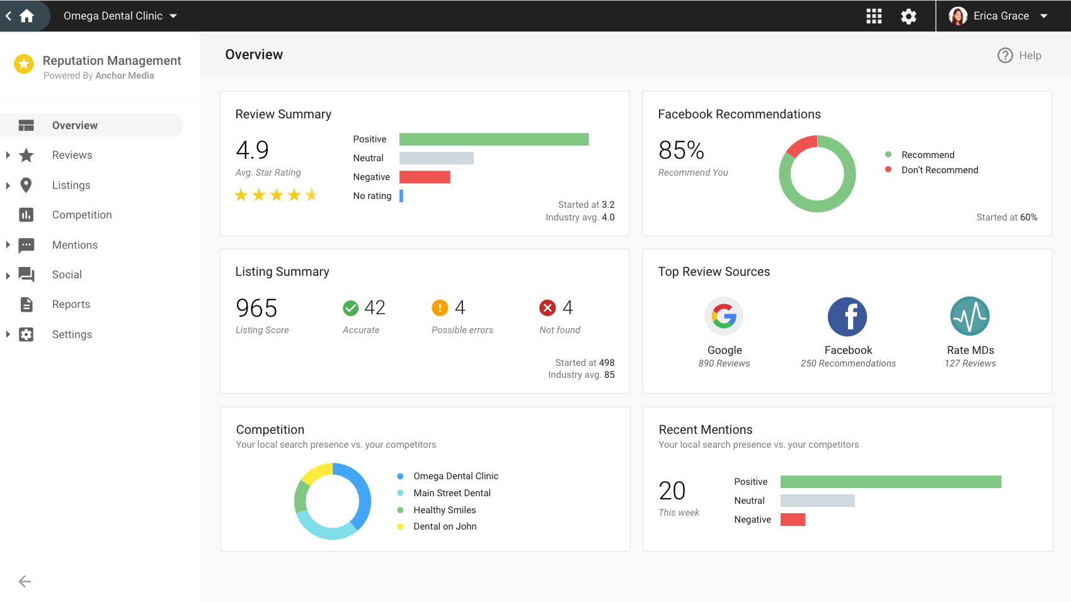
We believe businesses have the right to...
Reputation Management
Businesses should have the ability to...
Manage their online reputation from one place
Be found by customers through accurate listings
See what’s being said online and engage in online conversation
Notes:
At its heart, we know Reputation Management will empower your clients to take an active approach to improving their online reputation.
From a single product, your clients can remain on top of their business’s online reputation, including monitoring and improving listing accuracy and understanding what’s being said about their business online through mention, citation, and review monitoring.

Slide 3
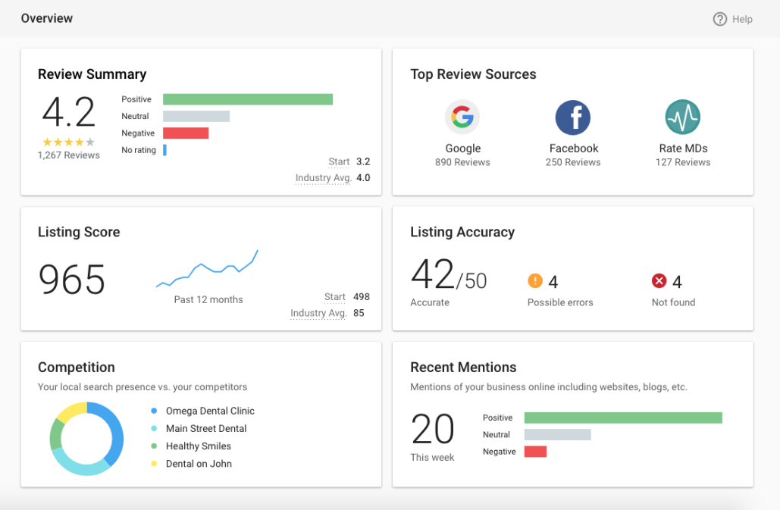
Two ways to request feedback
Customer Voice
Reputation Management
What is Reputation Management?
A tool that allows you to:
Confirm you are listed correctly online
Monitor and manage all your reviews
See how you compare to the competition
See what’s being said about your business online
Notes:
Our tool is comprehensive, as it covers all aspects of a business’s online reputation.
Are potential customers able to find your client’s business through accurate listings?
Do your clients understand their star rating and monitor what’s written on public review sites?
How do they compare to the competition in terms of search engine share of voice?
What are blogs, news outlets, or other public forums saying about their business?
The overview page in Reputation Management can help answer all these questions at a glance.

Slide 4
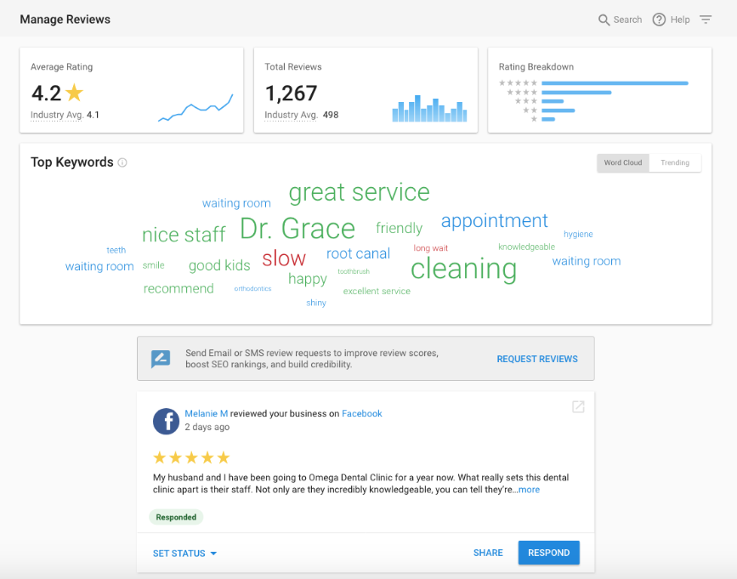
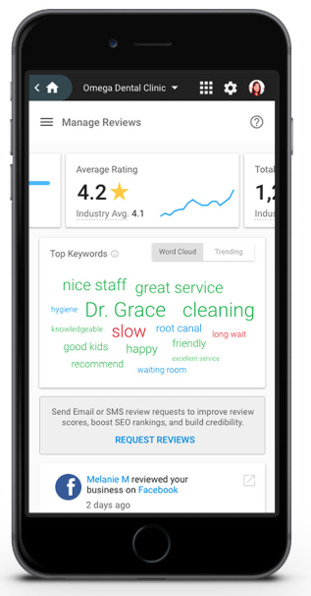
Two ways to request feedback
Customer Voice
Reputation Management
Tab: Reviews Manage and respond to online reviews
Manage Reviews
See reviews from all top review sites in your industry
Respond in-line to Facebook and Google reviews with templates
Keep on top of trending keywords in conversation
Sort reviews by keyword sentiment to drill in
Notes:
And as we dig deeper, each tab in the product uncovers useful insights and the ability for your clients to take action right then and there!
The Reviews tab is the central hub for managing and responding to customer reviews. Online reputation is a very hot buzzword with businesses right now. We offer the ability to see in-depth information about your client’s online word of mouth.
Monitor for reviews on influential sites like Google and Facebook. We also cover sites with specific business categories like Cars.com in the automotive space, Zomato for the restaurant industry, and RateMD's for health & medical.
From this dashboard, your clients can easily see which reviews they need to respond to and even respond to Google and Facebook reviews without leaving the page.
And to help influence potential customers on social media, they can even grab their five-star reviews, and in one click, share them with their followers on social media!
Every review the business receives triggers an email alert, so your client can learn about the review within 24 hours, and take action. The importance of responding to reviews should not be overlooked.

Slide 5
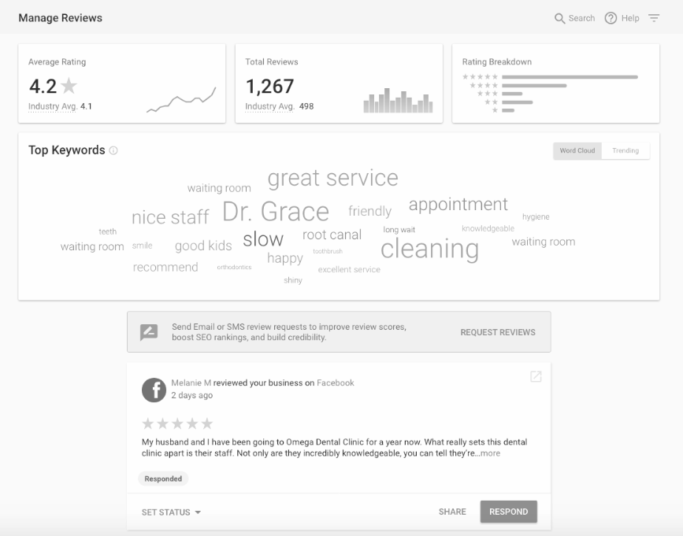
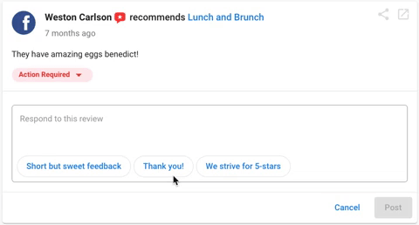
Two ways to request feedback
Customer Voice
Reputation Management
Tab: Reviews Respond to reviews in as little as 2 clicks
Review Response Templates
Templates are selected intelligently based on star rating
Create an unlimited number of custom templates
Complete control over default templates
Notes:
And speaking of responding to reviews… over 53% of people who leave a review expect a response! Reputation Management offers a built in review management strategy, making the task of responding to reviews super simple.
Each Reputation Management account comes with 40 default templates for a variety of star-rated reviews. Each Google and Facebook review will display 3 intelligently selected templates so your clients can respond to a review in as little as 2 clicks.
Plus, your clients have the freedom to edit or delete any default template they don’t like AND add unlimited custom templates.
Not only does responding to reviews increase trust and credibility, but doing so can improve the business’s search engine ranking.

Slide 6
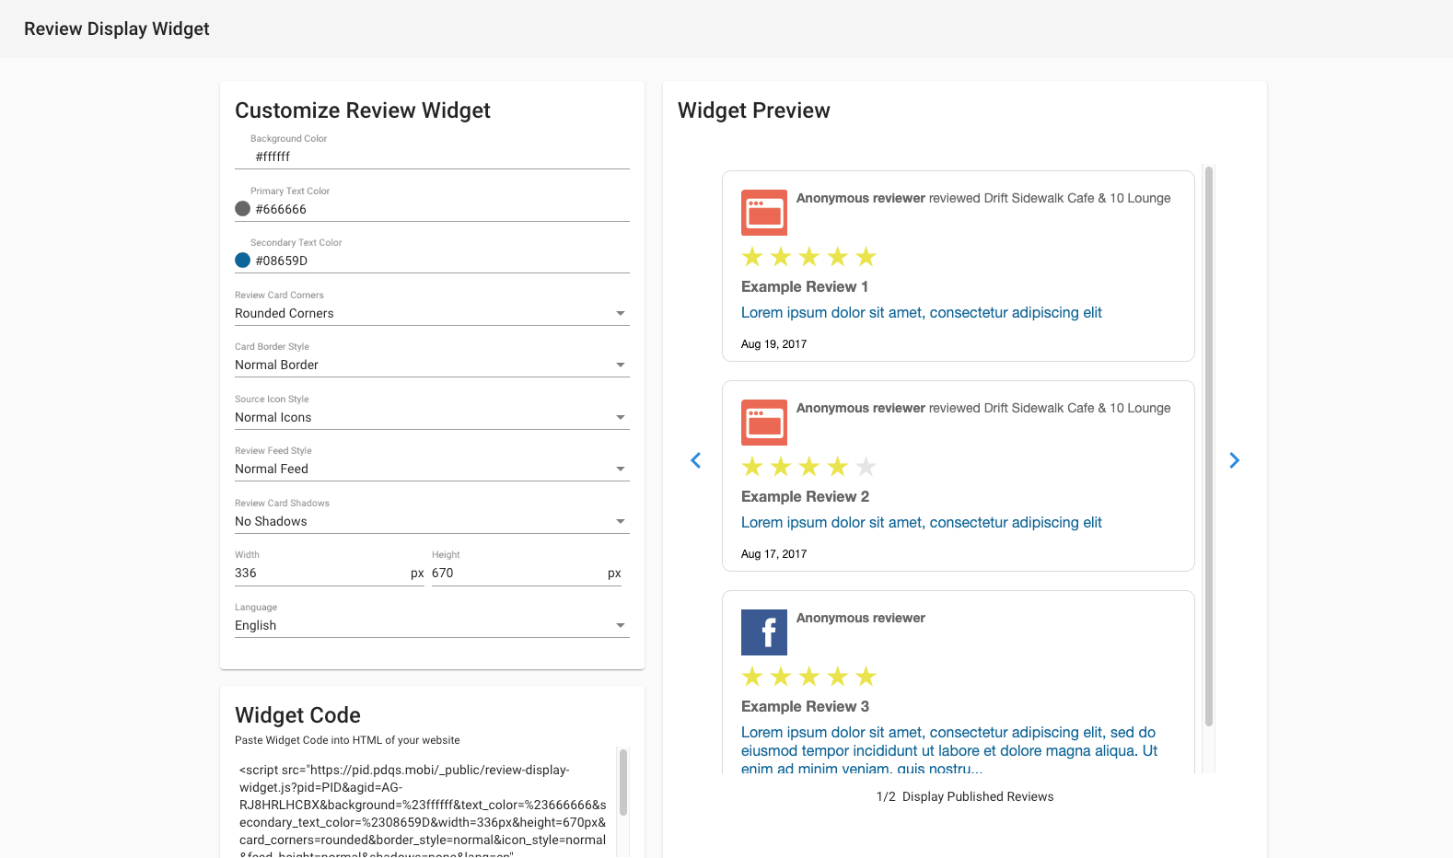
Two ways to request feedback
Customer Voice
Reputation Management
Tab: Reviews Display your best reviews on your website
Review Display Widget
Embed the Widget Code on your site to show off your best reviews
90%
of customers read reviews before purchasing
Notes:
And all those positive reviews should no go unnoticed! Using the Review Display Widget, your clients can show off their best reviews right on their website. Afterall, a staggering 90% of customer read reviews before purchasing, so make sure they’re highlighting their best ones.

Slide 7
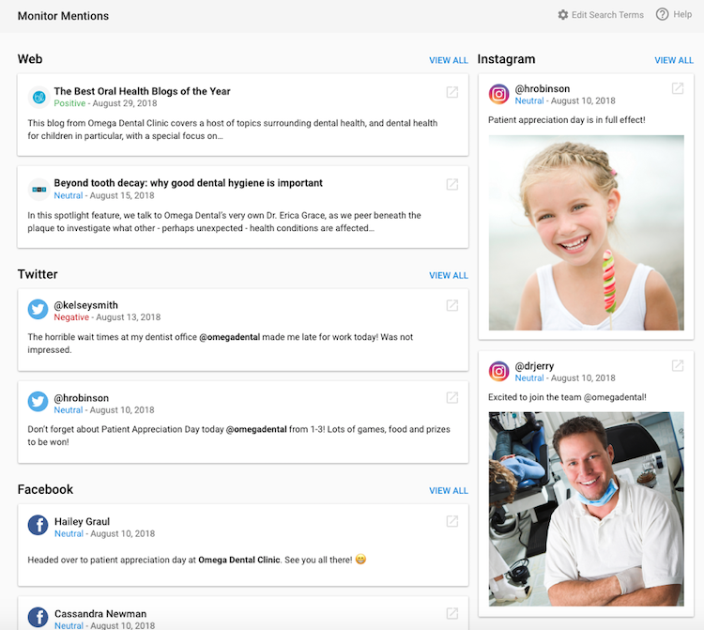
Two ways to request feedback
Customer Voice
Reputation Management
Tab: Mentions Ensure you’re involved in the conversation
Monitor Mentions
See who is mentioning your business name
Scan the web for selected search terms
Mentions are tracked from:
Social media
News articles
Blogs, etc.
Notes:
Let’s move on to Mentions! Now, customer reviews are excellent for structure feedback. But what about everywhere else online? Many times a comment, image or news story is written somewhere in the nooks and crannies of the internet such as blogs, websites and social media.
Tracking online word of mouth is simple and easy with “Mentions”. Imagine a blog has posted some slanderous information about a business and your client is completely unaware. The damage that post can make could be disastrous.
However, once our system finds it, the business can take action to have it removed. This is exactly why businesses need to know about these mentions.
Plus, our mentions engine also tracks Instagram, so no stone is left unturned.

Slide 8
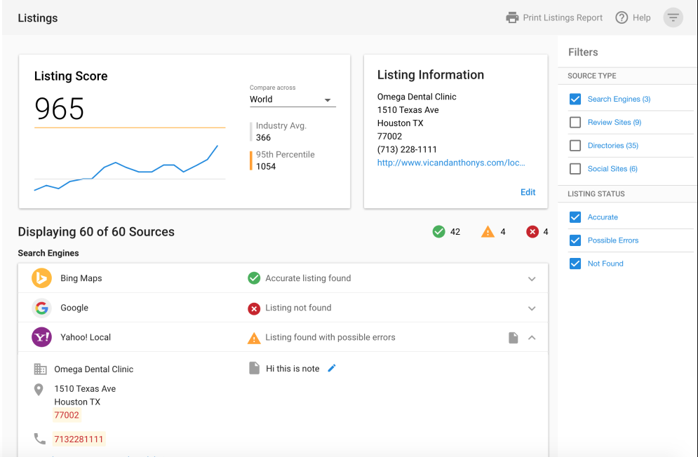
Customer Voice
Reputation Management
Tab: Listings See the accuracy of your business listings
Primary Listings
Determine on what sites your business is inaccurately listed
Correct your listings to be found by more customers
Compare your Listing Score to your industry
Notes:
Moving on to the Listings tab, this is where your clients can do work to improve their online listings. Reputation Management monitors the top listing sites in your clients’ industries, including search engines like Google, review sites like OpenTable or TripAdvisor, plus many many more.
The Listing Score is an evaluation of the business’s listing accuracy on these sites. Compare it to the industry average to see how the business stacks up.
Your clients can take action to correct their listings right from this page. You can correct or ignore listing errors to ensure the business is found correctly on the most important sites.

Slide 9
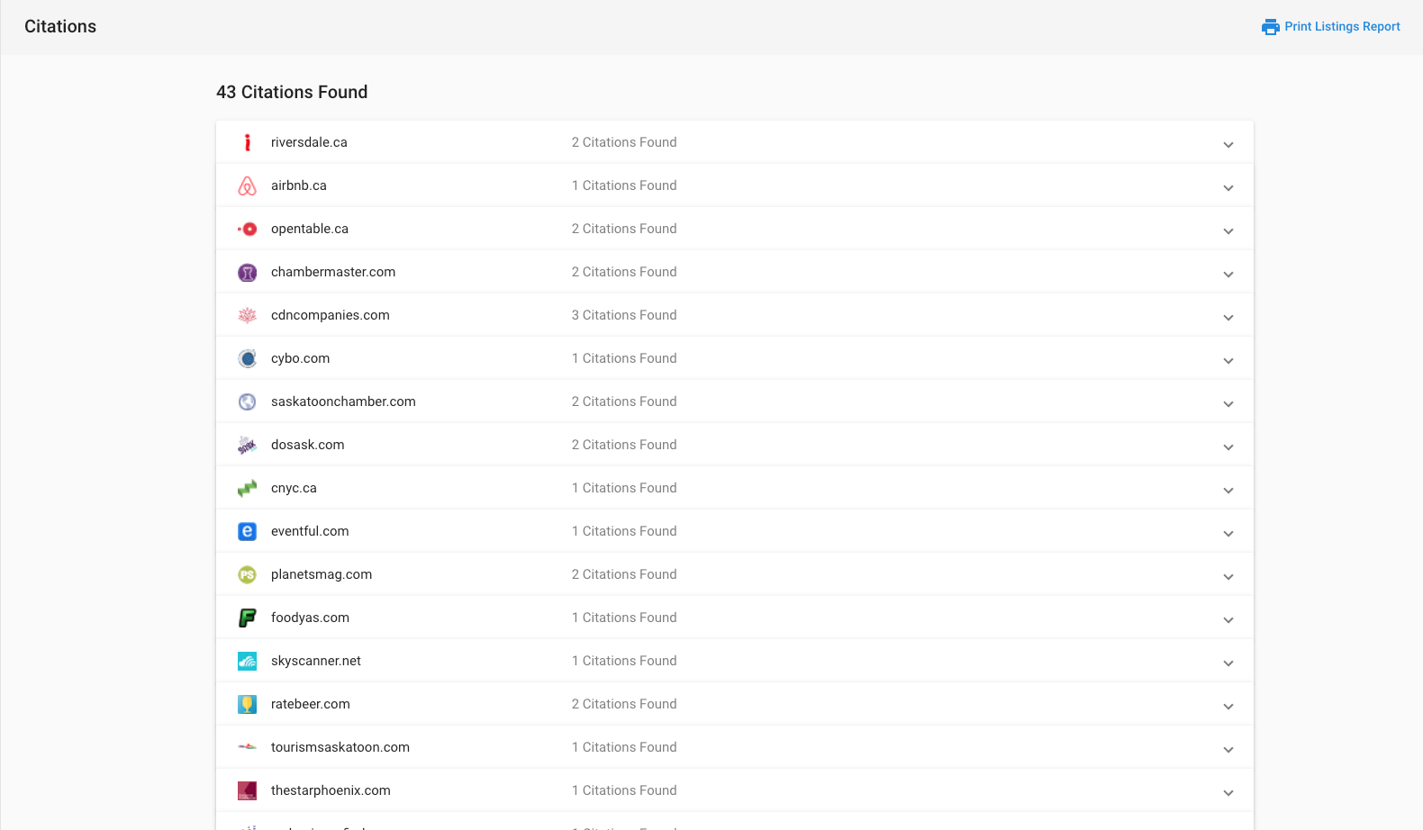
Two ways to request feedback
Customer Voice
Reputation Management
Tab: Listings Scan the web for all business citations
Citations
Spot all instances that your business name and data is cited across the web
Notes:
Citation are mentions of the business name along with another piece of business data, like the phone number, address, or website and they are key in search marketing optimization! Accurate citations helps people discover your business which can result in more phone, web, and foot traffic.
Each citation on this page links back to the website it appeared on so you can get the full picture.

Slide 10
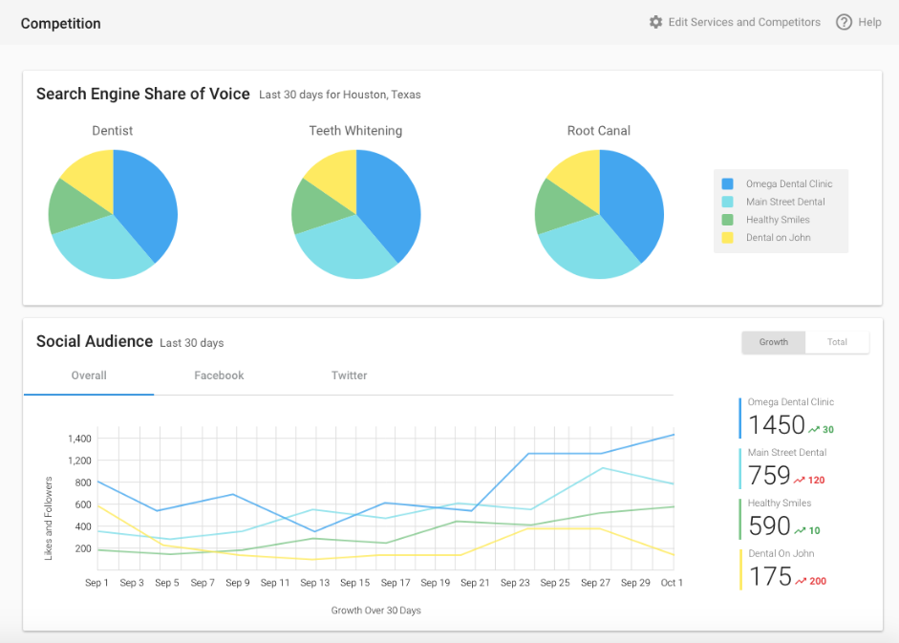
Two ways to request feedback
Customer Voice
Reputation Management
Tab: Competition Manage your online share of voice
Competition
Keep an eye on up to three chosen competitors to:
Determine Search Engine Share of Voice
Track social audience growth on Facebook and Twitter
Notes:
Seeing how your clients’ rivals are doing online is a huge competitive advantage!
All it takes is three keywords, three competitors in their market, and they’ll get an insightful look into their online share of voice.
As well, we can compare the social audience, including followers and growth over time so we can see how their social media presence compares.

Slide 11
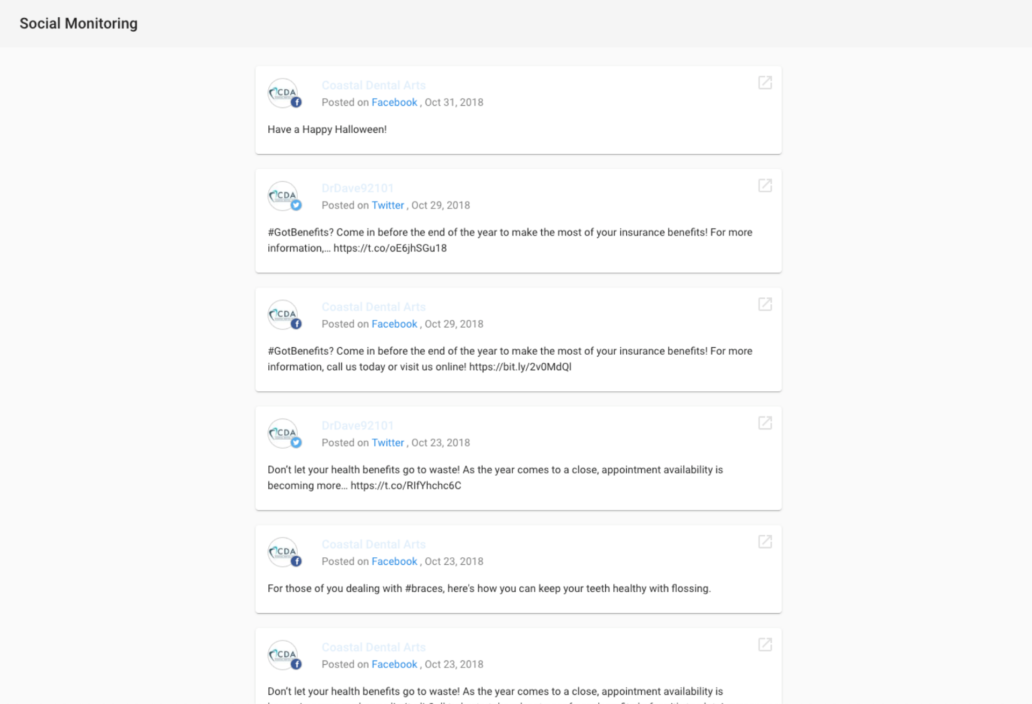
Two ways to request feedback
Customer Voice
Reputation Management
Tab: Social Monitor your social accounts
Social Monitoring
Connect your social accounts to monitor Likes and followers over time
Keep up with customer conversations
Monitor employee Twitter accounts to stay in the know
Notes:
And in the Social tab, your clients can connect their social accounts to monitor likes and followers over time, as well as keep up with customer conversations.
Plus, if your clients have ever wondered what employees might be saying about the business, our system can also monitor employees’ Twitter feeds. Stay in the know with social monitoring right from Reputation Management!

Slide 12
Two ways to request feedback
Customer Voice
Reputation Management
Tab: Reports Measure success over time
Executive Report
Demonstrate improvement over time
Short term changes and long-term trends
Automated email with relevant highlights
White-labeled
Notes:
Lastly, Reporting can’t be missed when it comes to managing an online reputation.
After all, keeping your clients informed about their online reputation is vital to retaining their business.
We’ll deliver an executive report to the business about their performance on a weekly, or monthly basis.
This report contains vital information, including star rating over time, most recent reviews, and average review rating over time. The Executive Report is a great way to build trust, position yourself as the local marketing expert, and show how you are delivering real and measurable results.

Slide 13
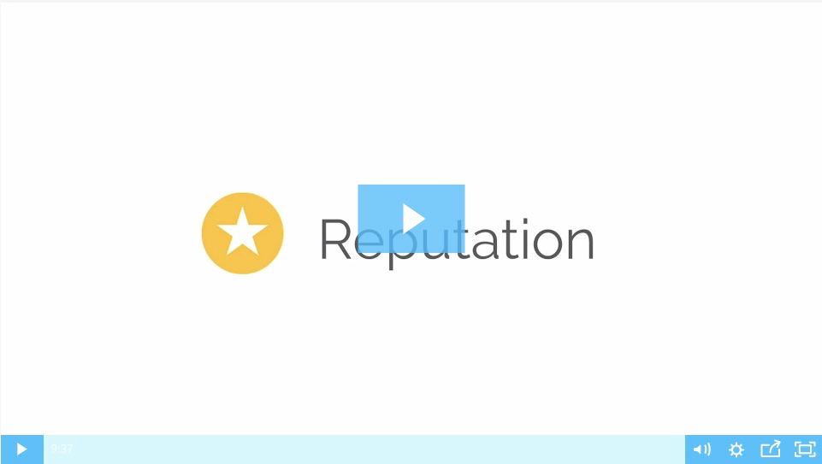
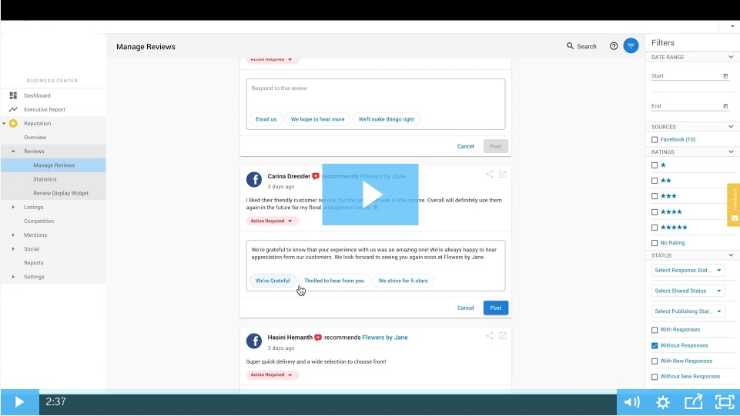
Two ways to request feedback
Customer Voice
Reputation Management
DEMO
Full product walkthrough
NEW feature walkthrough: Review Response Templates
Notes:
Links to:
Full product walkthrough:
https://vendasta-1.wistia.com/medias/l4760cm7t7
https://support.vendasta.com/hc/en-us/articles/202318496-Reputation-Management
Review Response Templates walkthrough:
https://vendasta-1.wistia.com/medias/28eauy4yjo
https://support.vendasta.com/hc/en-us/articles/360033267054-Tutorial-How-to-use-review-response-templates-white-labeled-

