Slide 1
The State of Local
The State of Local
What every local business needs to know
in a digitally powered world
Full Name
Noah Moss
812-631-3585 austin@vivabove.com
Notes:
Before starting a presentation, make sure to:
Run a snapshot report
Prepare a Business Center login for the person you’re seeing, so you can live demo their account and train them on how to log in.
Thanks for joining me on today’s presentation! I promise to stick to our time limit of [x minutes]. Set timer.

Slide 2
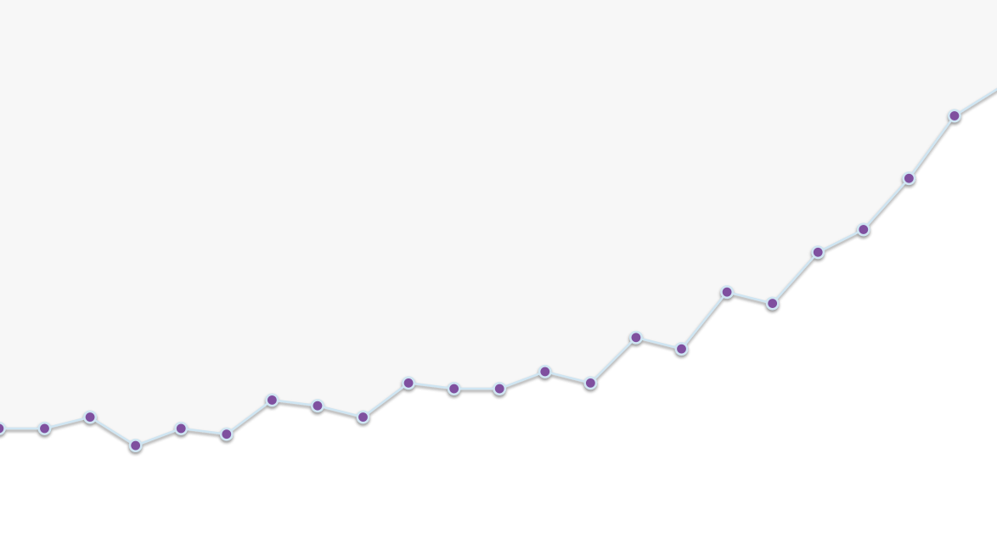
Business Goals
What are your business goals?
Notes:
So, I was thinking about you before our presentation. I’d like to learn more about your business's goals. What are you hoping to accomplish this year?
[Discover the business’s wants and needs, so you can align the conversation to match their marketing goals.]
LISTEN. LET THEM TALK. MAKE NOTES.

Slide 3
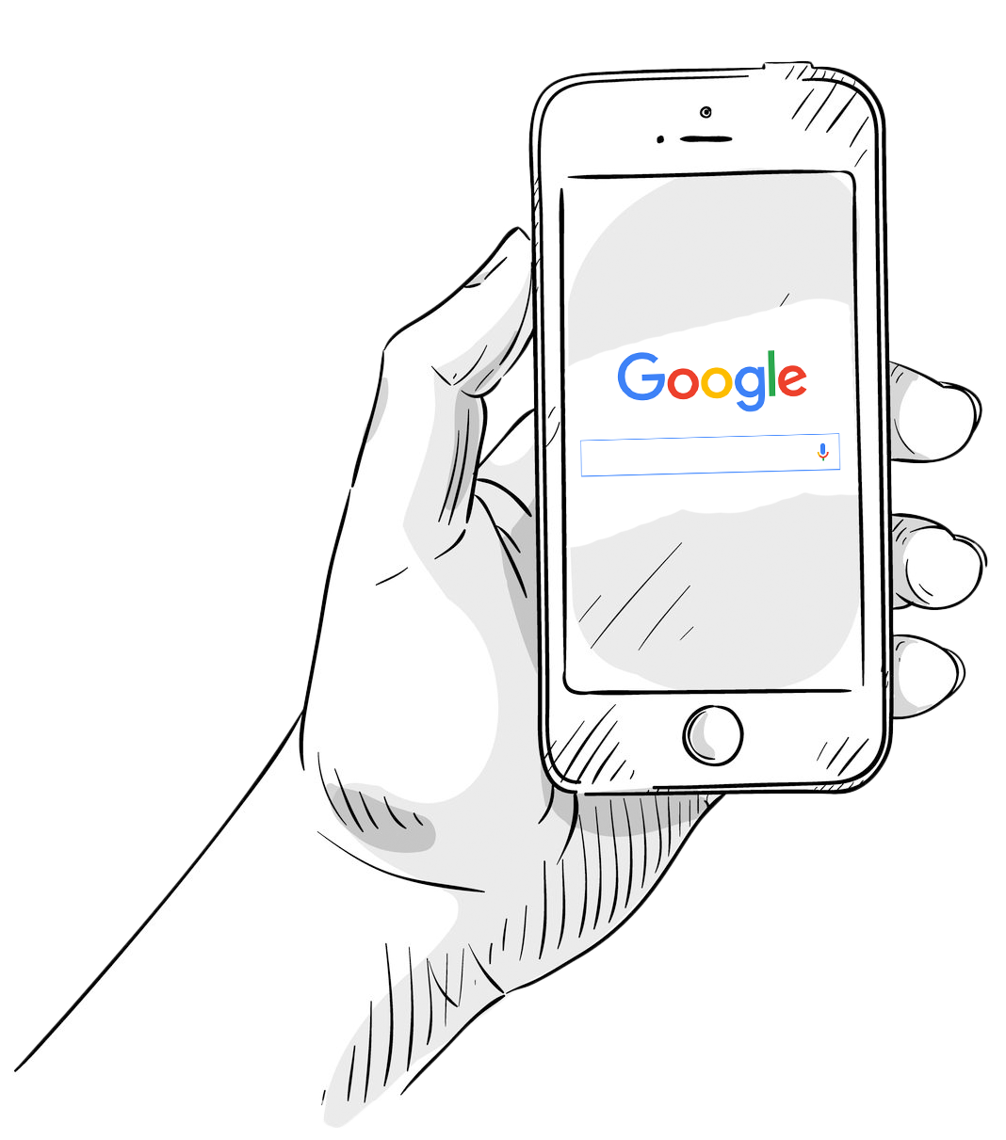
How Marketing has Changed
Exactly how
has marketing
changed?
Notes:
I’d like to talk to you about the state of local marketing. We all know that things have changed!
Thanks to how quickly we can discover information, your customers know way more about your business before they set foot in your front door.

Slide 4
Buying decisions are made online
Buying decisions are made online
93%
Shoppers say they've used online resources
83%
Shoppers who visited a store and used online search before going in
Notes:
This means your customers often know exactly what they want before they visit you.
In 2019, 93% of shoppers say they’ve used online resources (search, video, apps) while 83% of U.S. shoppers who visited a store said they used online search before going in. (Source: Google/Ipsos, Global Retail Study, Feb. 2019)
But, what exactly do I mean by “buying decisions”?

Slide 5
Traditional Buying Model
Traditional buying decision model
Stimulus
First Moment of Truth
Second Moment of Truth
“I’m interested.”
“Take my money.”
“I love / hate this!”
Notes:
Before the internet and mobile devices existed, your customers discovered your business pretty simply!
First, an initial Stimulus would catch the attention of your customer -- something like a radio ad, television spot, or a coupon in the phone book for your business.
Next, if this sparks their interest, they immediately head to your business. They buy the product or service they were interested in, and experience a “First Moment of Truth.”
Then, afterwards, they see if expectations match reality. Did they love their experience? Hate whatever it is they bought? Often, consumers share bad experiences with friends and family; that’s important to keep in mind...

Slide 6
Customer behavior has changed
Customer behavior has changed
Stimulus
First Moment of Truth
Second Moment of Truth
“I’m interested.”
“Take my money.”
“I love / hate this!”
Notes:
… especially because of how things have changed.
People research your business before they enter your front door!

Slide 7
Zero Moment of Truth
The ‘zero-moment-of-truth’
The moment someone decides they want something.
Stimulus
Zero Moment of Truth
First Moment of Truth
Second Moment of Truth
“I’m interested.”
“I want this.”
“Take my money.”
“I love / hate this!”
Contributes to next person’s ZMOT
Notes:
The moment people are making decisions is happening ONLINE. Google calls this the Zero-Moment-Of-Truth. And it’s happening every single day for your business.
Source: https://www.thinkwithgoogle.com/marketing-resources/micro-moments/zero-moment-truth/

Slide 8
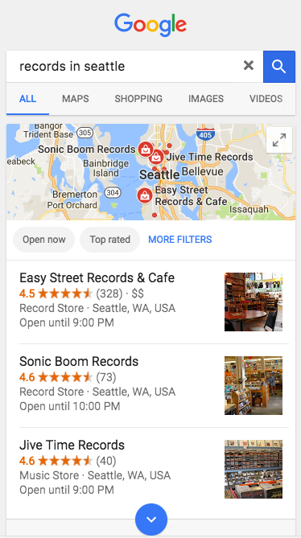
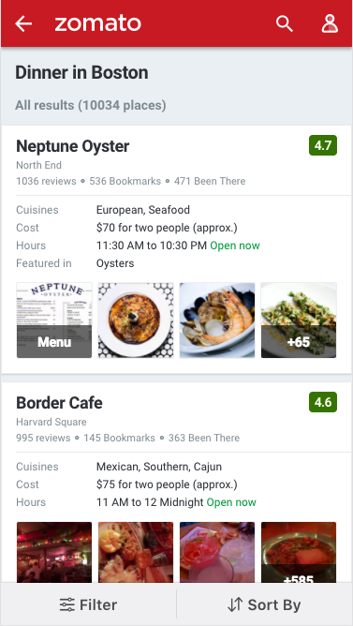
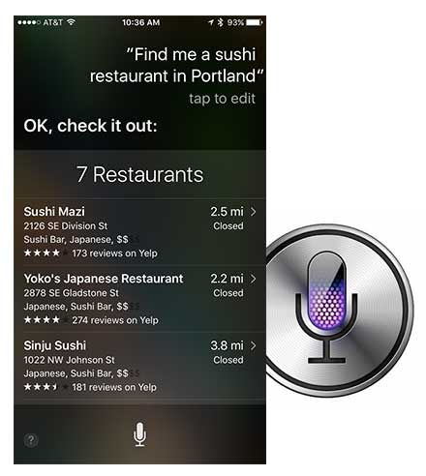
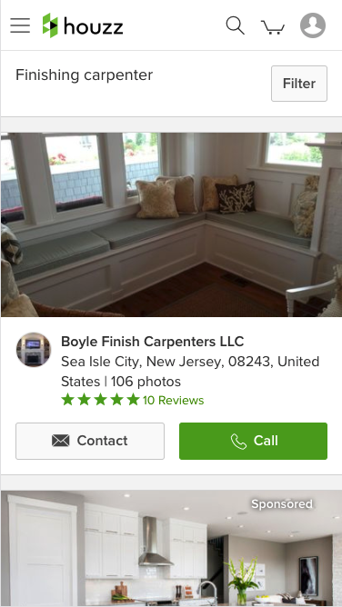
Do you stand out?
Do you stand out where people are making decisions?
93%
Shoppers say they've used online resources
Notes:
Since 93% of shoppers say they use online resources and buying decisions are made at the Zero Moment of Truth, how is your marketing performing?

Slide 9
Customer Journey
Customer Journey
Notes:
The typical customer journey looks like this...

Slide 10
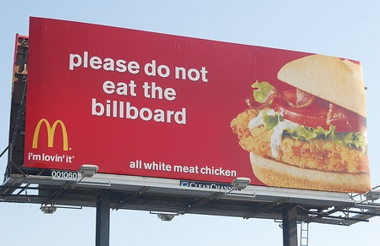
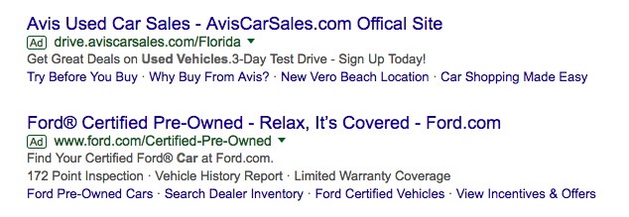
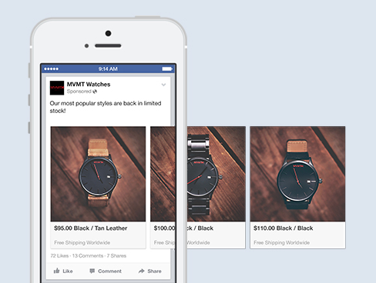
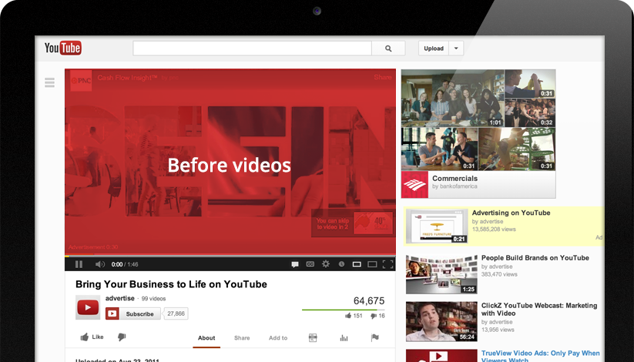
Customer Journey: Awareness
Customer Journey
Generate Interest
Awareness
I’d like to have that.
That looks cool.
I want to know more.
I needed one of those!
Interest & Awareness
Social / Search Advertising
Email / Text Marketing
Loyalty programs
YouTube / Video Ads
Television
Billboard
Online display advertising
Newspaper / Magazine
Radio
Word of mouth
Notes:
It still starts with Interest & Awareness. Television, radio ads, billboard aren’t going away completely… but they’re now being supplemented by digital stimulus. Things like online advertising, email & text marketing, and YouTube video ads.
Question: What things are you currently doing to generate awareness and interest from new & existing clients?

Slide 11
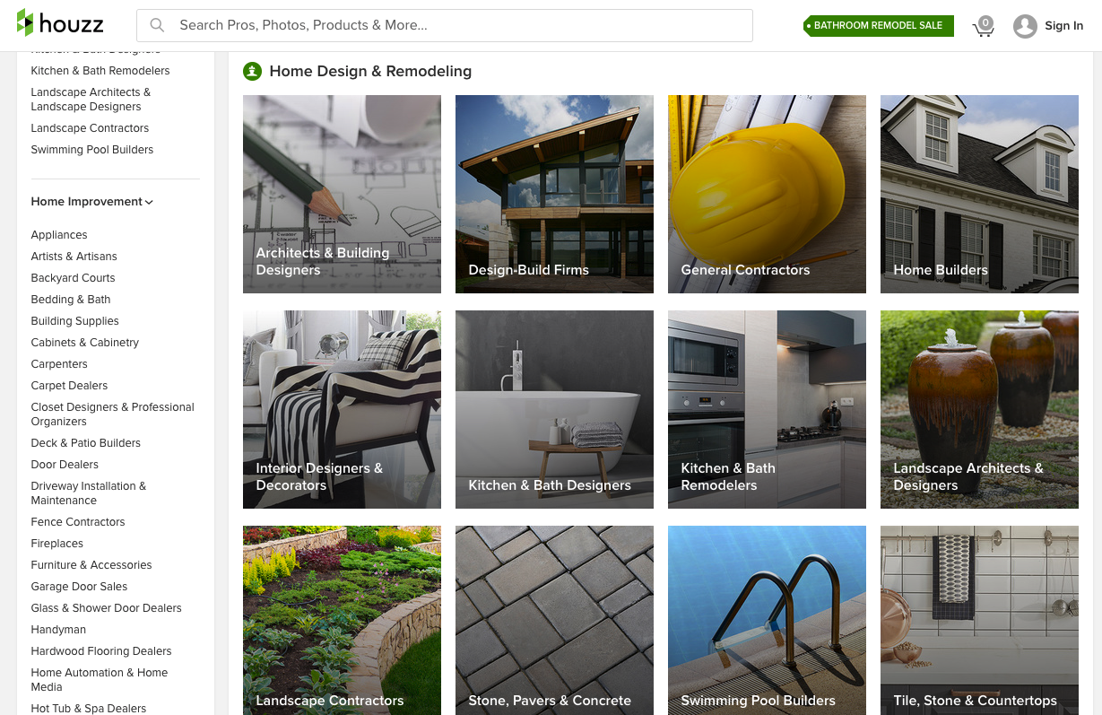
Customer Journey: Findability
Customer Journey
Be Found & Stand Out
Awareness
Findability
“best tacos boston”
“family lawyers in austin”
“record store near me”
“top home builders”
Search
Organic Search
PPC
Maps
Directories
Apps
“Near me”
Notes:
After becoming aware of your business, consumers start discovering more with search.
There are more places than EVER where people are searching for businesses. It’s not just Google either. There are apps, directories, voice search, GPS… lots of places.
Question: Do you know how findable your business is online? What places are you aware of?

Slide 12
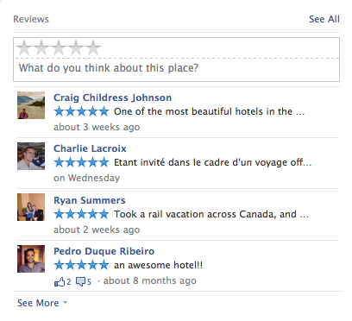
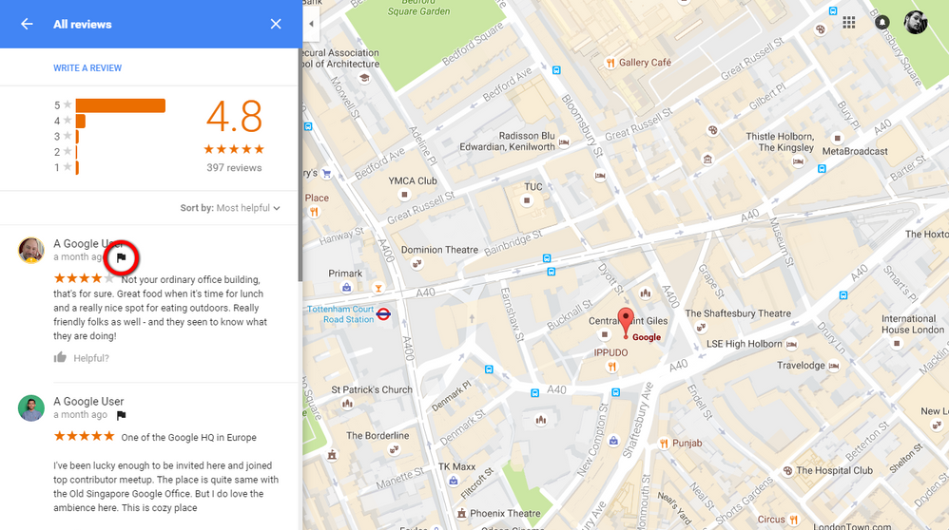
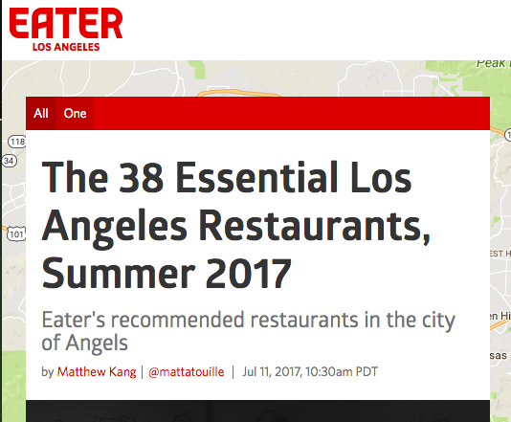
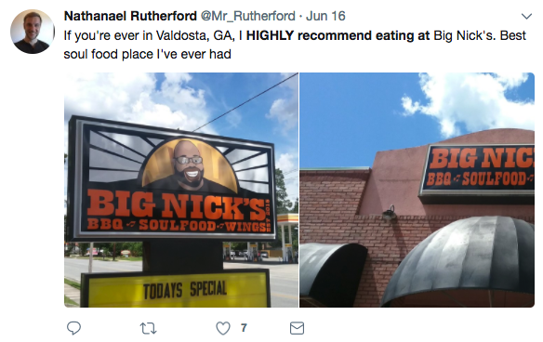
Customer Journey: Reputation
Customer Journey
ZMOT
Be Chosen
Awareness
Findability
Reputation
Research
Blogs & Articles
Reviews
Social Media
Friends and family
This business is popular! They have a lot of reviews, from mostly satisfied customers
Notes:
After finding your business, consumers see your reviews. In fact, it’s often the first thing showcased in Google search result.
When a consumer uses ratings, reviews, and recommendations to help them compare choices, this affects the Zero Moment of Truth – where they choose which business they're going to buy from.
Question: What’s your average review score? Do you have any negative reviews that you’re aware of? How have you taken care of them?

Slide 13
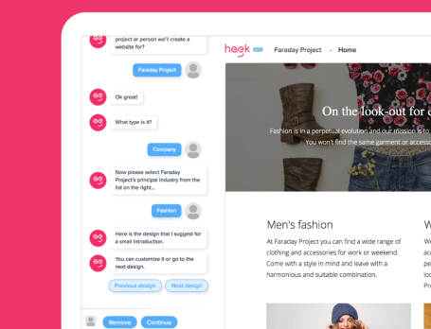
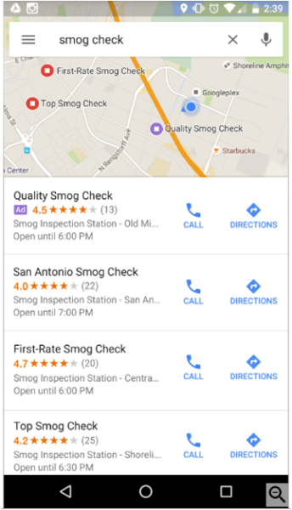
Customer Journey: Conversion
Customer Journey
Make the Sale
Awareness
Findability
Reputation
Conversion
Purchase
Website
App
Online booking
Phone Call
In-store purchase
It’s really easy to book an appointment
Notes:
Next step in the consumer’s journey is finally connecting with your business. Consumers are looking for quick, easy ways to make a booking, make an order, make an appointment, etc.
Question: Is your website making it really easy to convert and for people to become your customer?

Slide 14
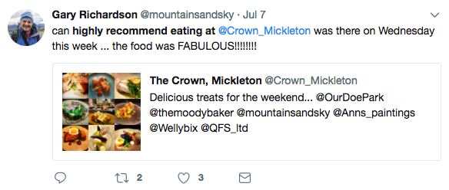
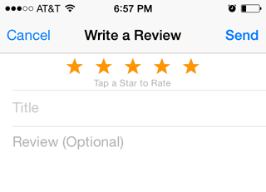
Customer Journey: Advocacy
Customer Journey
Be Talked About
Awareness
Findability
Reputation
Conversion
Advocacy
Experience
Post-purchase expectations vs. reality
Social Post
Write a Review
Discuss with friends
Blog
Quick, skilled service. You should really check them out.
Notes:
Finally, it’s important to do everything you can to encourage happy customers to return again, and tell other about you.
Let them know to write you a review, post on social media, and of course, invite them back.

Slide 15
Customer Journey: Channel Impact
Channels impacting your Customer’s Journey
Contributes to next person’s decision
Awareness
Findability
Reputation
Conversion
Advocacy
Stimulus
Social / search advertising
Email / text marketing
Loyalty programs
YouTube / Video ads
Television
Billboard
Online display advertising
Newspaper / Magazine
Radio
Word of mouth
Search
Organic Search
PPC
Maps
Directories
Apps
“Near me”
GPS
Research
Blogs & Articles
Reviews
Social Media
Word of mouth
Purchase
Website
Online booking
Purchase via app
In-store purchase
Salesperson
Marketing Materials
Experience
Post-purchase expectations vs. reality
Social Post
Write a Review
Blog
Word of mouth
Notes:
So here are all the channels, both traditional and digital, that can influence potential customers… [NEXT SLIDE]

Slide 16
Win each stage
It’s important to win in each stage.
Notes:
… and, it’s important to win in each stage.

Slide 17
Customer Journey: Business A vs B
Marketing for the competition
Stimulus
Search
Research
Purchase
Experience
Business A
Awareness
Findability
Reputation
Conversion
Advocacy
Oye, some bad reviews.
...this other business has 4.5 stars
Business B
Awareness
Findability
Reputation
Conversion
Advocacy
Notes:
Here’s the kicker. Let’s say the consumer is making their way along the funnel for business A.
They became interested after seeing a Facebook ad, then looked up that business and found them... but there were multiple negative Google reviews that hadn’t been responded to. Now, they likely won’t trust this business!
What does this consumer do? Well, since they’re already well into their research stage, it’s very likely that they’ll go directly to the next stage but with a competitor! [NEXT SLIDE]

Slide 18
Customer Journey: Business A vs B
Marketing for the competition
Stimulus
Search
Research
Purchase
Experience
Business A
Awareness
Findability
Reputation
Business B
Awareness
Findability
Reputation
Conversion
Advocacy
Notes:
This means that business A’s marketing and advertising dollars pushed that consumer directly into the hands of their competition, and further down the funnel which increases the chance of a sale!
A sale, and loyal customer, for the competitor!

Slide 19
Use your competitor’s marketing
The easiest & fastest way to increase your marketing budget is to use your competitor’s.
Notes:
The opposite is also true. By ensuring that your business can be found, trusted and liked, you can have your competitor’s advertising dollars work for you!
The fastest way to increase your business’ budget is to use someone else’s.

Slide 20
Where to Start?
Where is the smartest place to start?
Notes:
So… now I hopefully have you thinking, and excited to take action.
There’s a lot of different places to start – question is, what’s the smartest place to start?

Slide 21
3 Key Focus Areas
3 Key Focus Areas
Contributes to next person’s decision
Awareness
Findability
Reputation
Conversion
Advocacy
1
2
2
3
Notes:
Here’s the logical order of operations in local business marketing.
Make sure your conversion point is fantastic and well tuned. For most businesses, this is your website.
Next, focus on being influential at the zero-moment-of-truth, with listings & reputation.
Finally, increase interest and awareness with digital advertising.

Slide 22
How are you Performing?
How are you performing?
1
Conversion
2
Search Presence
3
Awareness
Notes:
With that said, let’s review your snapshot report together, and discover how you’re performing at these different key areas of focus.
OPEN THE SNAPSHOT REPORT. Review with the business the different grades along the top.
E.g. 1. Your website is doing pretty good 2. You’re not showing up on a bunch of listing sites, and you need more reviews 3. You could take advantage of new advertising strategies. Let’s look at some strategies around your wants and needs specifically… [Pick and choose from the following slides to show a solution to their specific requests and needs.]

Slide 23
Recommended Strategies
Recommended Strategies
Notes:
[Discuss a recommended strategy (or package) that will potentially solve this client’s needs and wants.]

Slide 24
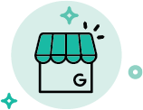
Getting Started: Competitive
START YOUR
DIGITAL MARKETING
JOURNEY
Competitive
Managed Reputation Listing Sync Pro
2 weekly social posts on one platforms of your choice. Choose from Facebook, Instagram, LinkedIn, Twitter, and Google My Business.
GMB Claim & Verification with on-going optimizations and 1 monthly GMB post.
Business Center Including : Listing Builder & Distribution, Reputation Management, Social Marketing, Customer Voice and Executive Reporting
Fully manage your digital marketing strategies with DIY tools.
Control the accuracy of your business listings across Google with Google My Business verification.
Save time and improve performance with our fully managed services, including social posting and digital advertising.
78% of location-based mobile searches result in an offline purchase.
Local searches lead 50% of mobile users to visit businesses within 1 day.
SETUP
$99
MONTHLY
$499
Notes:
1. 78% of location-based mobile searches result in an offline purchase (Junto, 2019)
2. Local searches lead 50% of mobile users to visit businesses within 1 day. (Google, 2018)

Slide 25
Getting Started: Advantage
START YOUR
DIGITAL MARKETING
JOURNEY
Advantage
SEO 10 Hours
Google Ads campaign
Managed review responses & Listing Sync Pro
2 weekly social posts on the platforms of your choice
GMB Claim & Verification with on-going optimizations and 1 monthly GMB post.
Business Center Including : Listing Builder & Distribution, Reputation Management, Social Marketing, Customer Voice and Executive Reporting
Fully manage your digital marketing strategies with DIY tools.
Control the accuracy of your business listings across Google with Google My Business verification.
Save time and improve performance with our fully managed services, including social posting and digital advertising.
78% of location-based mobile searches result in an offline purchase.
Local searches lead 50% of mobile users to visit businesses within 1 day.
SETUP
$299
MONTHLY
$2010
Notes:
1. 78% of location-based mobile searches result in an offline purchase (Junto, 2019)
2. Local searches lead 50% of mobile users to visit businesses within 1 day. (Google, 2018)

Slide 26
Social Optimization: Competitive
OPTIMIZE YOUR
SOCIAL
COMMUNITY
Competitive
2 weekly posts on the platforms of your choice. Choose from Facebook, Instagram, LinkedIn, Twitter, or GMB.
A monthly budget of $30 for Facebook post boosting.
Business Center Including : Listing Builder & Distribution, Reputation Management, Social Marketing
Leverage your existing efforts to build your brand and drive better results.
Target your audience with precision using built-in customer insights.
Turn social media into a revenue-generating machine for your business.
97% of marketers are using social media to reach their audiences.
86% of consumers prefer an authentic and honest brand personality on social networks.
SETUP
$299
MONTHLY
$350
Notes:
1. 97% of marketers are using social media to reach their audiences. (Lyfe Marketing, 2018)
2. 86% of consumers prefer an authentic and honest brand personality on social networks. (Smart Insights, 2017)

Slide 27
Social Optimization: Advantage
OPTIMIZE YOUR
SOCIAL
COMMUNITY
Advantage
2 weekly posts on the platforms of your choice. Choose from Facebook, Instagram, LinkedIn, Twitter, or GMB.
A monthly budget of $30 for Facebook post boosting.
A monthly blog post created by our dedicated team of writers.
Business Center Including : Listing Builder & Distribution, Reputation Management, Social Marketing
Leverage your existing efforts to build your brand and drive better results.
Target your audience with precision using built-in customer insights.
Turn social media into a revenue-generating machine for your business.
97% of marketers are using social media to reach their audiences.
86% of consumers prefer an authentic and honest brand personality on social networks.
SETUP
$499
MONTHLY
$499
Notes:
1. 97% of marketers are using social media to reach their audiences. (Lyfe Marketing, 2018)
2. 86% of consumers prefer an authentic and honest brand personality on social networks. (Smart Insights, 2017)

Slide 28
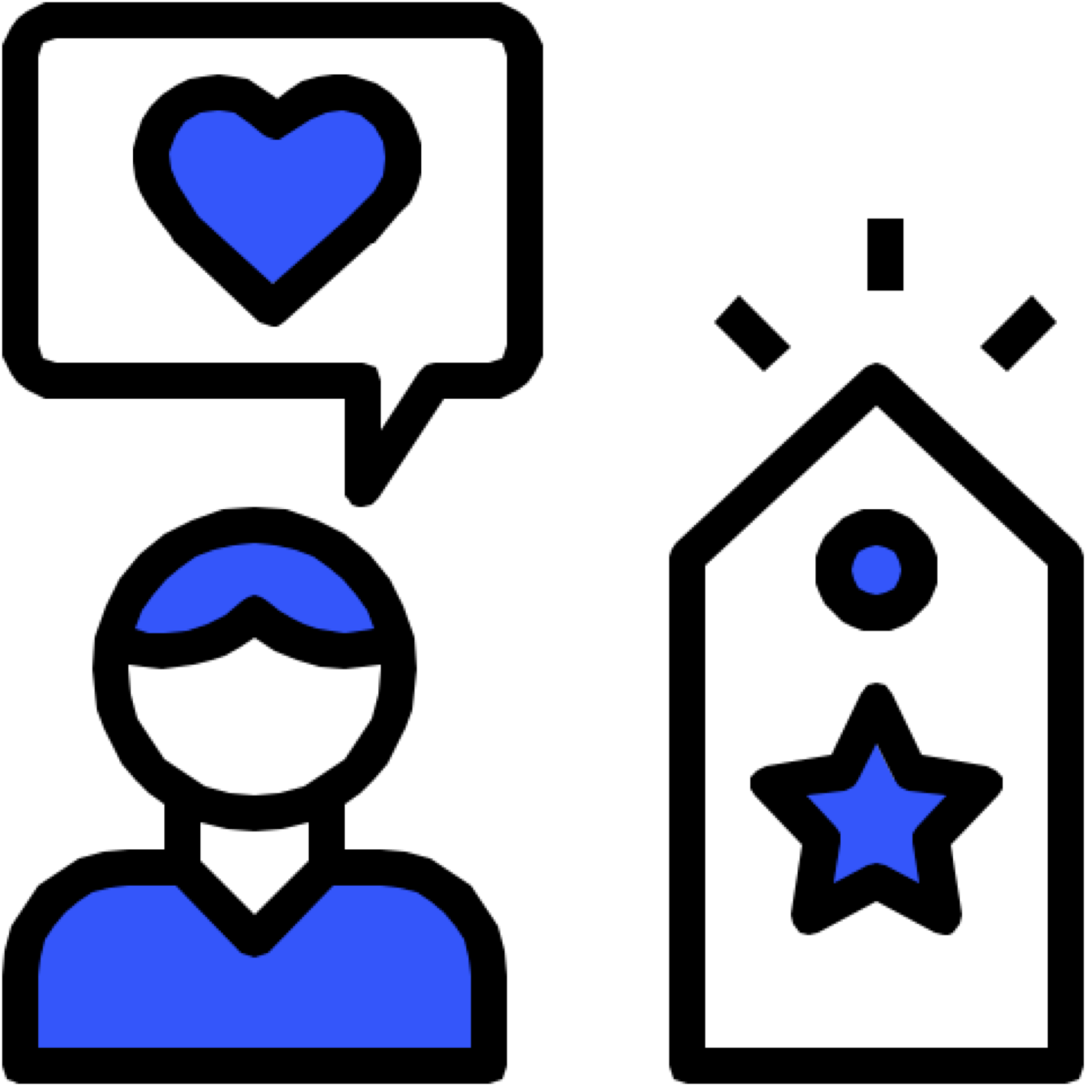
Presence Builder: Competitive
REINFORCE YOUR
ONLINE
PRESENCE
Competitive
Google My Business Posts: 4x Month Managed Google Search Ads
Listing Sync Pro
Business Center Including : Listing Builder & Distribution, Reputation Management, Social Marketing, Customer Voice and Executive Reporting
Drive awareness to give your business more exposure in your local area.
Capitalize on your in-market audience that is actively searching for your services.
Engage prospects where they spend their time across all available channels.
86% of consumers rely on the internet to find a local business.
97% of search engine users searched online to find a local business.
SETUP
$99
MONTHLY
$585
Notes:
1. 86% of consumers rely on the internet to find a local business. (SocialMediaToday, 2019)
2. 97% of search engine users searched online to find a local business. (SocialMediaToday, 2019)

Slide 29
Presence Builder: Advantage
REINFORCE YOUR
ONLINE
PRESENCE
Advantage
Fully managed SEO program 10 hours monthly
Google My Business Posts: 4x Month Managed Google Search Ads
Listing Sync Pro
Business Center Including : Listing Builder & Distribution, Reputation Management, Social Marketing, Customer Voice and Executive Reporting
Drive awareness to give your business more exposure in your local area.
Capitalize on your in-market audience that is actively searching for your services.
Engage prospects where they spend their time across all available channels.
86% of consumers rely on the internet to find a local business.
97% of search engine users searched online to find a local business.
SETUP
$99
MONTHLY
$1100
Notes:
1. 86% of consumers rely on the internet to find a local business. (SocialMediaToday, 2019)
2. 97% of search engine users searched online to find a local business. (SocialMediaToday, 2019)

Slide 30
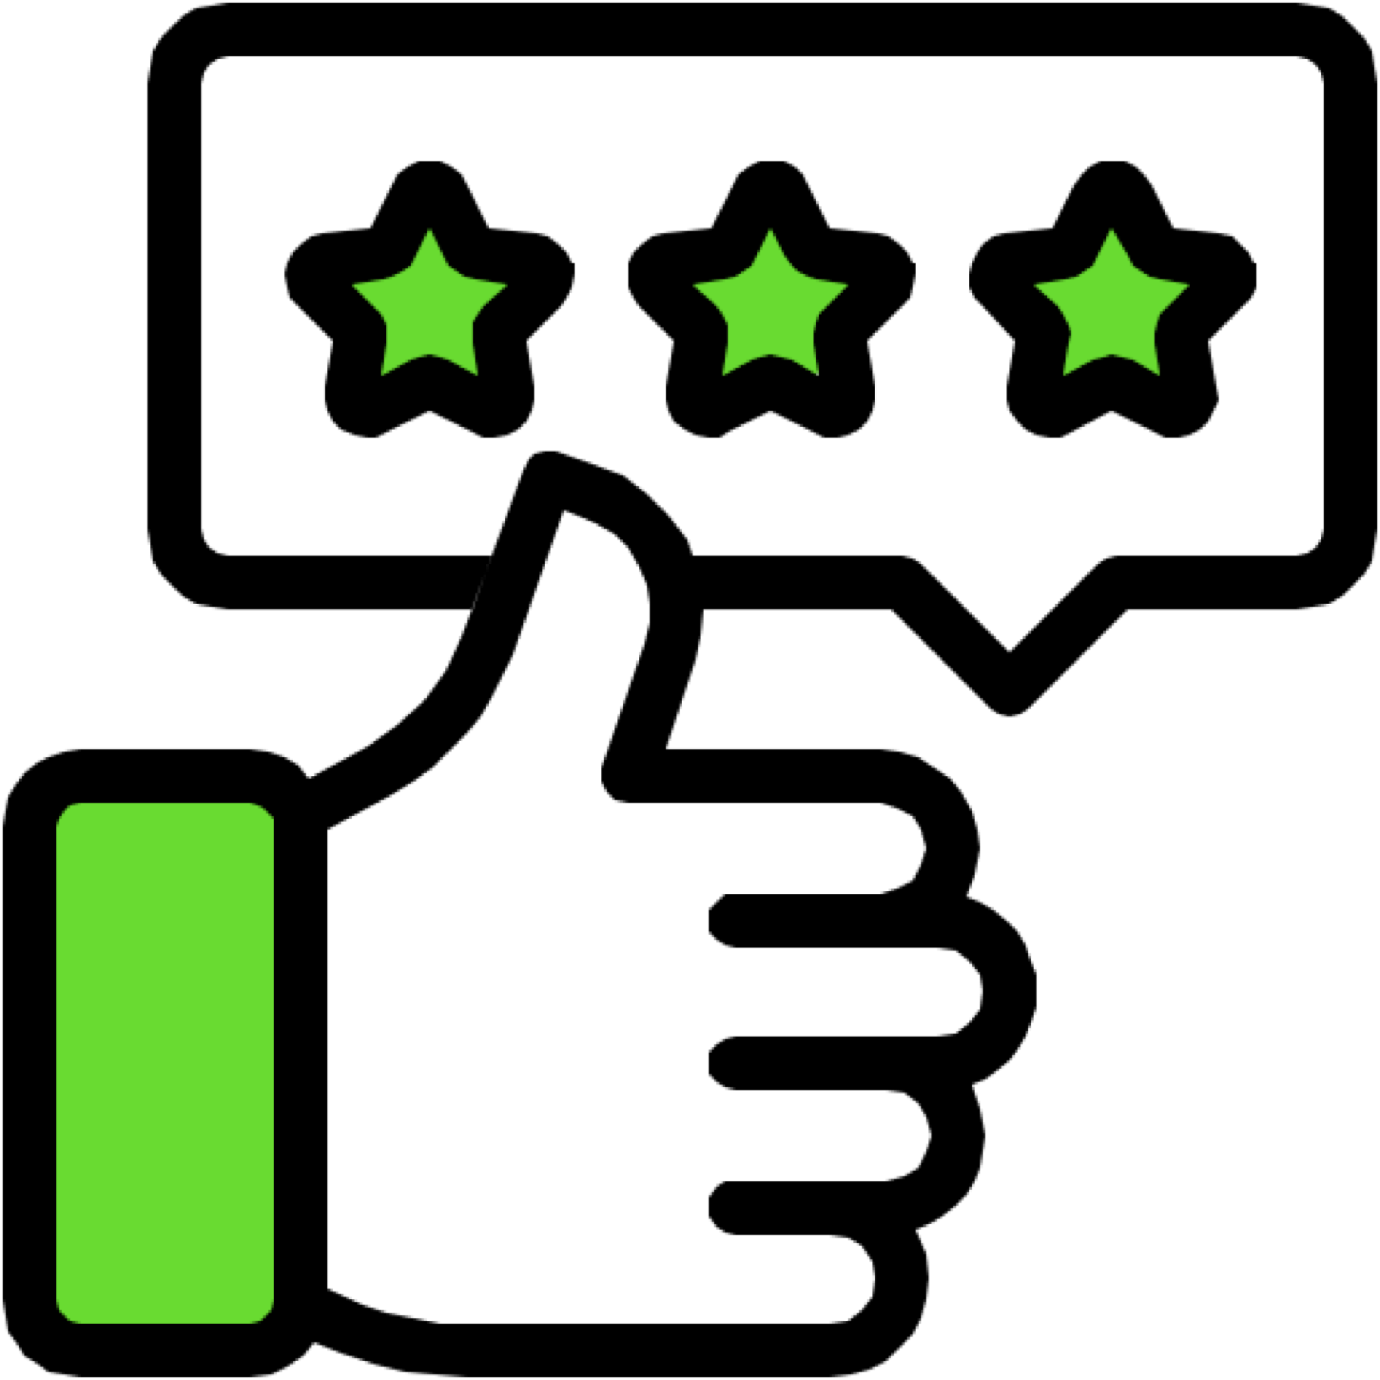
Business Reputation: Competitive
MONITOR & MANAGE YOUR
ONLINE
REPUTATION
Competitive
Professionally Managed review responses
Professionally Managed review requests
Supercharged 2x review scanning
widget to display reviews from trusted sources on your website
Business Center Including : Listing Builder & Distribution, Reputation Management, Social Marketing, Customer Voice and Executive Reporting
Stay on top of the online activity affecting your business reputation.
Generate more revenue by influencing the consumer decision process.
Engage prospects in conversation through professionally managed services.
86% of consumers read reviews for local businesses.
Consumers read an average of 10 online reviews before feeling able to trust a local business.
SETUP
$0
MONTHLY
$490
Notes:
1. 86% of consumers read reviews for local businesses. (BrightLocal, 2019)
2. Consumers read an average of 10 online reviews before feeling able to trust a local business. (BrightLocal, 2019)

Slide 31
Business Reputation: Advantage
MONITOR & MANAGE YOUR
ONLINE
REPUTATION
Advantage
Monthly Blog Post + Email Campaign Management + 1 Monthly Email Campaign Creation + Story Tap User Generate Video + Reviews Starter
Professionally Managed review responses
Professionally Managed review requests
Supercharged 2x review scanning
Widget to display reviews from trusted sources on your website
Business Center Including : Listing Builder & Distribution, Reputation Management, Social Marketing, Customer Voice and Executive Reporting
Stay on top of the online activity affecting your business reputation.
Generate more revenue by influencing the consumer decision process.
Engage prospects in conversation through professionally managed services.
86% of consumers read reviews for local businesses.
Consumers read an average of 10 online reviews before feeling able to trust a local business.
SETUP
$0
MONTHLY
$1280
Notes:
1. 86% of consumers read reviews for local businesses. (BrightLocal, 2019)
2. Consumers read an average of 10 online reviews before feeling able to trust a local business. (BrightLocal, 2019)

Slide 32
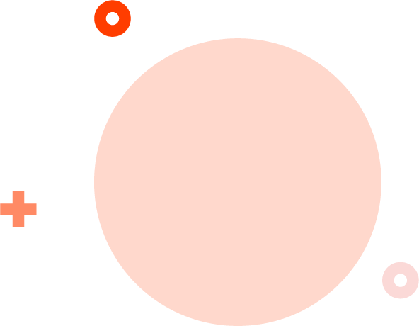
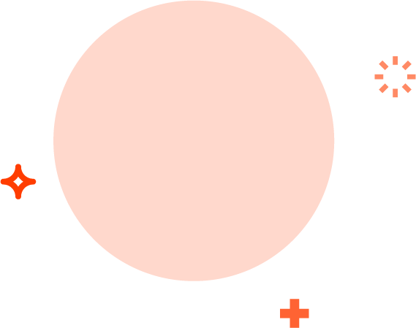
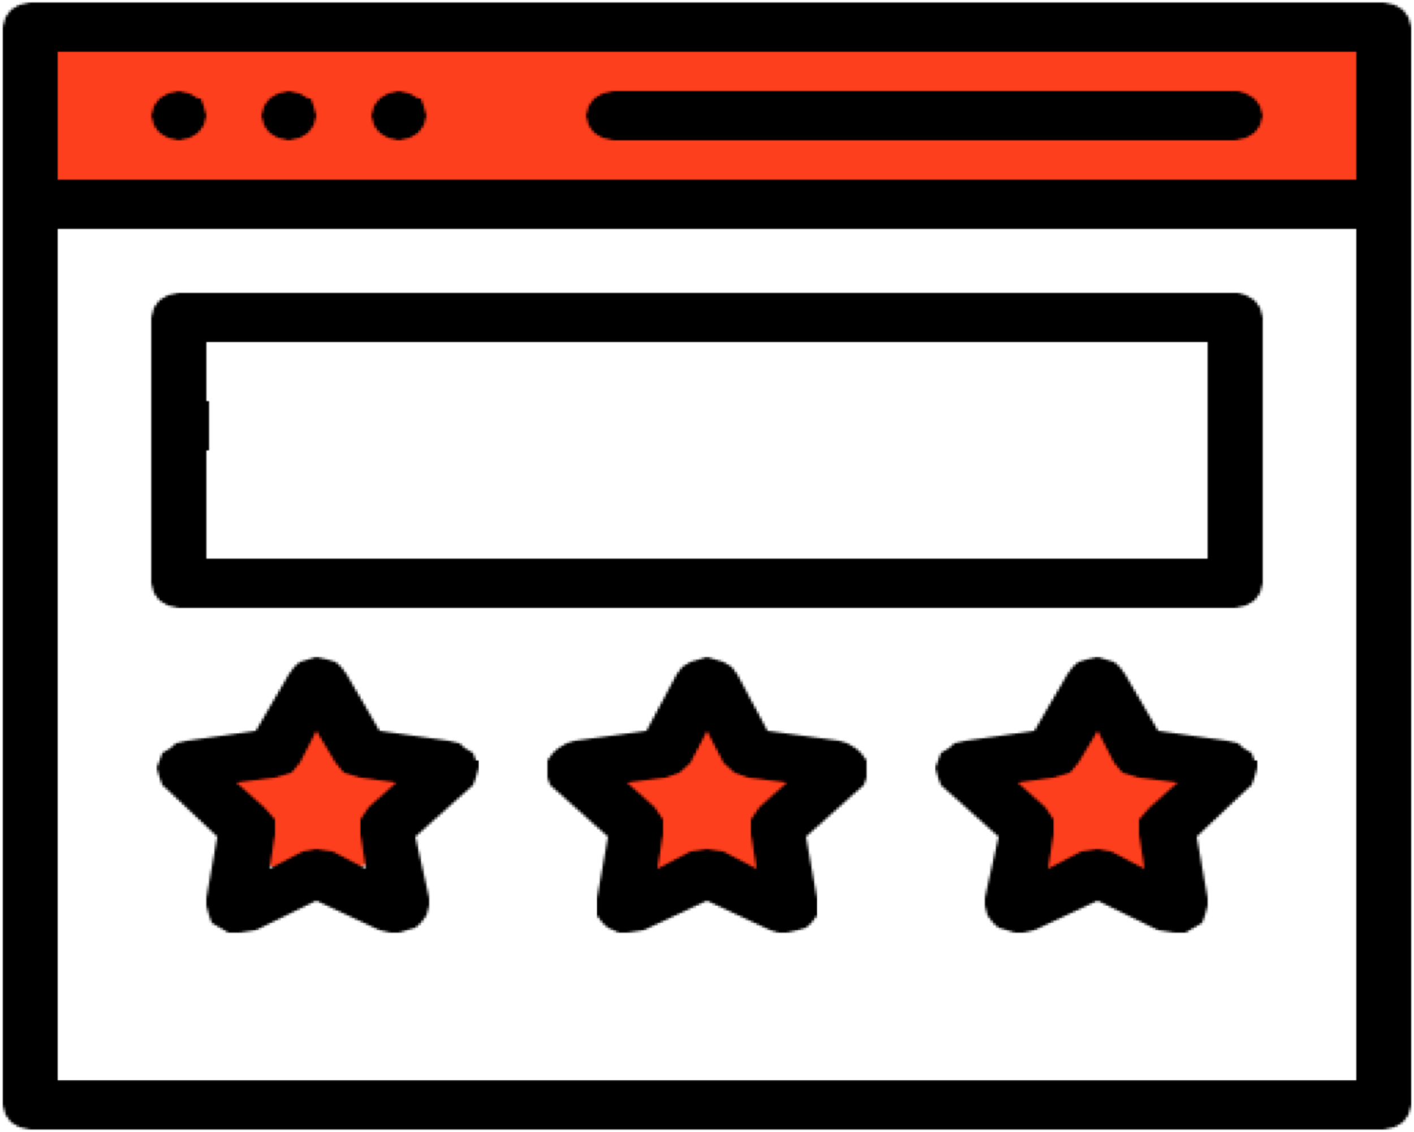
Web Essentials: Competitive
MASTER THE
WEBSITE
ESSENTIALS
Competitive
10-15 Custom Built Pages With Call To Actions
Professionally designed mobile first (5 Page) website. Includes website maintenance and management hosted on a secure cloud
Business Center Including : Listing Builder & Distribution, Reputation Management
Custom-built websites, designed to perform.
Website maintenance and management.
Mobile and performance optimized features.
Mobile websites that load in 5 seconds or less will end in a viewing session that’s 70% longer than their slower counterparts.
61% of mobile searchers are more likely to contact a local business if they have a mobile-friendly site.
SETUP
$800
MONTHLY
$199
Notes:
1. Mobile websites that load in 5 seconds or less will end in a viewing session that’s 70% longer than their slower counterparts. (Google, 2017)
2. 61% of mobile searchers are more likely to contact a local business if they have a mobile-friendly site. (Junto, 2019)

Slide 33
Web Essentials: Advantage
MASTER THE
WEBSITE
ESSENTIALS
Advantage
15+ custom built pages optimized for lead conversions
Additional 5 pages focused on your specific products or services which is better for SEO.
Professionally designed mobile website. Includes website maintenance and management hosted on a secure cloud
Business Center Including : Listing Builder & Distribution, Reputation Management
Custom-built websites, designed to perform.
Website maintenance and management.
Mobile and performance optimized features.
Mobile websites that load in 5 seconds or less will end in a viewing session that’s 70% longer than their slower counterparts.
61% of mobile searchers are more likely to contact a local business if they have a mobile-friendly site.
SETUP
$1000
MONTHLY
$249
Notes:
1. Mobile websites that load in 5 seconds or less will end in a viewing session that’s 70% longer than their slower counterparts. (Google, 2017)
2. 61% of mobile searchers are more likely to contact a local business if they have a mobile-friendly site. (Junto, 2019)

Slide 34
When can we Start?
When can we start?
Notes:
There’s a lot we can do for you. Think of all these strategies like a firehose. We could turn them on slowly, or we can crank them all the way open. You let me know where you’d like to start, and what your budget is, and we’ll craft a plan that solve the most important points first, and makes really good use of your spend.

Slide 35
Share Knowledge & Strategies
Sign into
Business Center together:
↗ URL-HERE.smblogin.com
Notes:
Let me show you how to keep an eye on your score, and learn how to improve it. [Show them how to Sign into Business Center on their computer / device.]
Show off LMI score, articles pertaining to their concerns.
Show off Reputation & Listing products that are enabled by default.

Slide 36
What we need from you to begin
Current complete address and contact information
Business gmail address & password (Google My Business)
Be made an administrator of your Facebook page (or share email and password)
Social media logins

Slide 37
Thank you.
Noah Moss
Senior Digital Strategist
812-631-3585 noah@vivabove.com

