Slide 1

Understanding The Aging Brain
Rene Colorado, MD, PhD
Medical Director, Stroke Center

Slide 2
[OUTLINE]
Dementia and mild cognitive impairment
Detection of dementia
Common causes of dementia
Risk factors for cognitive decline & dementia
How to prevent dementia
QUESTIONS

Slide 3
Notes:
In December 2013, the G8 nations—Canada, France,
Germany, Italy, Japan, Russia, the United Kingdom, and
the United States—created the World Dementia Council
(WDC) [3] to provide global advocacy and leadership on
key dementia challenges

Slide 4
[Main conclusions: ]
47 mill with dementia, projected to triple 2050
No disease-modifying treatments
Emphasis on reducing risk
Enough evidence to conclude: (1) regular exercise and (2) reduction of vascular risk factors reduce risk of cognitive decline and may reduce risk of dementia
Healthy diet and lifelong learning may also reduce risk of cognitive decline
Notes:
An estimated 47 million people worldwide are living with dementia in 2015, and this number is
projected to triple by 2050. In the absence of a disease-modifying treatment or cure, reducing the risk
of developing dementia takes on added importance. In 2014, the World Dementia Council (WDC)
requested the Alzheimer’s Association evaluate and report on the state of the evidence on modifiable
risk factors for cognitive decline and dementia. This report is a summary of the Association’s evaluation,
which was presented at the October 2014 WDC meeting. The Association believes there is
sufficient evidence to support the link between several modifiable risk factors and a reduced risk
for cognitive decline, and sufficient evidence to suggest that some modifiable risk factors may be
associated with reduced risk of dementia. Specifically, the Association believes there is sufficiently
strong evidence, from a population-based perspective, to conclude that regular physical activity and
management of cardiovascular risk factors (diabetes, obesity, smoking, and hypertension) reduce the
risk of cognitive decline and may reduce the risk of dementia. The Association also believes there is
sufficiently strong evidence to conclude that a healthy diet and lifelong learning/cognitive training
may also reduce the risk of cognitive decline.

Slide 5
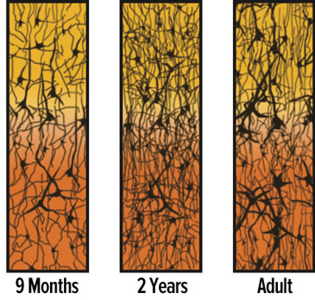
[What happens to the brain with aging?]
Loss of brain volume
Loss of brain cells and components
Accumulation of proteins (NF tangles and amyloid)
Loss of function in multiple domains
Notes:
Brain Aging
Characteristics of brain aging is loss of brain volume (white matter > gray matter) especially in the hippocampus and frontal lobes; loss of myelin; synapses and the dendritic arbor; cystoskeletal changes (accumulation of neurofibrillary tangles and deposition of amyloids in brain and blood vessels). Infarcts of various sizes and other evidence of cerebrovascular disease
Aging is associated with progressive losses in function across multiple systems (sensation, cognition, memory, motor control and affect) and they occur with increasing age

Slide 6
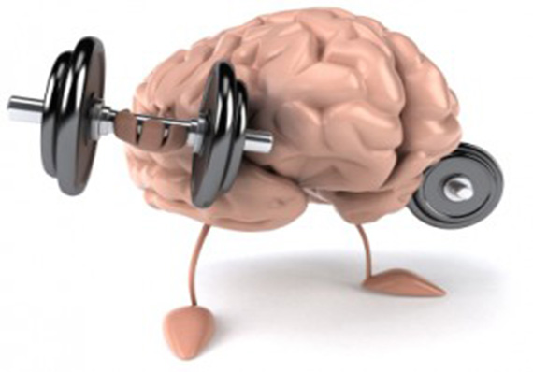
[Healthy brain aging ]
Maintenance/improvement of cognitive performance
Ability to make decisions and remain independent
Avoidance of disease and disability by maintenance of physical, cognitive and social engagement
Notes:
Healthy Brain Aging
Maintenance or improvement of cognitive performance
Larger brain and hippocampal volumes were associated with preserved cognitive function
Ability to make decisions and remain independent
Avoidance of disease and disability by maintenance of physical, cognitive and sustained social engagement
Erten- Lyons D, et al. Neurology 2009; 72 (4):354-360
Rowe JW, Kahn RL, Gerontologist 37 (4):433-440, 1997

Slide 7
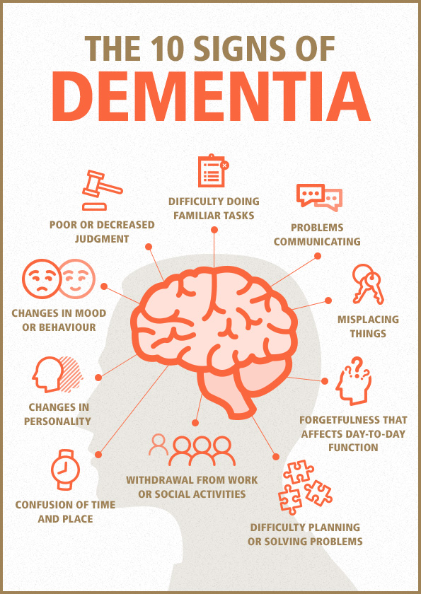
[What is dementia?]
Impairment of cognition typically in multiple domains
Severe; interferes with function/independence
Expected to rise

Slide 8
[What is mild cognitive impairment?]
Mild cognitive deficits not severe enough
Precursor to dementia
Important to recognize early
Important to recognize treatable conditions

Slide 9
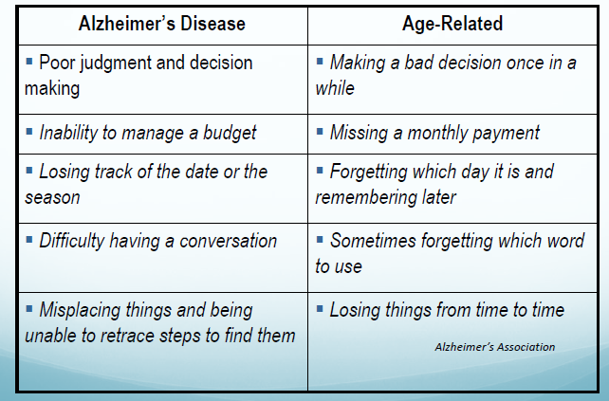

Slide 10
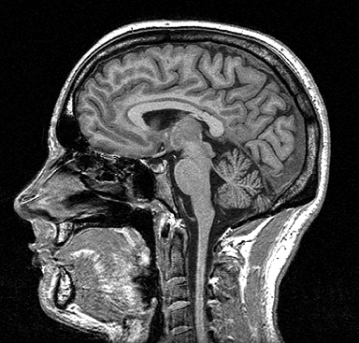
[What test are there to detect dementia?]
No test that can diagnose it
Detailed evaluation by physician
MOCA, MMSE, neuropsych test
Complimentary:
Neuroimaging
Blood tests: B12, thyroid function, others

Slide 11
[What causes dementia?]
MAJOR CAUSES:
Alzheimer disease
Cerebrovascular disease
Others: substance use, brain tumors, thyroid disease, other neurodegenerative diseases

Slide 12
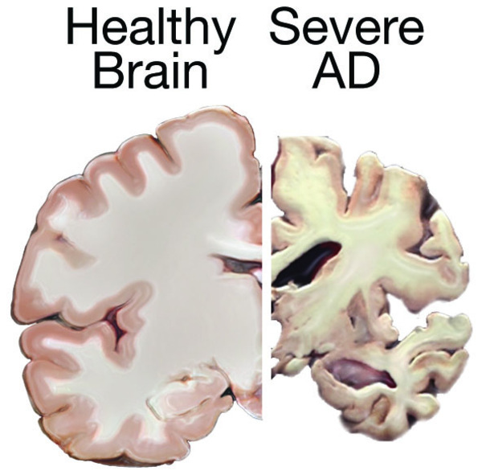
[Alzheimer Disease ]
- 5.3 million Americans have AD
- By 2021, expected increase to 7.5- 9 mill. By 2051, 12.6-16 mill.
- 66% of dementias in older adults
- 33-50% of people > 85 have AD
- Women account for 66%
- AD develops over decades

Slide 13

[Vascular dementia and strokes ]
Dementia after multiple strokes
Few large strokes, multiple small stroke, strokes in strategic places
Strong relationship to cardiovascular risk factors

Slide 14
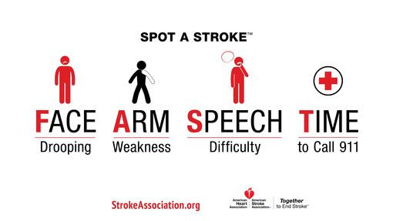
F. A. S. T.

Slide 16
[Combined causes of dementia is common]
Viswanathan, et al., Neurology 2009
80% of all cases of dementia
Notes:
Both vascular and degenerative mechanisms often contribute to dementia development in older adults

Slide 17
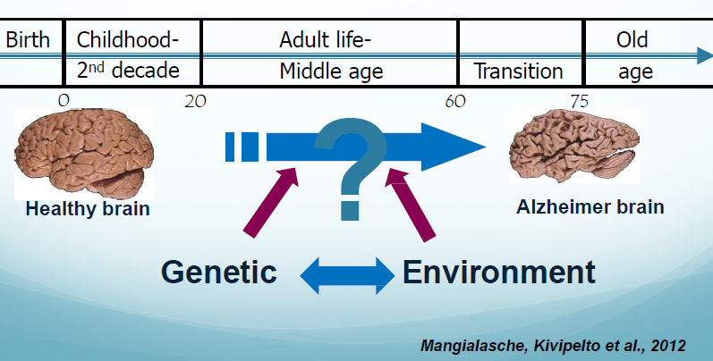
Dementia and lifelong espouse to multiple factors
Notes:
Cognitive decline, dementia and AD: role of life-long exposure to multiple

Slide 18
[non-modifiable risks factors]
Strongest risk factors
Age
strongest risk factor (exponential increase)
Genetics
ApoE e4 allele for later onset, early-onset genes
Family history
Nonmodifiable by medical interventions or individual behavior

Slide 19
[modifiable risks factors]
Cardiometabolic
Diabetes, hypertension, smoking
Strongest association in mid-life not late life
ADDITIVE
Lifestyle:
Physical activity, alcohol, sleep, obesity, diet, TBI

Slide 20
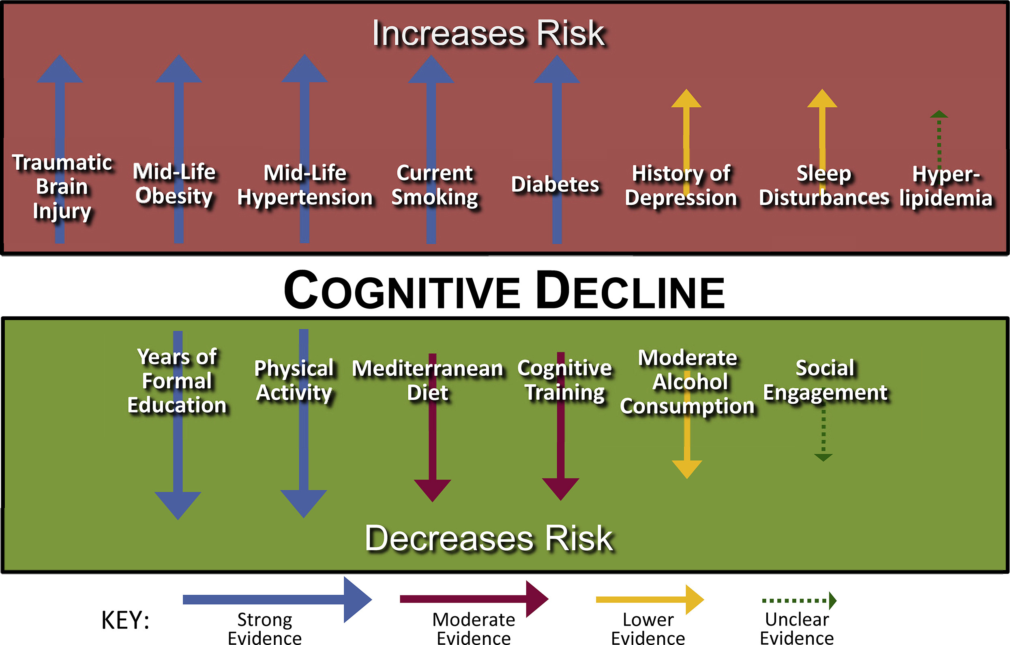

Slide 21
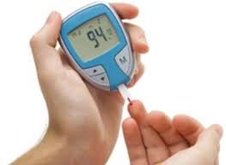
[Diabetes mellitus]
1.5-2-fold increase in risk of cognitive decline and dementia
Present for both VascD and AD
May be higher for VascD
Hga1c (long-term DM control) inversely correlated to cognitive measures
Worse control -> greater cognitive decline
Notes:
Further, a recent meta-analysis demonstrated that
individuals with mild cognitive impairment (MCI) and diabetes
were more likely to progress to dementia than individuals
with MCI and no diabetes [27]. Some evidence suggests
diabetes increases dementia risk not only through vascular
pathways but also through interactions of other biological
mechanisms related to diabetes itself

Slide 22

[Mid-life hypertension (high blood pressure)]
May be most important
About 1.5 increase risk of dementia when mid-life
Numerus mechanisms
Multi-infarct dementia
Increases also risk of stroke
Notes:
Meta-analyses of clinical trials and prospective, observational,
longitudinal, and cross-sectional studies, including a
Cochrane review, have not indicated a consistent relationship
between high blood pressure and dementia; there is stronger
evidence for a link with cognitive decline [43–47]. A
systematic review of meta-analyses, observational studies,
and randomized controlled trials found treatments of hypertension
may reduce the risk of cognitive decline [48]; a metaanalysis
of longitudinal studies concluded the opposite [49].
Similar to data on the link between obesity and cognitive
decline/dementia, studies demonstrate that later-life hypertension
may be protective against cognitive decline

Slide 23
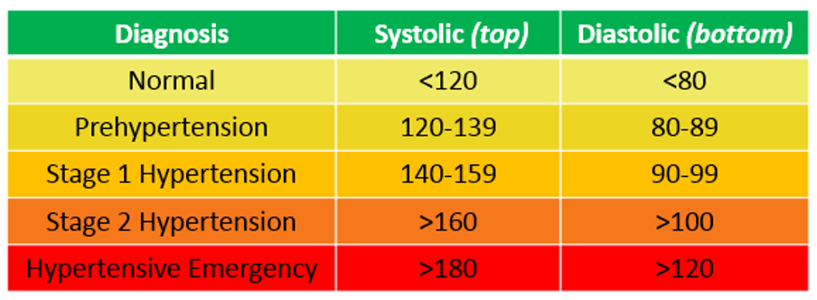
[Stages of hypertension ]
Elevated BP
Notes:
Meta-analyses of clinical trials and prospective, observational,
longitudinal, and cross-sectional studies, including a
Cochrane review, have not indicated a consistent relationship
between high blood pressure and dementia; there is stronger
evidence for a link with cognitive decline [43–47]. A
systematic review of meta-analyses, observational studies,
and randomized controlled trials found treatments of hypertension
may reduce the risk of cognitive decline [48]; a metaanalysis
of longitudinal studies concluded the opposite [49].
Similar to data on the link between obesity and cognitive
decline/dementia, studies demonstrate that later-life hypertension
may be protective against cognitive decline

Slide 24
[Stages of hypertension ]
Elevated BP
120-129
<80
130- 139
80-89
> 140
> 90
Notes:
Meta-analyses of clinical trials and prospective, observational,
longitudinal, and cross-sectional studies, including a
Cochrane review, have not indicated a consistent relationship
between high blood pressure and dementia; there is stronger
evidence for a link with cognitive decline [43–47]. A
systematic review of meta-analyses, observational studies,
and randomized controlled trials found treatments of hypertension
may reduce the risk of cognitive decline [48]; a metaanalysis
of longitudinal studies concluded the opposite [49].
Similar to data on the link between obesity and cognitive
decline/dementia, studies demonstrate that later-life hypertension
may be protective against cognitive decline

Slide 25

[Smoking]
Mixed results
Estimated 1.3-1.8 increase risk of dementia
Current smoking also associated with greater yearly decline in cognitive scores
Quitting may reduce levels to comparable risk of non-smokers
Notes:
According to several systematic reviews and metaanalyses,
prospective and longitudinal studies have found
strong evidence that current smoking increases the risk of
cognitive decline and possibly dementia [7,26,35,59–64].
Quitting smoking may reduce the associated risk to levels
comparable to those who have not smoked [7,63–65]. One
study of a large multi-ethnic cohort found heavy smoking
in middle-age as much as doubled the risk of later-life dementia

Slide 26

[Mid-life obesity]
Multiple studies showing increased risk of dementia
Estimated increases risk: 50%
Mid-life rather than late life
Weight loss in late life precedes MCI or dementia
Notes:
Based on several meta-analyses, systematic reviews, and
individual studies, evidence from at least a half dozen prospective
studies found that mid-life obesity is associated
with an increased risk of dementia. Most postulate this is a
strong link, especially with regard to cognitive decline
[20,22,31–36]. The association may change with age, as
being overweight—and, even possibly being obese—in
later life has been associated with reduced risk of
dementia [37–41]. And, a recent, large, retrospective
cohort study found a lower risk for dementia among those
who were overweight even in midlife, while those who
were underweight had an elevated risk

Slide 27

[Physical activity]
> 20 studies showing physical activity (even mild) associated with decreased risk of cognitive impairment
Must be regular and vigorous
Details of duration, type, intensity and what period in life less clear
Seniors enrolled in exercise program experience improved cognitive function
Notes:
According to systematic reviews and meta-analyses, more than 20 prospective, longitudinal, and cross-sectional studies, as well as randomized controlled trials, have shown
physical activity—even in some cases, mild physical activity such as walking—is associated with a decreased risk of cognitive impairment and/or improved cognitive function [35,62,67–76].
Several randomized controlled trials and a Cochrane review of such trials have found that inactive, but otherwise healthy, seniors who begin an exercise program experience significantly improved cognitive function [77,78]. Studies most consistently demonstrate the exercise must be regular and tend toward the more vigorous side [69–72,74]; however, to date, they have failed to pinpoint the optimal duration of the activity, the type and intensity of the exercise, and what period during a person’s lifespan it should occur that would maximize potential protective effects

Slide 28
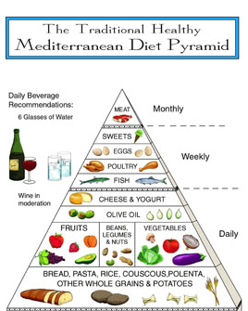
[Diet]
Difficult to study and to control other co-variables (lifestyle, demographics)
Information limited and conflicting
Few studies on the Mediterranean diet suggest associated reduced risk of dementia
Notes:
Information on the effects of various aspects of diet (including various nutrients and vitamins, foods, or food groups) on reducing risk is limited and conflicting. Given
that many elements of diet are interrelated and interactive, the idea of a whole dietary pattern approach has gained some ground. However, interpretation is challenging as dietary pattern often varies with other lifestyle factors and with demographic variables that may also have an impact on risk. A few cohort studies on the Mediterranean diet (relatively little red meat with an emphasis on whole grains, fruits and vegetables, fish, nuts, and olive oil) or a combined Mediterranean-DASH (Dietary Approaches to Stop Hypertension) diet suggest an association between these diets and reduced risk

Slide 29

[Cognitive training and social engagement ]
Small studies
Inconclusive data
Some studies report improve cognitive function in seniors
Other studies show potentially protective
Notes:
Cognitive training: A Cochrane review found three dozen randomized controlled trials of mental engagement/cognitive training interventions showing improvements in immediate and delayed recall among those in the treatment group compared with the control group [88]. Systematic reviews of observational studies and randomized controlled trials reached similar conclusions [89,90]. However, based on these analyses, it is unclear whether the improvement is attributed specifically to the cognitive intervention. Despite the large number of trials, most were fairly small, and the data overall were inconclusive. And, as with physical activity, the “recipe” for any successful engagement remains unknown.
Social engagement: There are very few systematic reviews of the evidence on social engagement—such as doing volunteer work, joining a club, or going to church—as a potential protective factor against cognitive decline or dementia [91]. Some individual studies have shown that social activities, larger social networks, and a history of social contact are associated with better cognitive function and reduced risk for cognitive decline [92–101]. However, an independent coordinated analysis of four longitudinal studies found no effect on cognitive functioning [102]. Looking at the totality of the evidence, most studies in this area are small, are combined with cognitive training and/or physical activities (making it difficult to disaggregate the potential benefits solely of social engagement), and/or are too dissimilar in types of social engagement to draw any conclusions.

Slide 30

[Alcohol use]
Inconclusive and mixed results
Some studies suggest small/moderate alcohol consumption may decrease risk of cognitive decline and dementia
Weak evidence
Not recommended to start drinking (harm may be greater)
Notes:
Alcohol: Meta-analyses of prospective and case control studies of older adults suggest small or moderate alcohol consumption by older individuals may decrease the risk of cognitive decline and dementia [82–84]. The evidence is not strong enough, however, to suggest those who do not drink should start drinking, especially when weighed against the potential negative effects of excessive alcohol consumption, such as an increased risk of falls among older adults

Slide 31
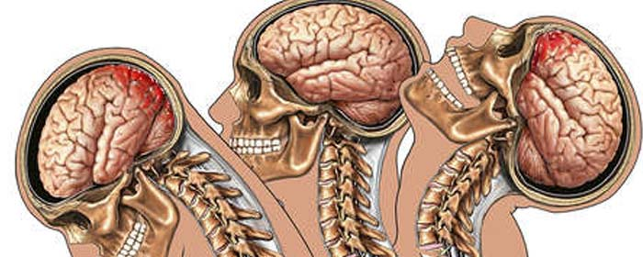
[Traumatic brain injury ]
Solid evidence that moderate/severe TBI increases risk of dementia
Repeated head injury likely at higher risk
Active area of research on mechanisms
Notes:
TBI: Solid evidence exists that moderate and severe traumatic brain injury (TBI) increases the risk of developing certain forms of dementia [112–117]. And those who experience repeated head injuries (such as boxers, football players, and combat veterans) may be at an even higher risk [118–124]. While it is not known what specific aspect of TBI (force, repetitiveness, etc.) leads to disrupted brain function, these multiple studies taken together strongly link TBI to increased risk of cognitive decline and dementia.

Slide 32

[Depression]
Multiple studies showing history of depression increases risk of dementia
Possibly just an early marker
Effect of treatment and subsequent risk unknown
Pseudo-dementia from depression
Notes:
Meta-analyses of cohort and longitudinal studies, as well
as additional cohort studies, have shown a history of depression
increases the risk for dementia [125–127]. While a
recent cohort study found depressive symptoms are
independently associated with cognitive decline [128], questions
remain regarding whether depression may increase an
individual’s risk or be an early marker of brain changes associated
with dementia. In addition, the effect of treatment for
depression on subsequent cognitive functioning is not well
understood.

Slide 33

[Sleep]
Multiple studies liking sleep disturbances (insomnia, sleep apnea) to increased risk of cognitive decline
Recent study showing treatment of OSA with CPAP reduces risk of cognitive decline
Unknow mechanisms of relationship
Unknown if it may just be a precursor to dementia
Notes:
Several cohort and observational studies link sleep disturbances
(for example, insomnia and sleep apnea) to increased
risk for cognitive decline [129–137]. A recent study further
suggested that treatment for breathing disorders that occur
during sleep—specifically with continuous positive airway
pressure (CPAP)—may reduce the risk of cognitive decline
[134]. However, how the exact nature or duration of an individual’s
sleep problems are related to increased risk is not
well understood, nor is it clear whether the sleep disturbances
are a cause of or a related precursor to dementia.

Slide 34

[Years of formal education]
People with more years of formal education or greater literacy have lower risk for dementia
Strong and consistent evidence
Cognitive reserve
Notes:
Among potentially modifiable risk factors, the most
consistent evidence surrounds years of formal education
(years of schooling in a classroom-based setting taught by
professionally trained teachers). People with more years of
formal education (measured by grade level attained and/or
college attendance) or greater literacy have a lower risk for
dementia than those with fewer years of formal education

Slide 35
Notes:
All of the following risk factors have strong evidence for developing cognitive decline except:
Mid-life obesity
Mid-life hypertension
Smoking
Social engagement
Traumatic brain injury

Slide 36
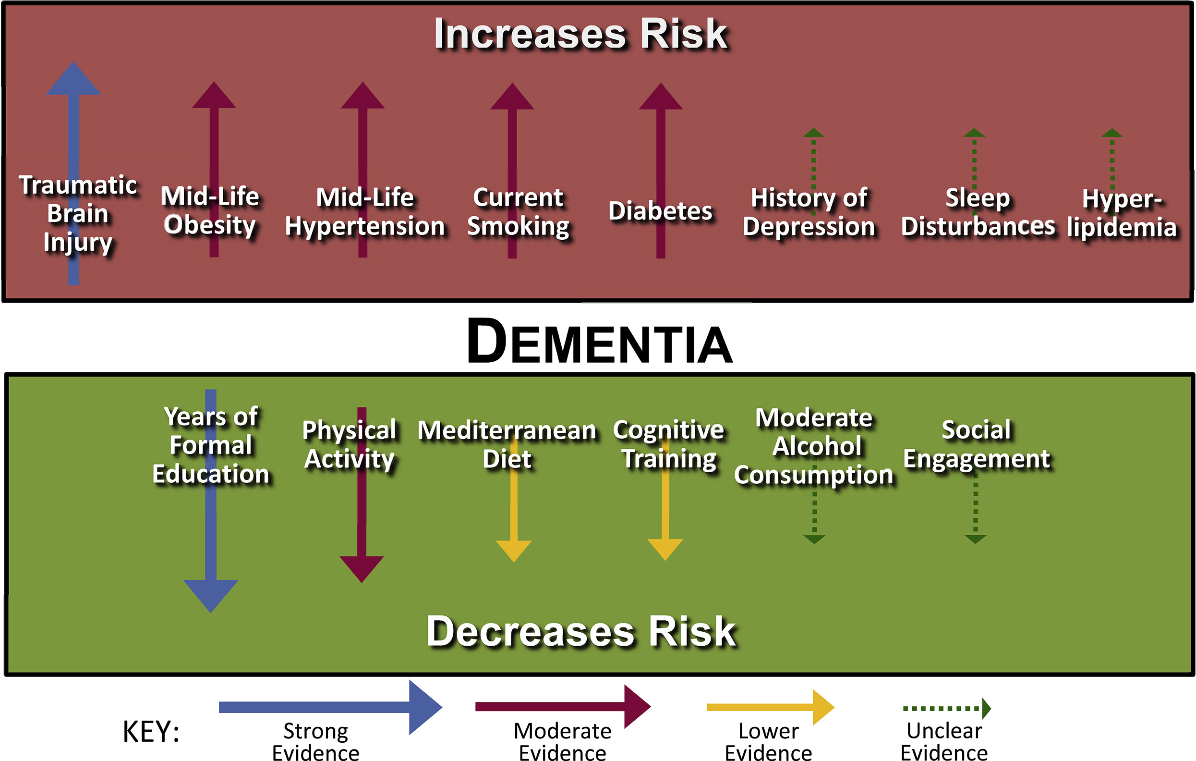

Slide 37
[Conclusions]
No disease-modifying treatments or cures for dementia
Reduction of risk factors is only option
STRONG EVIDENCE that:
(1) regular exercise and
(2) reduction of vascular risk factors (DM, obesity, smoking, HTN) reduce risk of cognitive decline and dementia
PROBABLY
healthy diet and
lifelong learning/cognitive training reduce risk of cognitive decline
Notes:
Exercise regularly and maintain healthy weight
Treat high blood pressure, diabetes and high cholesterol
Eat a healthy diet
Regular check-ups
Do not smoke or drink excessive alcohol

Slide 38
[How can I prevent developing dementia?]
Exercise regularly and maintain healthy weight
Treat high blood pressure, diabetes and high cholesterol
Eat a healthy diet
Regular medical check-ups
Do not smoke or drink excessive alcohol
Remain socially engage and cognitively active
Avoid head trauma
Notes:
• Eat a healthy diet low in saturated fat, trans fat, cholesterol and salt.
• Keep your weight under control.
• Be physically active at least 30 minutes on most or all days of the week.
Don’t smoke, and avoid other people’s tobacco smoke.
• Lower your blood pressure if you need to. Treat high blood pressure if you have it.
• Control your blood sugar if you have diabetes.
• Get regular medical check-ups.
• Follow your doctor’s orders for taking medicine.

Slide 39
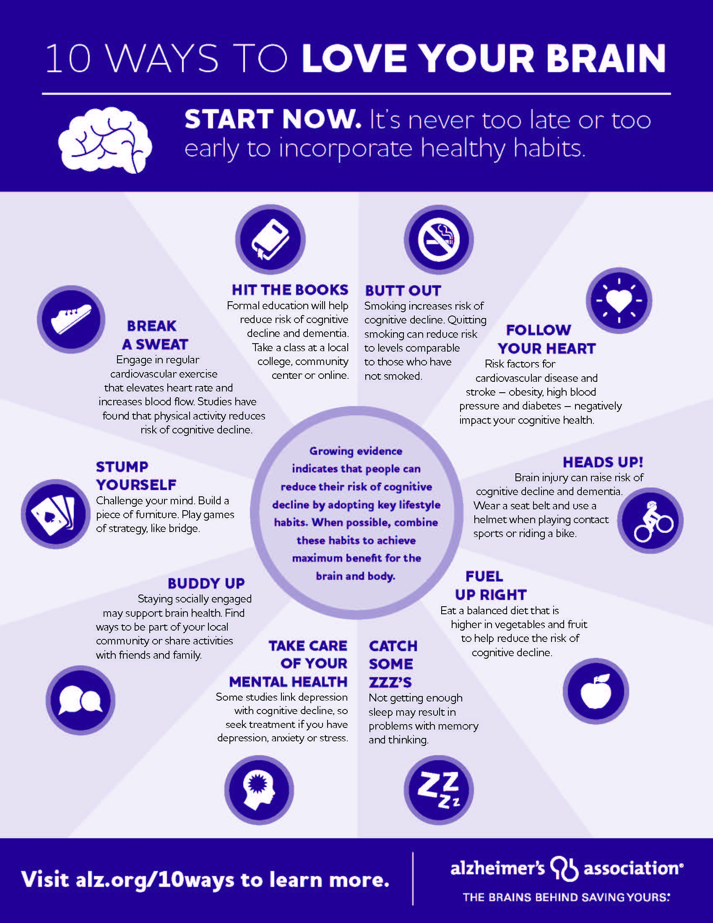
Notes:
Reducing Your Heart Disease and Stroke Risk
You can reduce your risk of heart disease and stroke. Here are some key steps you can take:
• Eat a healthy diet low in saturated fat, trans fat, cholesterol and salt.
• Keep your weight under control.
• Be physically active at least 30 minutes on most or all days of the week.
Don’t smoke, and avoid other people’s tobacco smoke.
• Lower your blood pressure if you need to. Treat high blood pressure if you have it.
• Control your blood sugar if you have diabetes.
• Get regular medical check-ups.
• Follow your doctor’s orders for taking medicine.

Slide 40
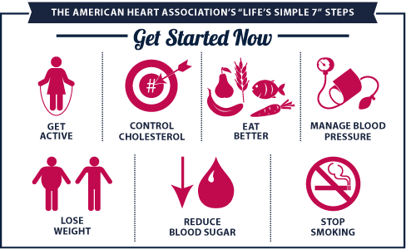
[Life’s Simple 7 ]
Notes:
Reducing Your Heart Disease and Stroke Risk
You can reduce your risk of heart disease and stroke. Here are some key steps you can take:
• Eat a healthy diet low in saturated fat, trans fat, cholesterol and salt.
• Keep your weight under control.
• Be physically active at least 30 minutes on most or all days of the week.
Don’t smoke, and avoid other people’s tobacco smoke.
• Lower your blood pressure if you need to. Treat high blood pressure if you have it.
• Control your blood sugar if you have diabetes.
• Get regular medical check-ups.
• Follow your doctor’s orders for taking medicine.

Slide 41
QUESTIONS?

