Slide 1
How to edit Theme and Slides of this Presentation
Create or customize a slide master in MS Powerpoint
Create and save a PowerPoint template in MS Powerpoint
Google Slides:
Change the theme, background, or layout in Google Slides
This is an easy to follow template for plugging in your business research findings and turning them into a
Killer Sales Presentation.
The main difference is the personalization to them in the titles, screenshots, and subtle details that paint the pictures for the client. Instead of benefits and features = it describes and includes the best features for their business in the deck with solutions for their needs.
Take screen shots of the clients online profiles with the free Jing screencapture tool @ https://www.techsmith.com/jing-tool.html

Slide 2

Insert Client Logo Here
Insert Background Image, if desired, or put on a background color (see previous slide for how to)
Leveraging Mobile Solutions to grow your Business
Notes:
This is your title page and the 1st slide in your presentation. With this page, you will want to put on either a solid background or a background image that does not interfere with the text and logo.

Slide 3
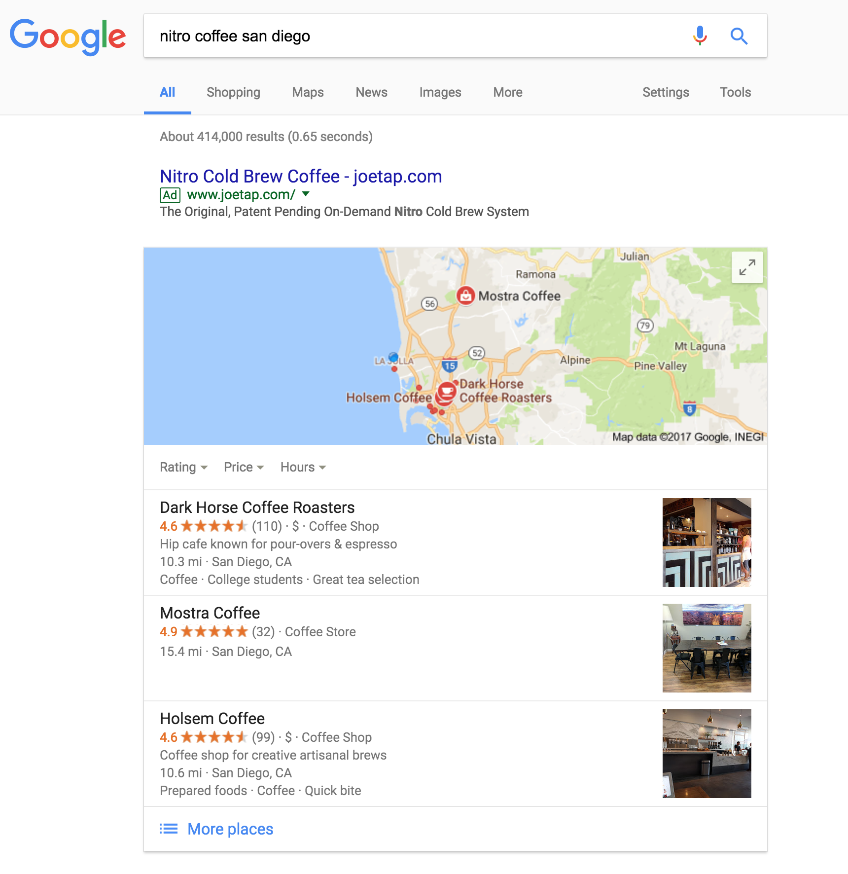
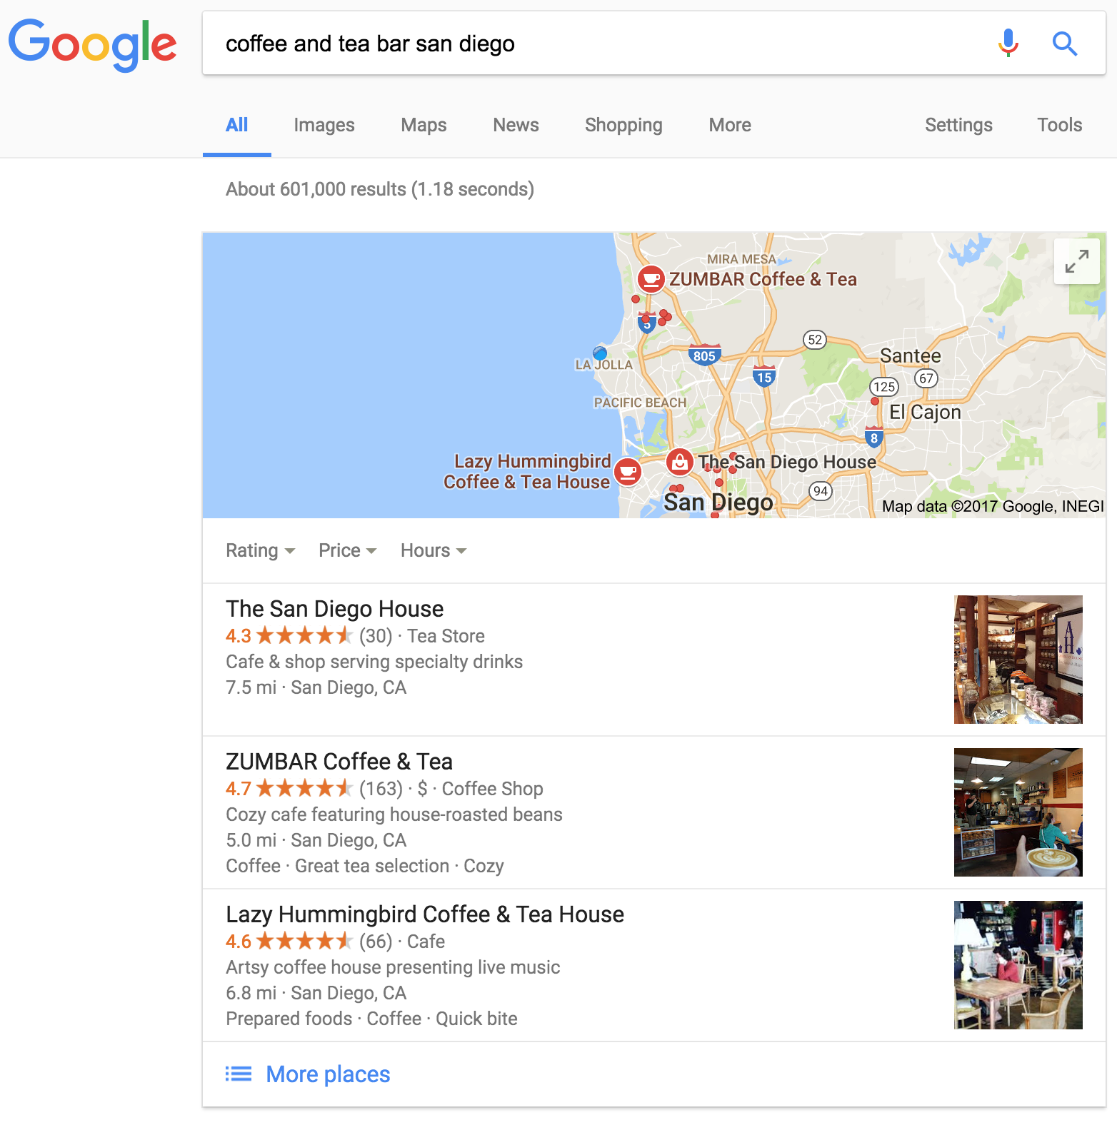
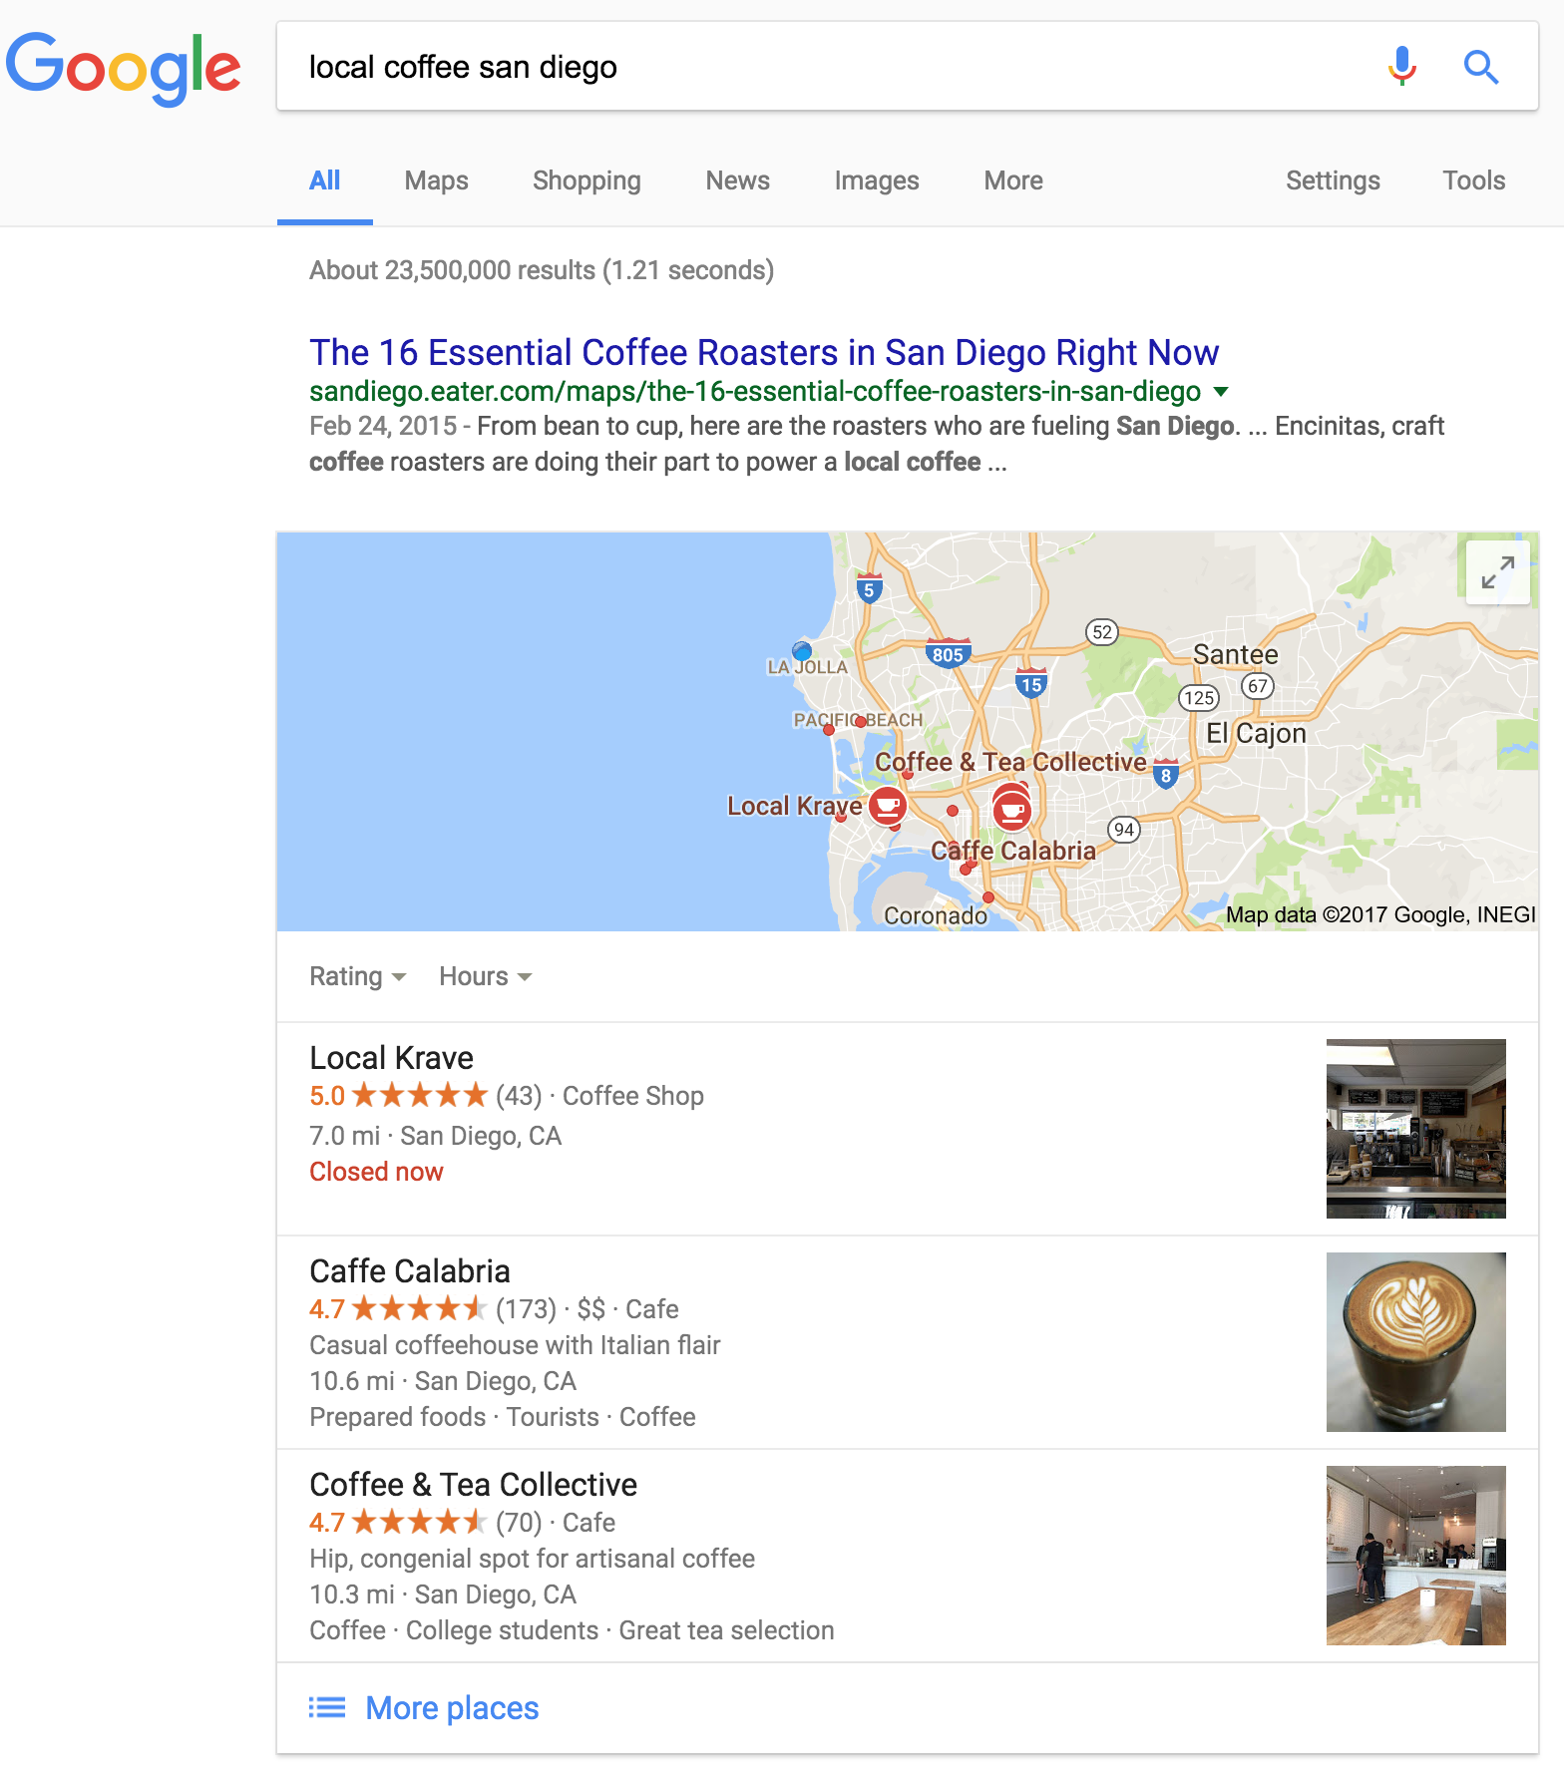
Where is Superfood Coffee Co?
Are you found over your competitors?
Nitro Coffee in San Diego
Tea in San Diego
Local Coffee San Diego
(Insert Screenshots of competition)
Notes:
Highlight competitors if they are not ranking. EVEN CIRCLE THEM - IN this example the customer did not come up and the competition did.
If they are make sure you ask them how they got there and if they ask for review proactively
REMEMBER- You will want to tackle those that do rank differently than ones that do rank.

Slide 4
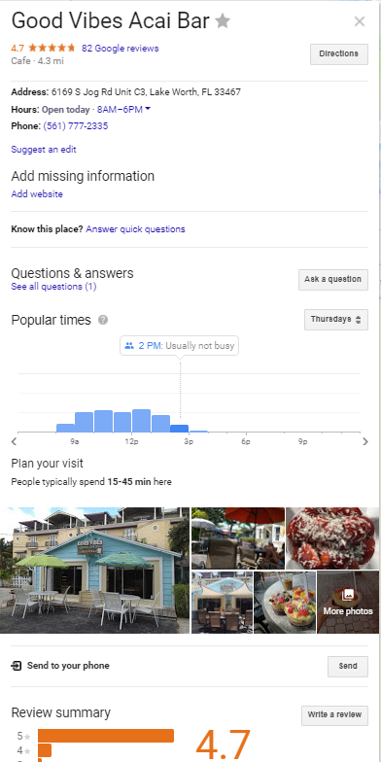
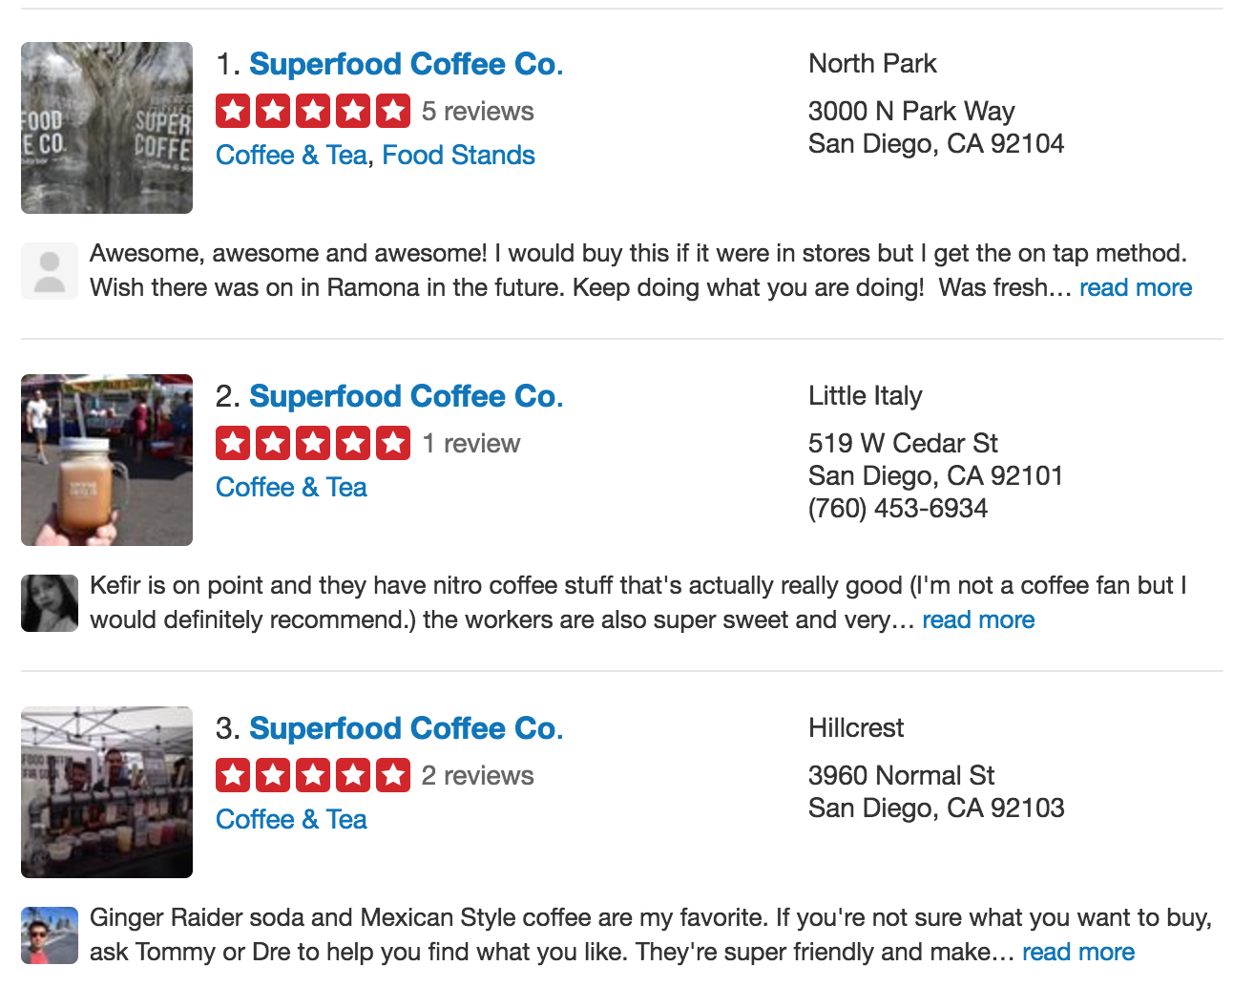
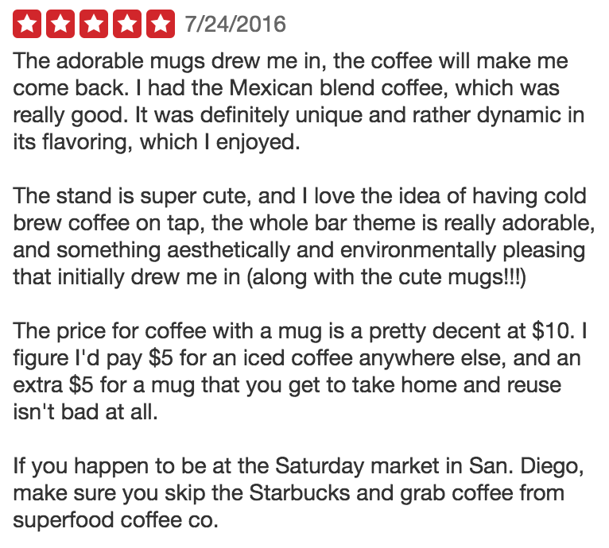
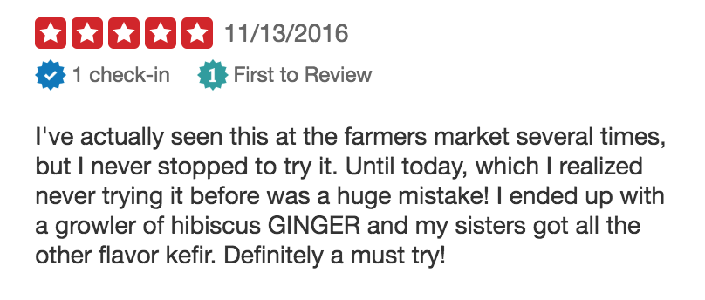
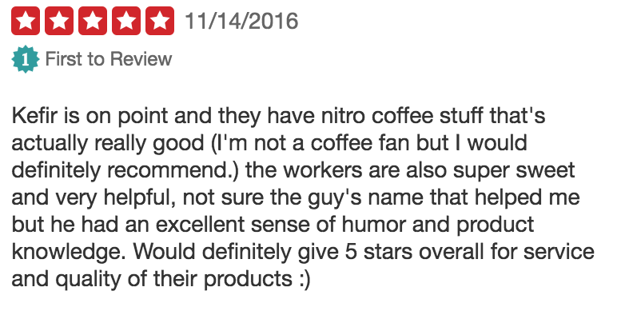
What People say about INSERT CLIENT NAME.
(Insert Screenshots of Google & Yelp listing/reviews)
Notes:
These were great reviews but I shared how a person wrote that they have walked by and did not know who they were several visits.
This is an easy win especially if you look for leads via yelp.
Remember most SMB’s do not like YELP so you share how you can help take reviews back and push them to facebook or google by linking the website link feature or asking for fans to leave reviews in Yelp.
Depending on positive or negative reviews you share the importance to take back ownership of your brand.
Do they have enough reviews? If they do not have more than 5 reviews you want to tell them to get more where the customers are reviewing their business.

Slide 5
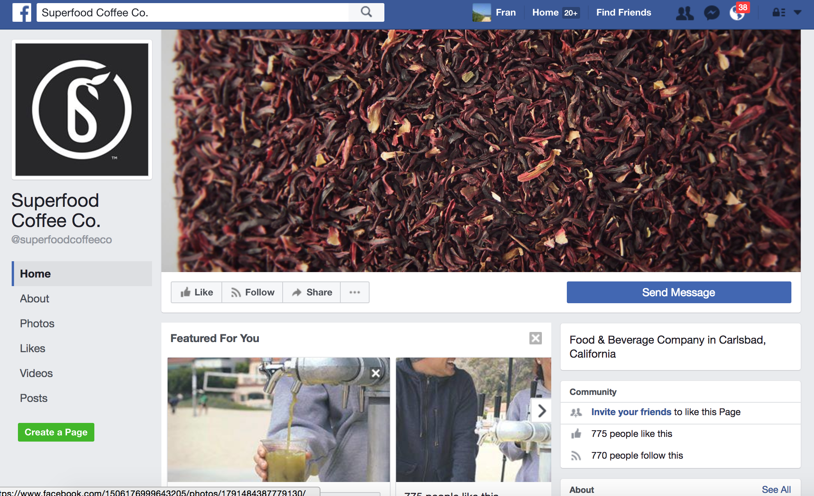
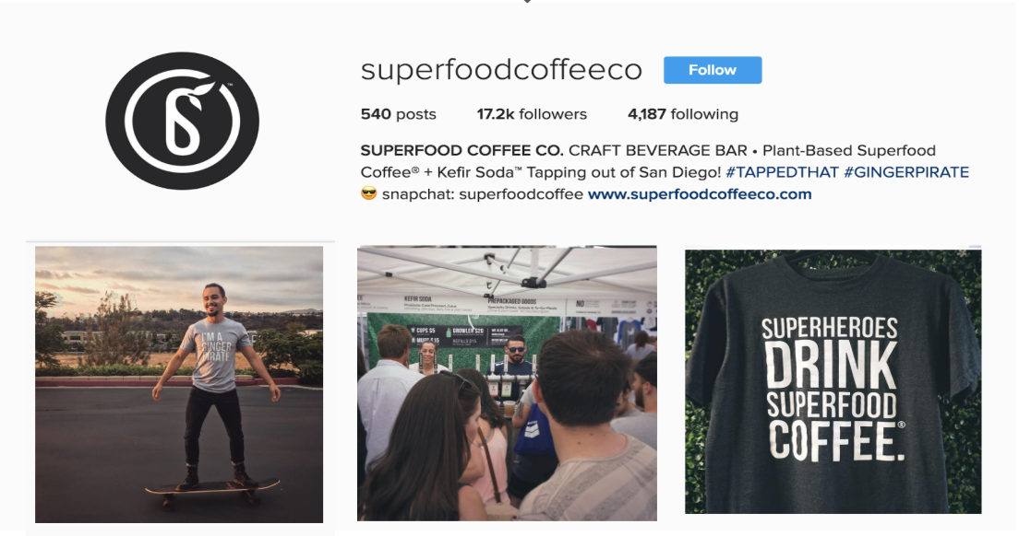
Who is INSERT CLIENT NAME?
(Insert Screenshots of social media pages)
Notes:
Credibility is important - WHO are they? What are people saying? Are they leveraging followers?
HERE, I Explained that it was great that she had 17.2 followers on her instagram
BUT the option to leave reviews in Facebook- 0 reviews on her facebook page .. In fact THe Reviews are not even turned on.
Also identify branding and key findings to weave in - see example like Ginger PIrate and Superheroes branding.

Slide 6
Firing on all cylinders? | Today’s score | Score you want | Observations/Quick wins!
Local Search - Are you found? |  | 10 | Are the found on Google? If so, how easily? Do they have a Google My Business Page? Is it fully optimized? Are they getting reviews on Google? Are there more than 5 and stars are on?
Social media |  | 10 | How Many Total Follows do they have (break it down) Instagram: ## Followers, Facebook: ## Followers, Twitter: ## Followers, etc. Is there a large following for any of the above? Do they have active engagement? What is their engagement percentage? Do they have better engagement / more followers than their competition? Fully explore this area and IDENTIFY areas of improvement, if any.
Reviews |  | 10 | Kudos on the 10 Positive Yelp Reviews Optimize your GMB page to leverage organic SEO rank benefits Add Facebook reviews to FB page - http://randomtrendz.com/how-to-enable-reviews-on-facebook-business-page/ Create a Review Campaign with your happy Clients Claim and manage your Yelp pages- 3 pages live w/less that 10 reviews combined - NEED MORE REVIEWS! Coach your staff to ask Happy People only and leverage the APP to ask in the future!
Loyal customers |  | 10 | Do they have any Active Loyalty Programs? If so, does it look effective? Is it costing them a lot of money? Can you improve it / work with it?
Engagement/Communication |  | 10 | Do they have good rapport with their client overall? Do they have email marketing? Do they have good engagement when they reach out to their clients?
Mobile strategy |  | 10 | Do they have a mobile solution already? How is a mobile strategy going to go over with their customers? Is is a good move forward? Do they already have mobile facing strategies (social media marketing, etc.) that will be enhanced by this?
Overall Customer Experience |  | 10 | Give them an idea of how the general experience is right now with their existing systems. Be honest but drive them towards how much better it can be once they factor in a FULL mobile strategy.
Notes:
This sounds like a ton of work but the top is just the APP and Access to CMS.
Below is a video and templates based on findings in her current marketing that can be repurposed to the mobile strategy for “how to download” etc.
Revise these based on Hot buttons.
If the audit was more operational, the bullets would be revised to capture automation of process.

Slide 7
Beat your competition! Leverage your new mobile solutions
Lets Take A Look At Your Demo!

Slide 8
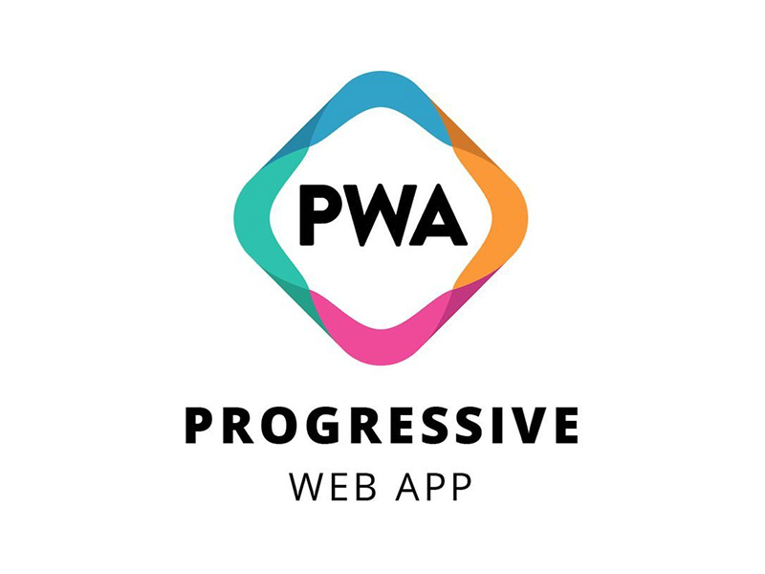
Our URL Technology – No More App Stores
Mobile Apps Delivered Through the Browser
Easy to Find - Easily identified by search engines, allowing the app to come up in the search results
No Downloads - Launched straight from a URL without needing to download it from an app store.
Can also be added to device home screen like a native app.
Always Up-To-Date - No manual updates needed, the app is always displayed in its most recent version. The app runs in the background 24/7.
Notes:
Don’t forget about Skipper! She shared at discovery that she needed a way to alert an email people when she had remaining inventory and they run a last hour 50% off growler hour at every Farmers Markets.
Pulling in Skipper to share how she will work smarter not harder to communicate with customers and empty those Kegs by geo fencing and sending out a push note!

Slide 9
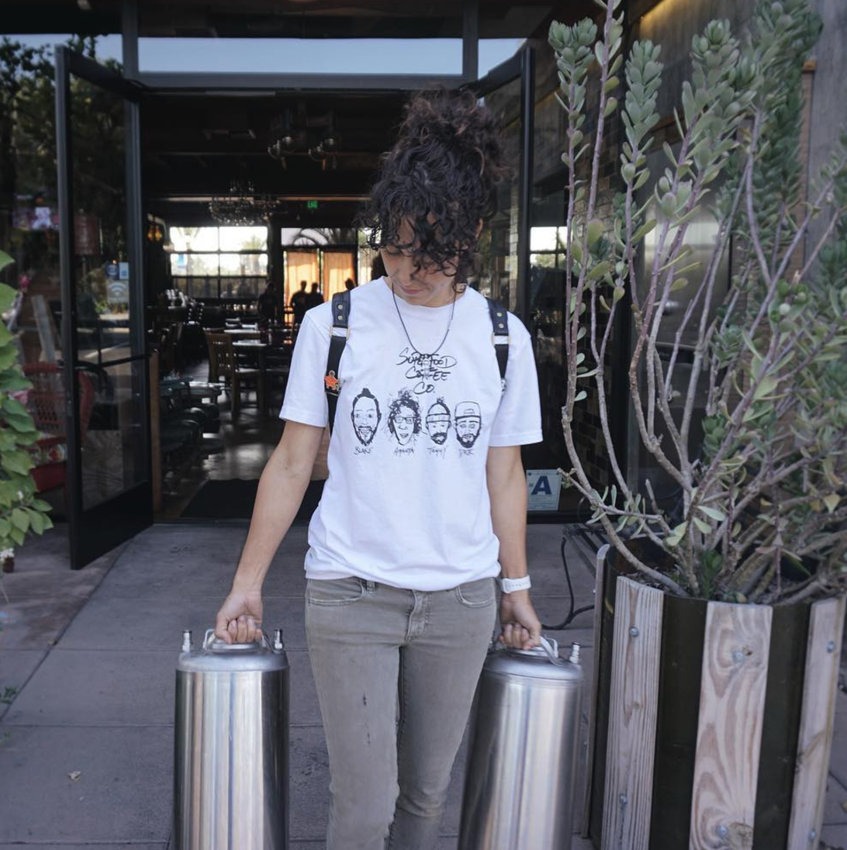
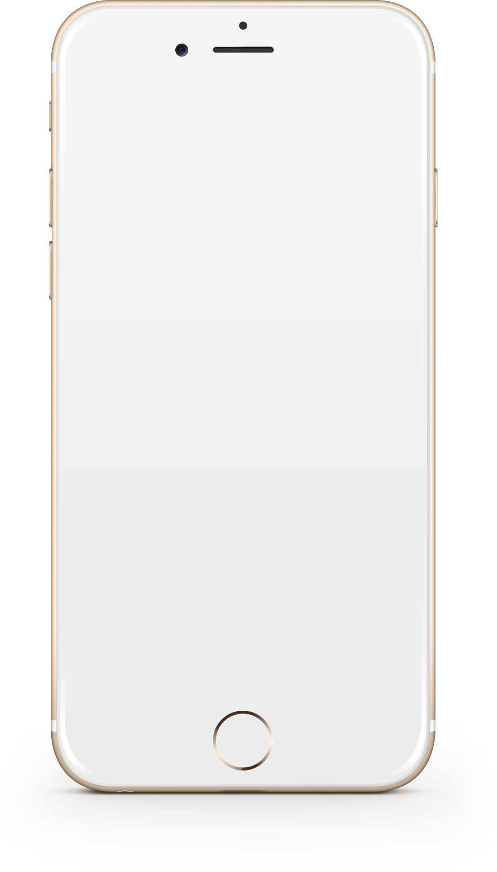
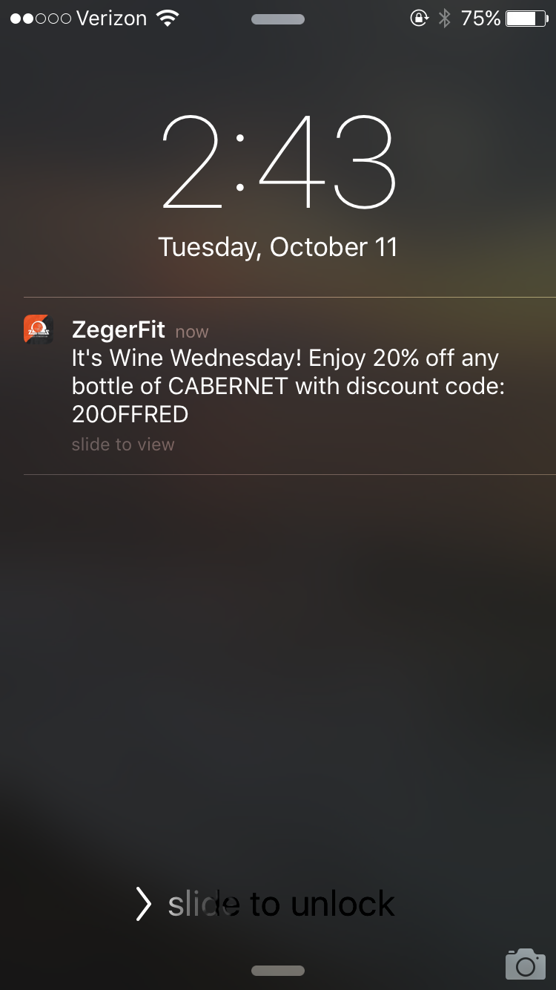
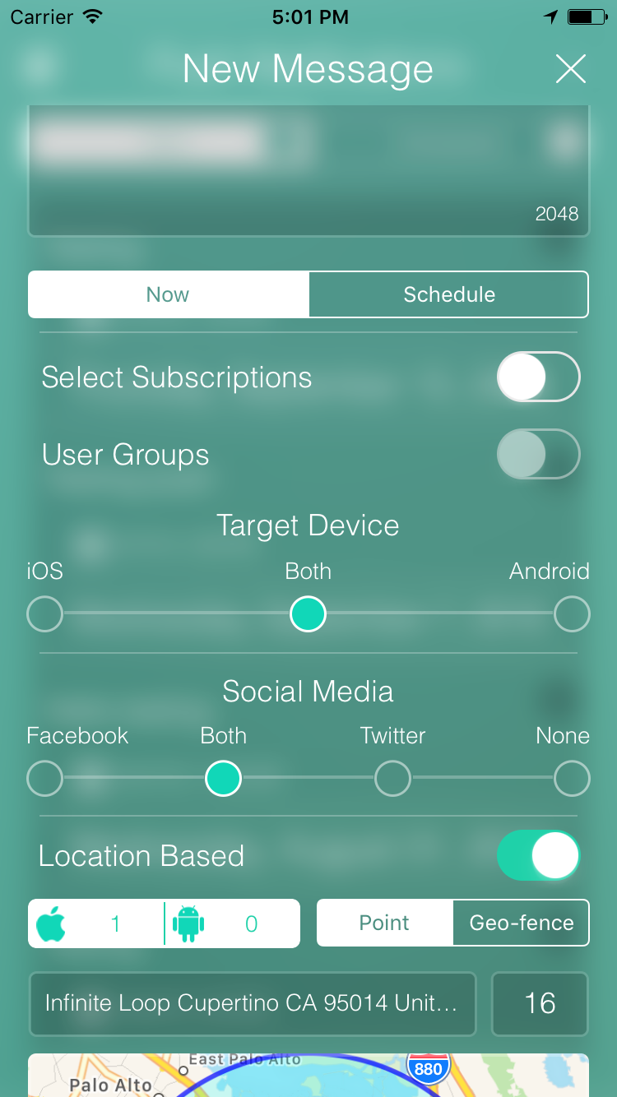
Empty those Kegs - Real Time Control in your Pocket!
(Insert Picture that matches client business)
The “Messages” feature serves as your users’ “library” for received push notifications. It allows users to refer back to previous push notifications, view plain text and linked content.
Notes:
Don’t forget about Skipper! She shared at discovery that she needed a way to alert an email people when she had remaining inventory and they run a last hour 50% off growler hour at every Farmers Markets.
Pulling in Skipper to share how she will work smarter not harder to communicate with customers and empty those Kegs by geo fencing and sending out a push note!

Slide 10
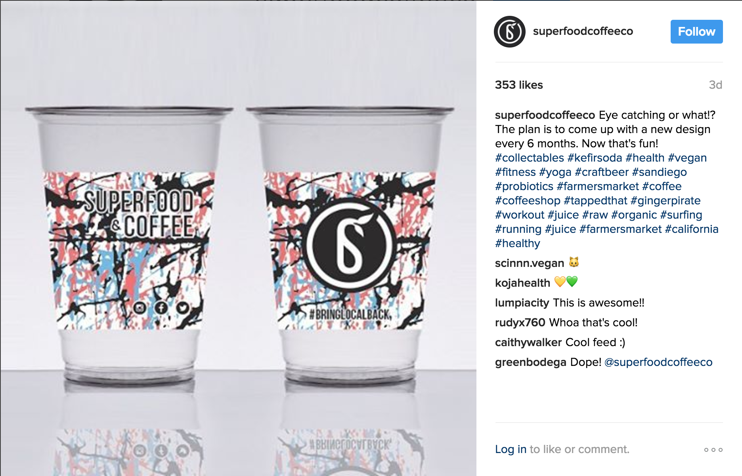
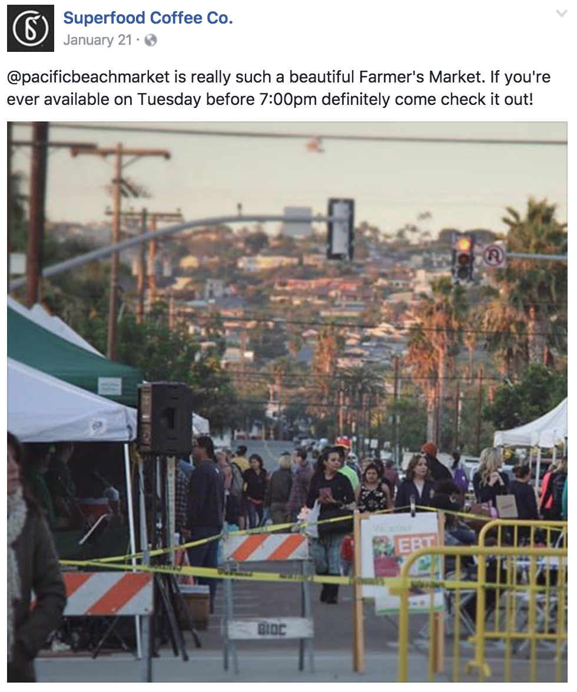
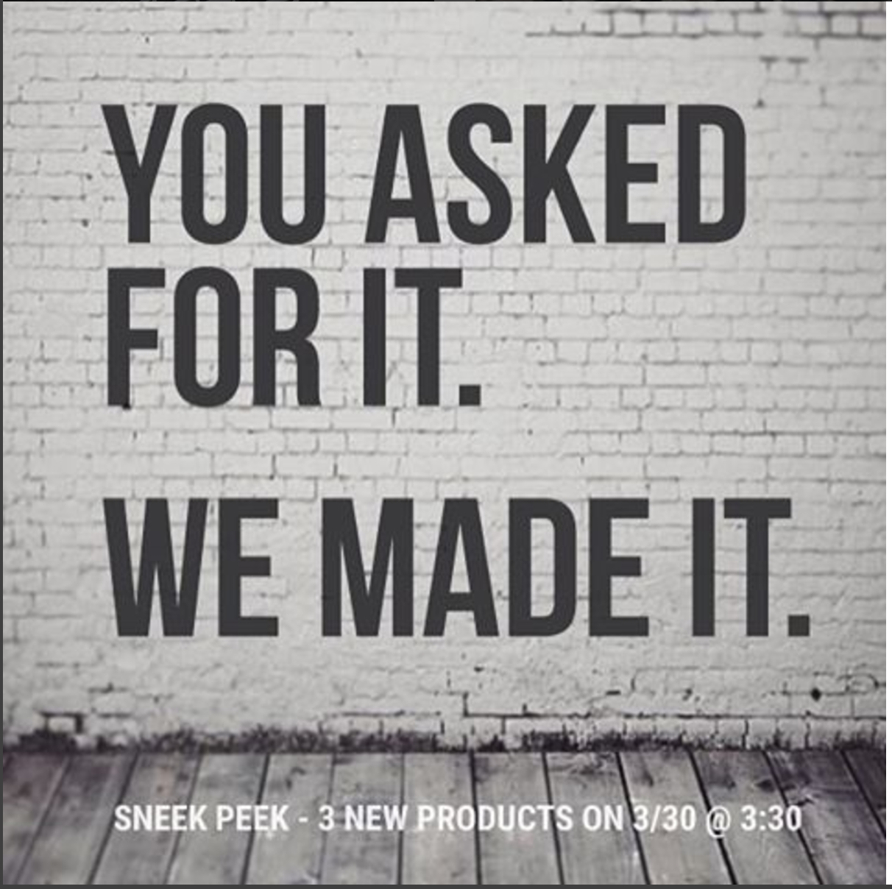
Ideas for Push Notes to enhance your Superfood campaigns
(Insert screenshot of social media posts)
Turn your social media posts into push notifications
Notes:
Making it easy for them to see the current campaigns mobilized- is great! Clip announcements or any push note ideas that might be great on this slide.

Slide 11
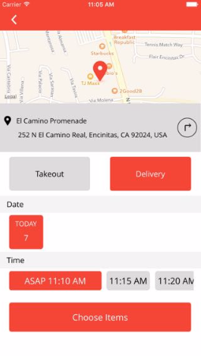
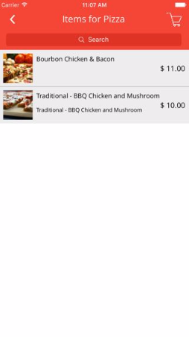
Has Coffee Superheroes tried mobile ordering yet?
Simple yet very effective way for your restaurant to take orders through your mobile app. You have full control with customizable menu and pricing, delivery, take-out options and in-app payment.
Notes:
I used my findings in the previous slides to personalize slide with Coffee Superheroes

Slide 12
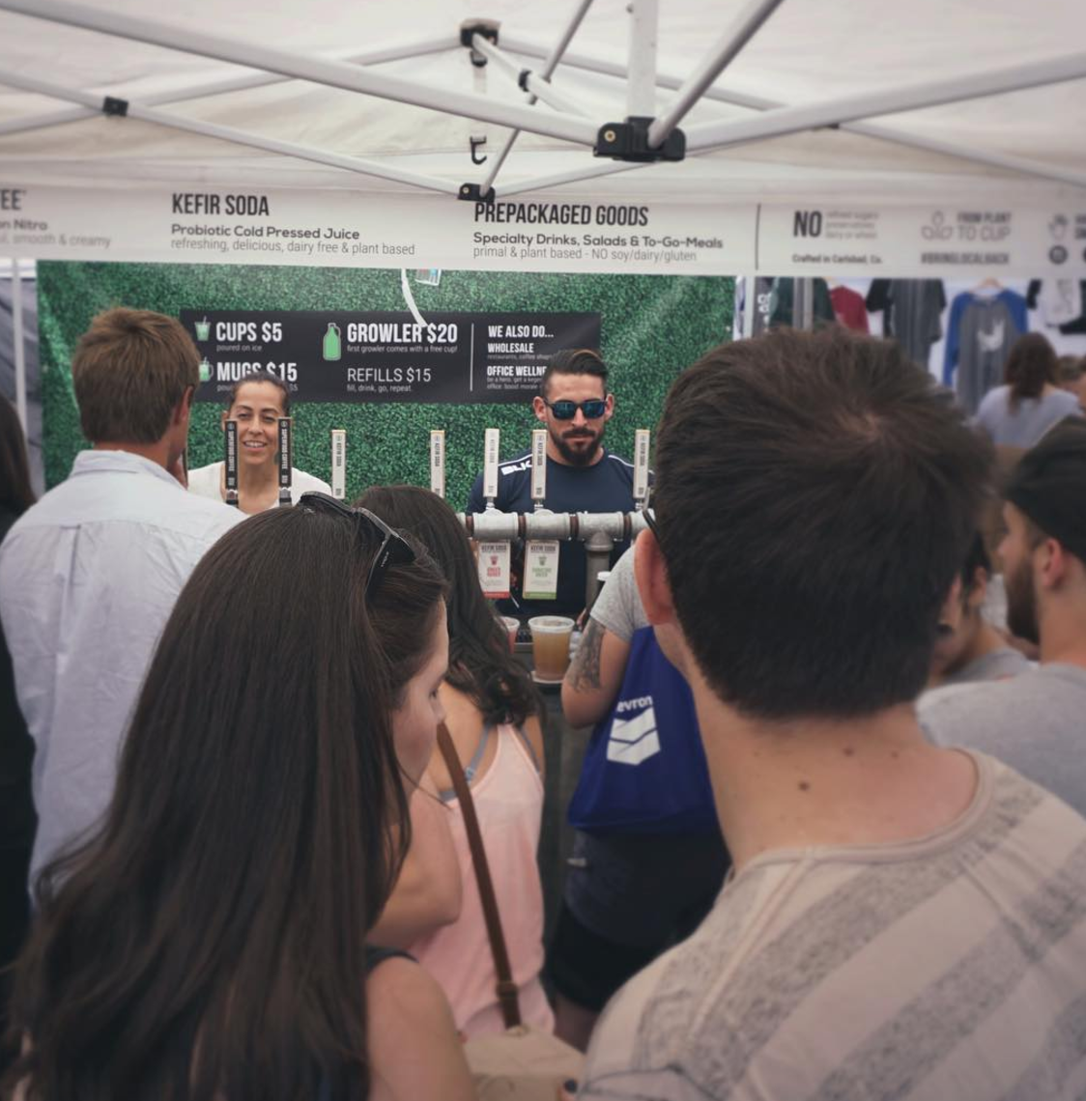
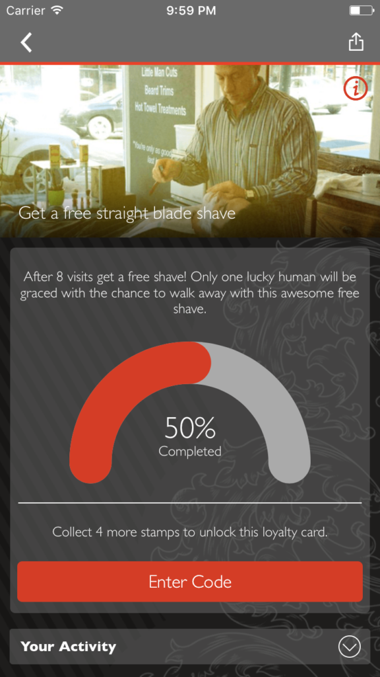
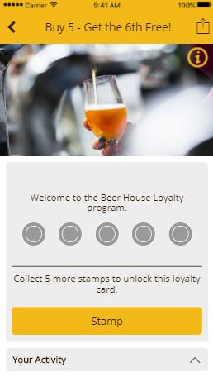
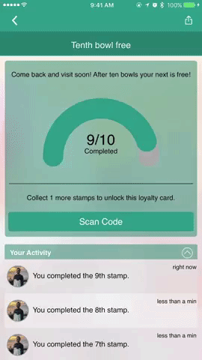
Advanced Loyalty programs for your Coffee Superheroes
The “Loyalty” feature allows users to have an in-app version of a traditional stamp card. This allows easy customization and increased user engagement.
Notes:
I used my findings in the previous slides to personalize slide with Coffee Superheroes

Slide 13
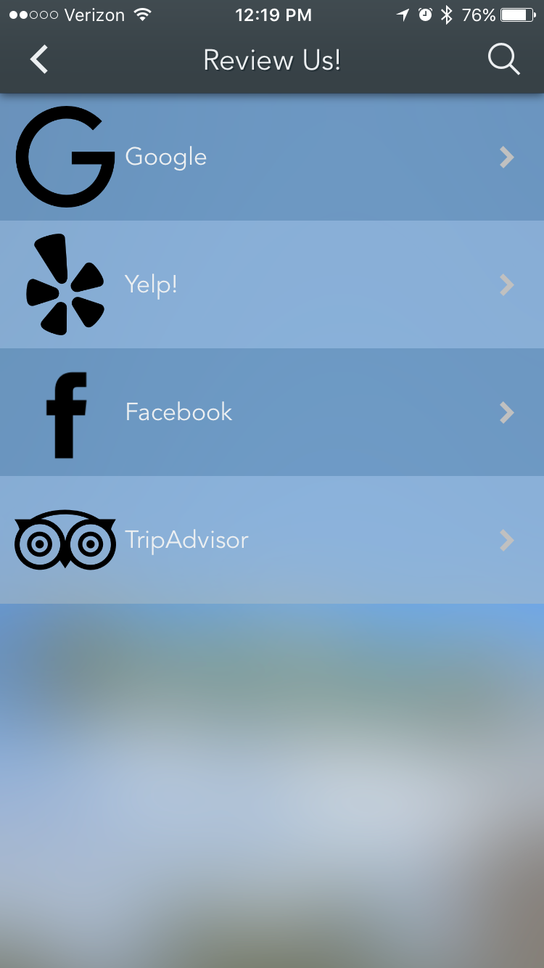
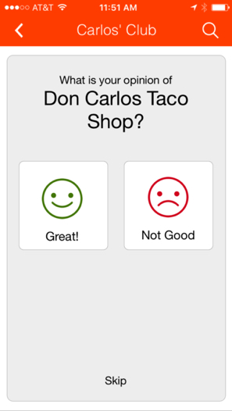
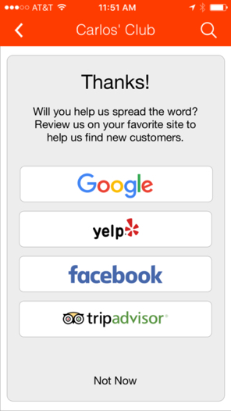
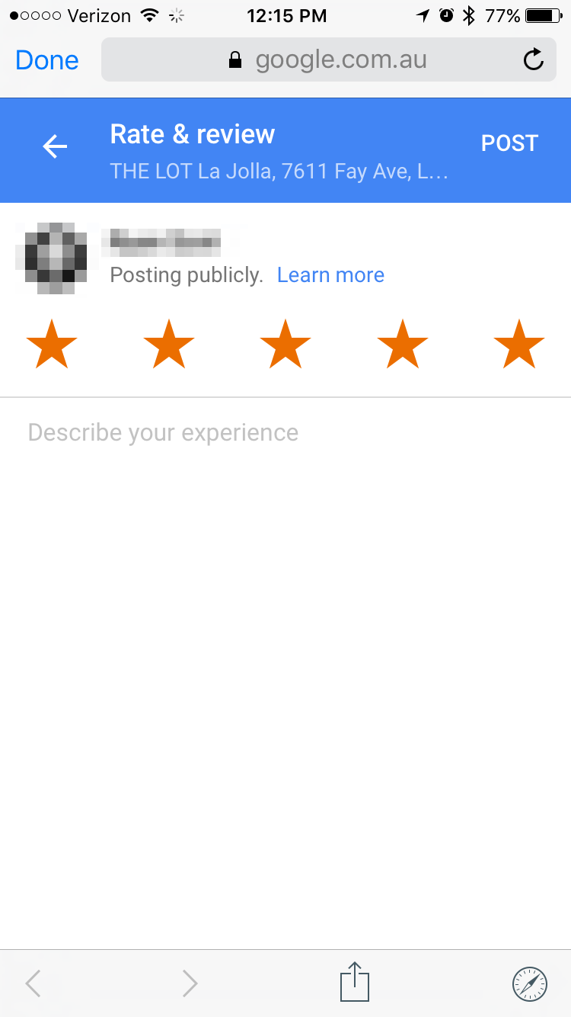
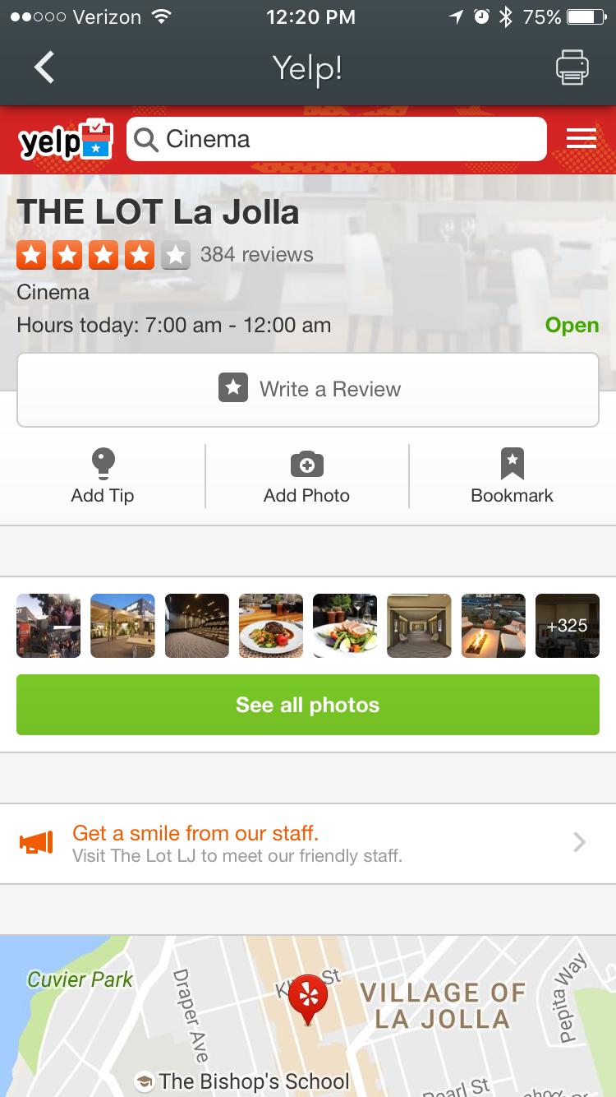
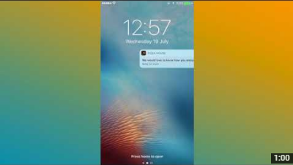
Capture more positive reviews from your Ginger Pirates!
Let client watch this 1 minute video https://youtu.be/tyAEw10E58s
Notes:
Added the ginger PIrates I saw in the instagram and put it in this slide to personalize her clients

Slide 14
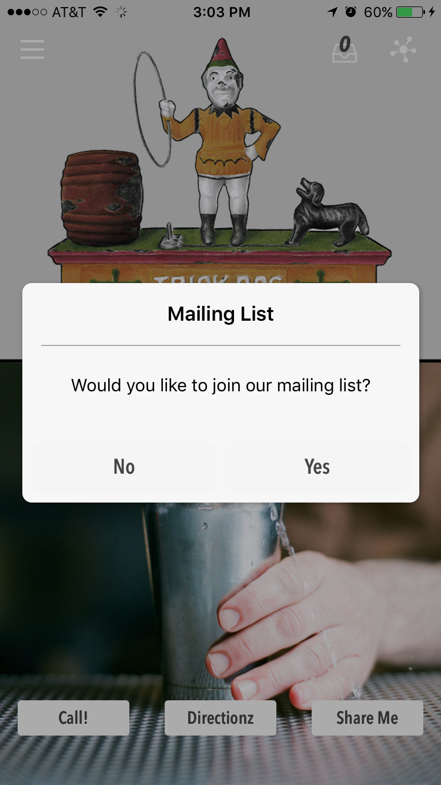
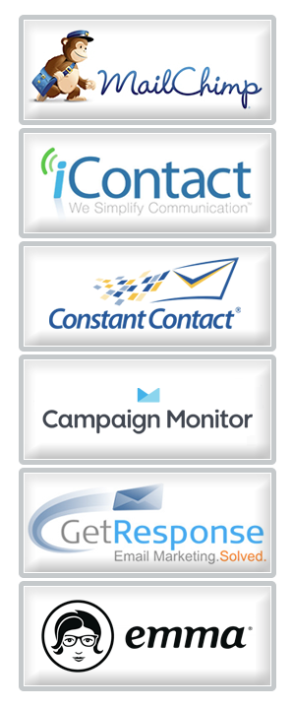
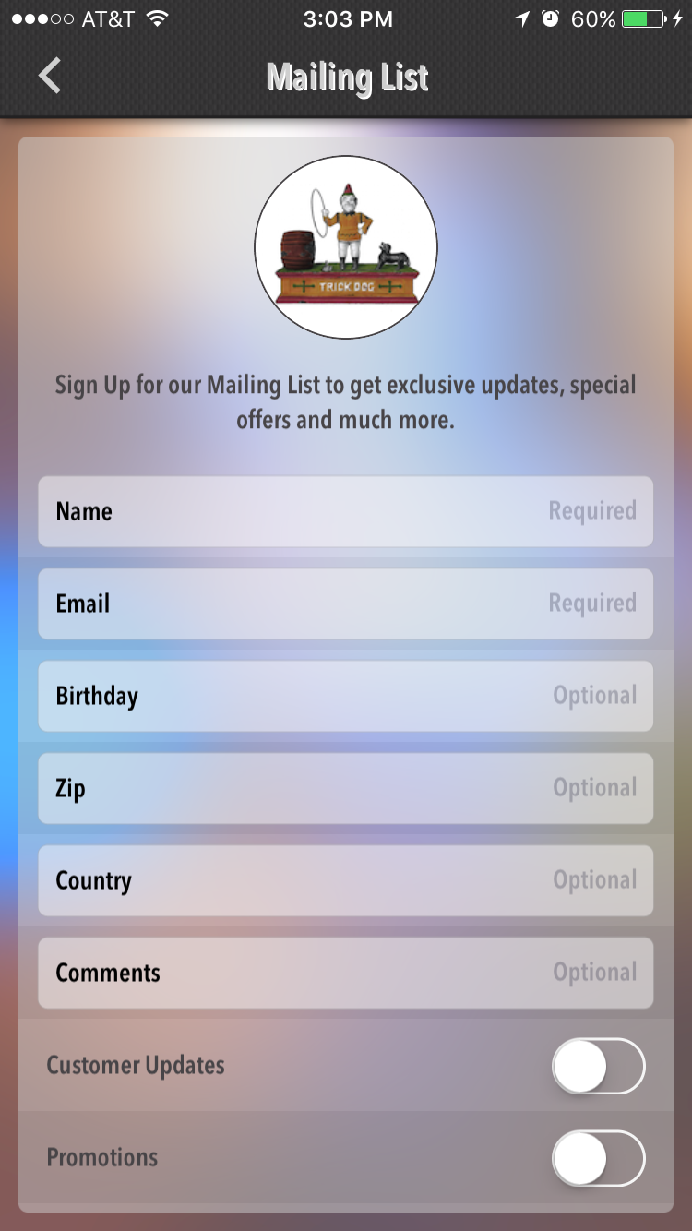
Get your RAVING fans out of the glass bowl!
INSERT LOYALTY/MEMBERSHIP NAME (IF ANY)!
The “Mailing List” feature is a great way to gather contact information from app users so that updates and special offers can be communicated easily and efficiently.

Slide 15
With 15+ other features available to help reach customers and grow your business!

Slide 16
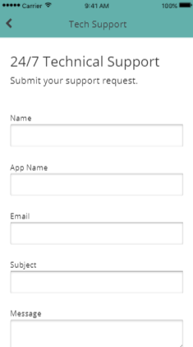
24/7 Technical Support
We Build the Mobile App and then you take over… anytime you need us, we will be right there with you…
We don’t have a “Do It Yourself” Platform… Instead we have a “Do It With Me” Platform!
If you know Microsoft Word you can do 75% of what’s in the back office
If you know Photo Shop or Illustrator you can do the other 25% in the back office
E-mail Support: 24/7 support@urlappdesign.com
Phone Support: by appointment only
Video Support: back office contains short how-to videos on each feature
Notes:
Added the ginger PIrates I saw in the instagram and put it in this slide to personalize her clients

Slide 17



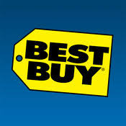

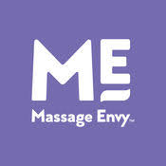

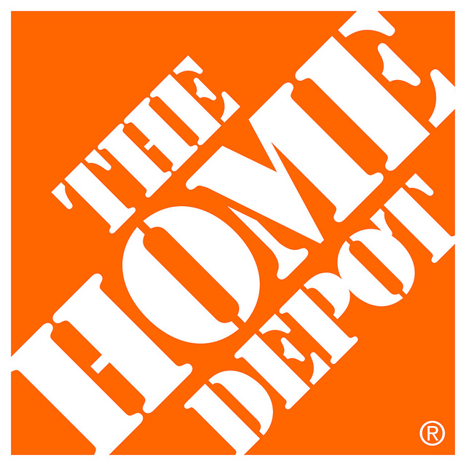

Mobile App Pricing:
Minimum $15k to $250k up into the Millions
Project Build Time:
3-6-12 Months
This is why small businesses can’t break into the app industry. App’s Cost too much.
Notes:
This sounds like a ton of work but the top is just the APP and Access to CMS.
Below is a video and templates based on findings in her current marketing that can be repurposed to the mobile strategy for “how to download” etc.
Revise these based on Hot buttons.
If the audit was more operational, the bullets would be revised to capture automation of process.

Slide 18
Investment

Slide 19
Investment
Superfood Mobile Solutions Include:
Mobile App design and publishing
QuickStart Mobile Strategy Blueprinting Session
Optimized Loyalty program
Positive Review Campaign
Improved Client Engagement - Push notes and email capture
24 X 7 Support & Access to CMS
Additional Services:
Staff Training Poster + Promotional Materials
Dedicated Partner Advisor to guide your Mobile success
INSERT CLIENT NAME Mobile APP Marketing Strategy
Investment:
Design and Set-up Fee: $1997.00 (50% set up 50% at launch)
Monthly Maintenance: $100.00/monthly
Notes:
This sounds like a ton of work but the top is just the APP and Access to CMS.
Below is a video and templates based on findings in her current marketing that can be repurposed to the mobile strategy for “how to download” etc.
Revise these based on Hot buttons.
If the audit was more operational, the bullets would be revised to capture automation of process.

Slide 20
If they have a problem with the price then ask which price. The monthly maintenance fee or the design fee?
Now you know which payment needs to be negotiated with our Limited Promotion or our payment plan.
Always negotiate for half upfront and half later. Only use payment plans when necessary.

Slide 21
How To Get Started
50% deposit on the design and set-up fee establishes project start date and the remaining 50% is due upon completion.
The app build process takes 5-15 days.
Determine coupon offers to be included inside of the app’s loyalty program.
Customer will be provided with QR Code/Flyer for easy App Download along with marketing materials in the back office.
Monthly fee is processed via VISA, M/C, AMEX or DISCOVER every month and won’t begin until 1 month after your app is live in the cloud.
Upon completion client gets back office access to make updates
The client will be provided 1 hour of Live training, and recorded tutorials
Notes:
This sounds like a ton of work but the top is just the APP and Access to CMS.
Below is a video and templates based on findings in her current marketing that can be repurposed to the mobile strategy for “how to download” etc.
Revise these based on Hot buttons.
If the audit was more operational, the bullets would be revised to capture automation of process.

Slide 22
Instant Savings
Today is your lucky day…
Take advantage of this special offer in 4 steps:
Golden Ticket: $500.00 OFF
Be an “early adopter” – one of the first 5 businesses in your area & Industry to get a Mobile App
Give 3 app referrals
Give us a video and/or written testimonial.
Sign Up Today
Limited Promotion
Notes:
This sounds like a ton of work but the top is just the APP and Access to CMS.
Below is a video and templates based on findings in her current marketing that can be repurposed to the mobile strategy for “how to download” etc.
Revise these based on Hot buttons.
If the audit was more operational, the bullets would be revised to capture automation of process.

Slide 23
Finance Plan Available
$App Amount divided by 3-6-9-12 months + Monthly Maintanence Fee ($75-100) = Total Monthly Payment.
An app with payment plan is better than no app (This is a last resort and will cause your commissions to be paid out monthly).
(This is for your own knowledge when negotiating a payment plan)

